Slide 1


Presentation to Primary Children’s Hospital
Rebecca L. Utz, PhD

Slide 2

An interdisciplinary group of researchers interested in families and health across the life course.
How can the family be used as a vehicle for promoting health and/or managing to chronic illnesses?
How do these family-based outcomes and strategies vary across developmental life stages (infancy, childhood, adolescence, across adulthood)?

Slide 3
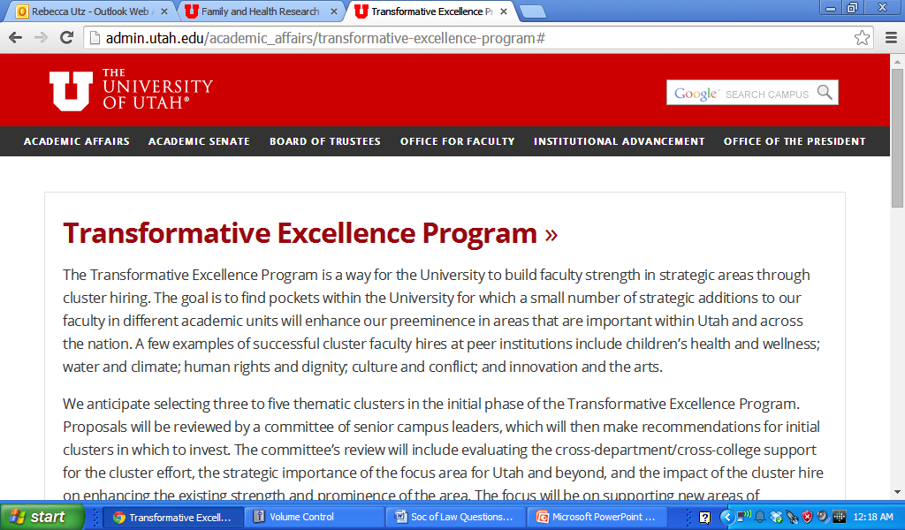
At about the same time
SVP Ruth Watkins issued a call for proposals to a new program……
Led by Cindy Berg, a team of approximately 30 faculty members quickly assembled and quickly created a TEP proposal related to families and health across the lifespan.

Slide 4

The proposal was selected as one of the 4 TEP - Cluster Hiring Initiatives.
• Lifespan Health and Wellness
• Digital Humanities
• Large-Scale Data Analysis/Utah Statistical Center
• Society, Water and Climate

Slide 5
An Emerging Consortium + Funding for Cluster Hire =

Slide 6
Spring 2014
Idea & Funding
Summer 2014
Executive Committee
Fall 2014
Kick-Off Meeting
Symposium & Research Mixer
Winter 2015
Student Interest Groups
Pilot Grant Program
2015-2016
Cluster Hiring
Membership Recruitment
It has not been that long …..
What is next? What else can we accomplish?

Slide 7





Currently over 60 faculty, with another 50 graduate students, representing many different disciplines.

Slide 8
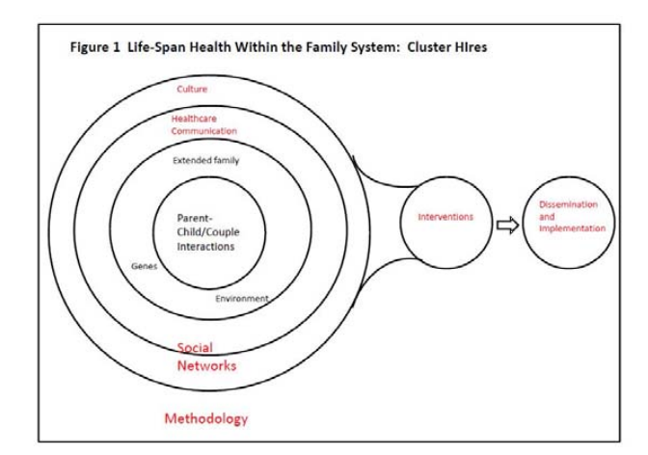
Family
Notes:
Health is determined by a series of complex influences – as represented by the concentric circles around the family.
We have speakers who will discuss specifically the role of genetics (Ken Smith), the role of environment (Ming Wen), and the role of health care (Joe Stanford)

Slide 9
Family
Methods & Data
Notes:
Considering the multiple layers of influence and dynamics – it becomes clear that a unique set of methods and models are needed to account for these complexities. Jon Butner, Psychology

Slide 10
Intervention
Dissemination
Family
Methods & Data
Notes:
And finally, we need to consider how this theoretical model can be extended into real-world application.
Becky Utz (Sociology) will speak about intervention and dissemination efforts associated with families and health.

Slide 11
Comprehensive, Family-Based Model of Health
Intervention
Dissemination
Family
Methods & Data
Notes:
DISCUSSION

Slide 12
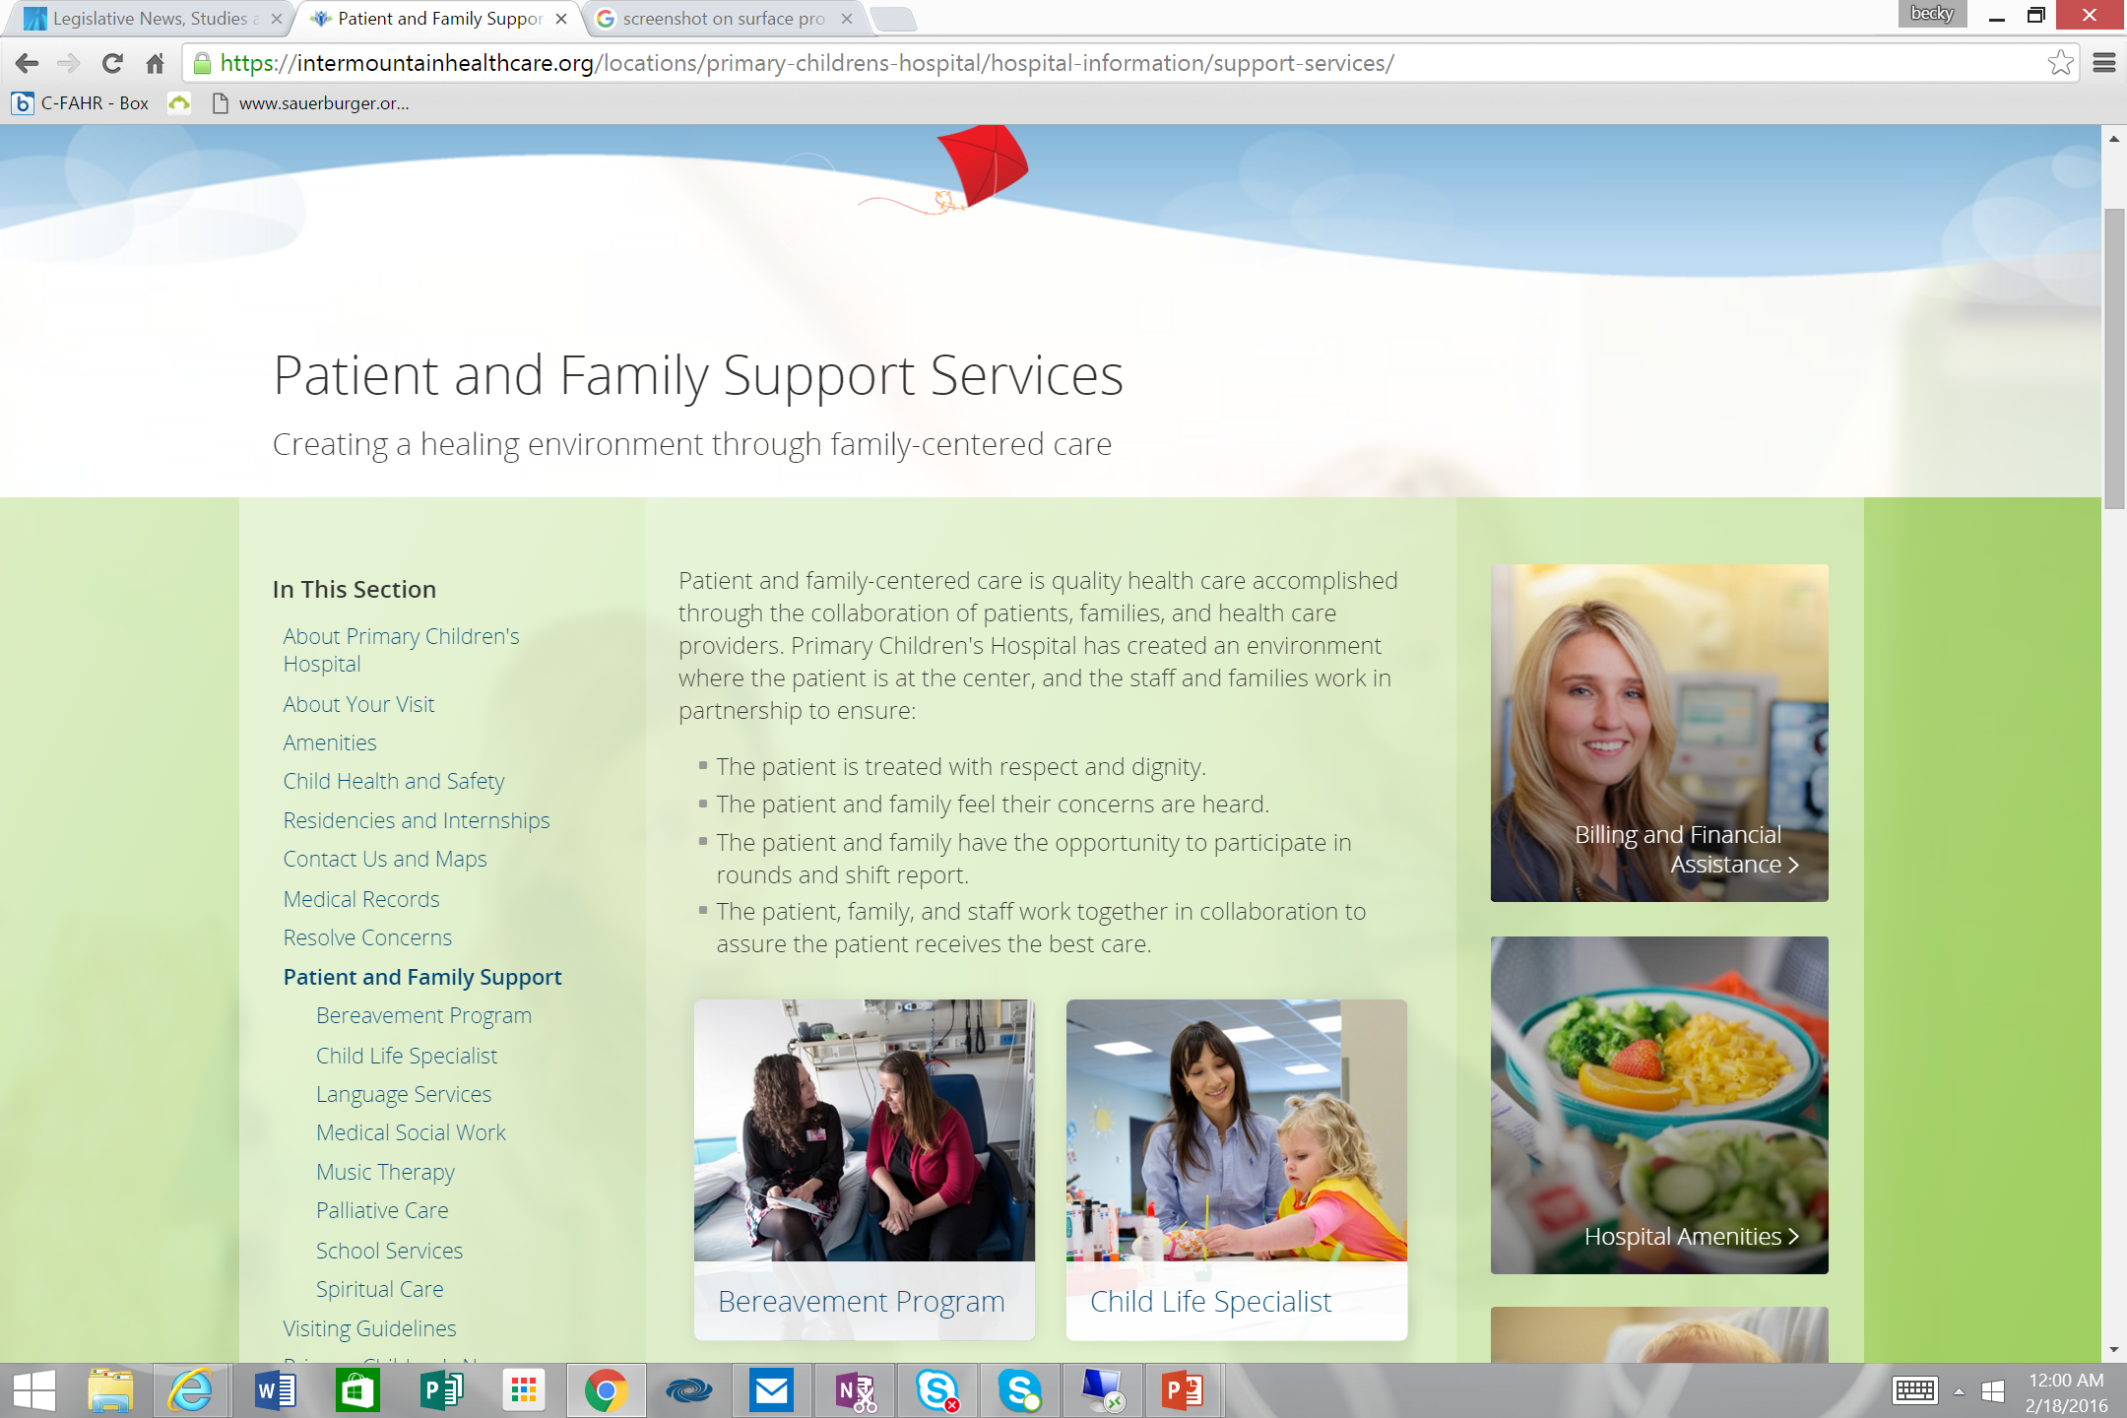
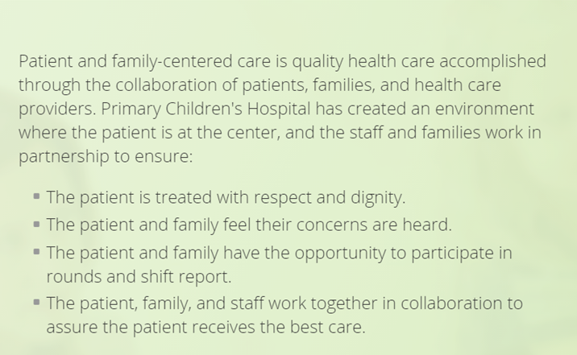

Slide 13

Ideas?
Opportunities?

Slide 14

Partnership & Mutual Benefit

Slide 15
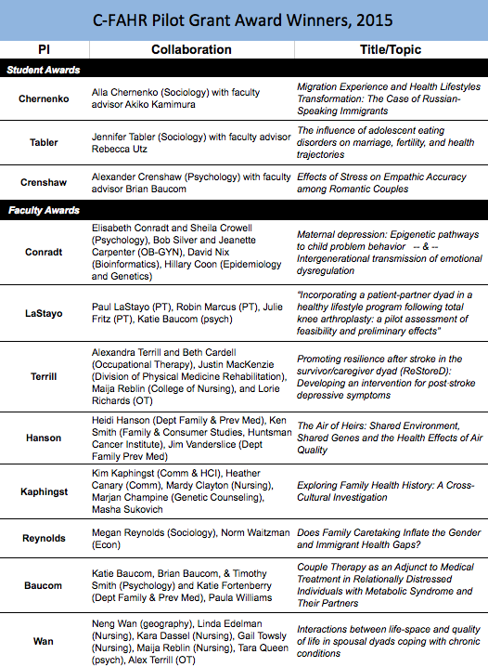
Research
C-FAHR will re-issue a
pilot grant program
in Spring 2016.

Slide 16
Submit your biosketch to become an Affiliated Member
C-FAHR-info@utah.edu

