Slide 1


Spring 2017
Poster Session & Symposium

Slide 2
Today’s Agenda
Poster Session
Presentation & Discussion
Challenges in recruiting families for health research
Introducing the 2017 Pilot Grant Awardees

Slide 3


Slide 4
2016-2017
Funded 6 graduate student pilot awards (displayed today at poster session).
Fruits of 2015 pilot awards
  1 K submitted, 2 R21s
  1 R03 funded
  1 LRP grant funded
  1 Foundation grant received
  1 NIH NINDS Utah StrokeNet Research Training Funded
  1 R21 funded
  1 internal KL2 funded
  Over 9 presentations submitted, numerous papers under review
  Monthly meetings
Executive Committee will be deciding on next year's programming (frequency and format, please give us feedback).

Slide 5
Today’s Agenda
Poster Session
Presentation & Discussion
Challenges in recruiting families for health research
Introducing the 2017 Pilot Grant Awardees

Slide 6
Recruitment Challenges in Health-Related Couple Intervention Research
Katie Baucom, PhD
Department of Psychology

Slide 7
Couple Therapy as an Adjunct to Medical Treatment for Metabolic Syndrome
Does adjunctive couple therapy improve relationship quality and health in individuals with Metabolic Syndrome and their partners?
Target sample: N = 10 married couples
  Clinically significant relationship distress
  At least one partner met criteria for Metabolic Syndrome, defined as 3 or more of:
    abdominal obesity, high triglycerides, low HDL cholesterol, hypertension (or rx), high fasting glucose (or rx)
Notes:
Using evidence based treatment for relationship distress, goal was to test whether focusing exclusively on the relationship would lead to health as well as relationship improvements
Lifestyle intervention is the first line of treatment for MetS – but likely hard to make health behavior changes in the context of the stress of an unhappy relationship

Slide 8
Method
 | Baseline Daily Assessment | Pre-Therapy Assessment | Couple Therapy | Post-Therapy Assessment | Follow-up Daily Assessment | 3-mo Follow-up Assessment
Length | Daily for 1-2 weeks | 3 hrs | 1 hr/wk Up to 26 wks | 3 hrs | Daily for 1-2 weeks | 1 hr
Payment per spouse | $15/week | $50 | None | $50 | $15/week | $30
Weeks 1-3
Weeks 3-29
Weeks 29-32
Week 42
$175 total
Notes:
Approx. 1 year of participation
Therapy was up to 26 weekly therapy sessions.
Before and after treatment had 1-2 week periods of wearing activity monitors 24/7 & completing daily online questionnaires; they also came into the lab for a long assessment of their relationship and health
Couples were compensated for the assessments and received up to 26 sessions of free couple therapy

Slide 9
Recruitment plan
Flyers & provider referrals from Madsen & Sugar House Family Medicine Clinics
Screening process
  Potential participants complete online screening of relationship and MetS criteria
  Medical record review (as needed)
Notes:
Wanted unhappy couples who wanted to work on their relationship (since it was a couple intervention), but we sought to ID people through visits to health provider.
Planned to collect health data from medical records, and to review them to determine eligibility – didn’t expect to need to do that much
CSI screening items:
Indicate the degree of happiness, all things considered, of your relationship.
I have a warm & comfortable relationship w my partner.
How rewarding is your relationship w your partner?
In general, how satisfied are you w your relationship?

Slide 10
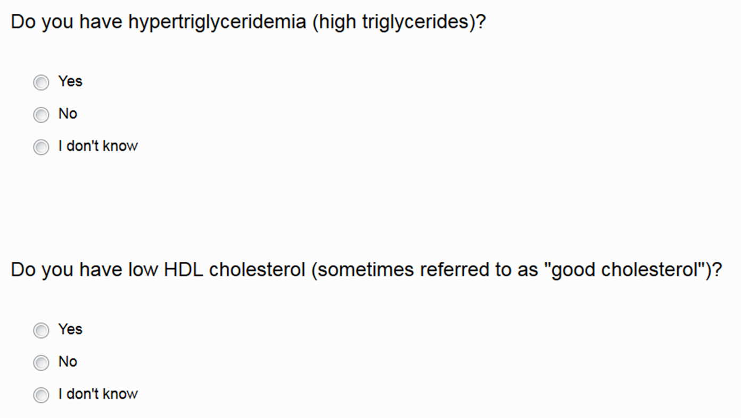
Notes:
~40% of individuals who completed the screening responded “I don’t know” to at least one MetS criterion
Med records weren’t as informative as we hoped - no lipid panels, recently moved to area so no prior lab data (couldn’t always determine eligibility)

Slide 11
Recruitment outcomes
Enrolled 9 couples (5 from clinics, 3 Facebook, 1 other)
  4 couples completed study
  3 couples receiving therapy
  2 couples dropped out before beginning therapy
Slow recruitment, made some adjustments:
  Facebook recruitment (12/2015)
    Extended our reach but led to more med record challenges
  Relaxed inclusion criteria (12/2016)
Notes:
Dropped out: Family reasons + too much to participate, lost contact after initial scheduling challenges
Some people weren’t in UUHC system

Slide 12
Baseline demographics
Measure | Patients | Partners
Age | 37.1 years (SD = 5.3) | 37.6 years (SD = 5.0)
Sex | 50% female | 62.5% female
BMI | 34.8 (SD = 5.9) | 28.1 (SD = 3.6)
Years married | M = 5.9 (SD = 3.8)
Children | 75% had 1-3 kids living in the home
Education | 87.5% bachelor’s or higher | 87.5% bachelor’s or higher
Religion | 50% LDS, 37.5% none, 12.5% Catholic | 50% LDS, 50% none
Race/ethnicity | 12.5% Native Hawaiian/PI, non-Hispanic 87.5% White, non-Hispanic | 12.5% White, Hispanic 87.5% White, non-Hispanic
Income | 75% annual household income > $90K
n = 8 couples who completed Pre-Therapy Assessment
Notes:
Based on MetS risk factors and Census data for Salt Lake City, would have expected older, slightly more diverse sample than the one we recruited
Sample is young, well-educated, almost exclusively White, non-Hispanic, and has annual household incomes well above the Mdn
Census data (2015) for Salt Lake City (https://www.census.gov/quickfacts/table/PST045215/4967000):
43.1% Bachelor’s degree or higher
$47K Mdn HHI
75% White
66% White, non-Hispanic

Slide 13
Summary
Lessons Learned | Next Time
1. Prioritize potential participant perspectives | Unhappy couples who want to improve marriage, happen to have MetS. vs. Individuals who have MetS, happen to be in unhappy marriages.
2. Consider feasibility of eligibility assessment (and med record use more broadly) | Consultation with providers & patients during study design CCTS Clinical Services Core
3. Multiple recruitment sites/strategies are likely needed for representative samples | Specialty clinics (e.g., UDEC) CCTS Collaboration/Engagement Team
Notes:
1. Didn’t think about 2 possible subgroups that would meet eligibility criteria – targeted 2nd group but likely would have been more effective recruiting 1st group
2. Didn’t think about this piece in enough detail. Assumed patients would know & assumed info would be easy to determine from med records. It wasn’t.
3. In case of MetS, which is most prevalent in older adults, we may have missed a lot of people based on our methods (Facebook, primary care).
-Our race/ethnicity data were similar to the population served at these Family Med Clinics, but likely collaboration with diverse communities on study design would be beneficial to expand reach.
-Possible older adults who have MetS aren’t presenting to family medicine clinics due to multiple health conditions, or are going to these clinics but don’t see working on relationship as priority (related to multiple conditions or not)

Slide 14
Acknowledgments
C-FAHR Faculty Pilot Grant
VP for Research, Funding Incentive Seed Grant
Co-investigators: Brian Baucom, Tim Smith, Paula Williams, Katie Fortenberry
Providers at Madsen and Sugar House Health Clinics
Key study staff
  Therapists: Janna Dickenson, Nick Perry, Jasara Hogan, Feea Leifker
  Grad RAs: Carlene Deits-Lebehn, Karena Leo, Jasara Hogan
  RAs: Trevor Bishop, Andrea Chavez, Christina Ferguson, Rene Gilfillan, Nick Klinkefus, Jon Rigby, Madison Schaaf

Slide 15
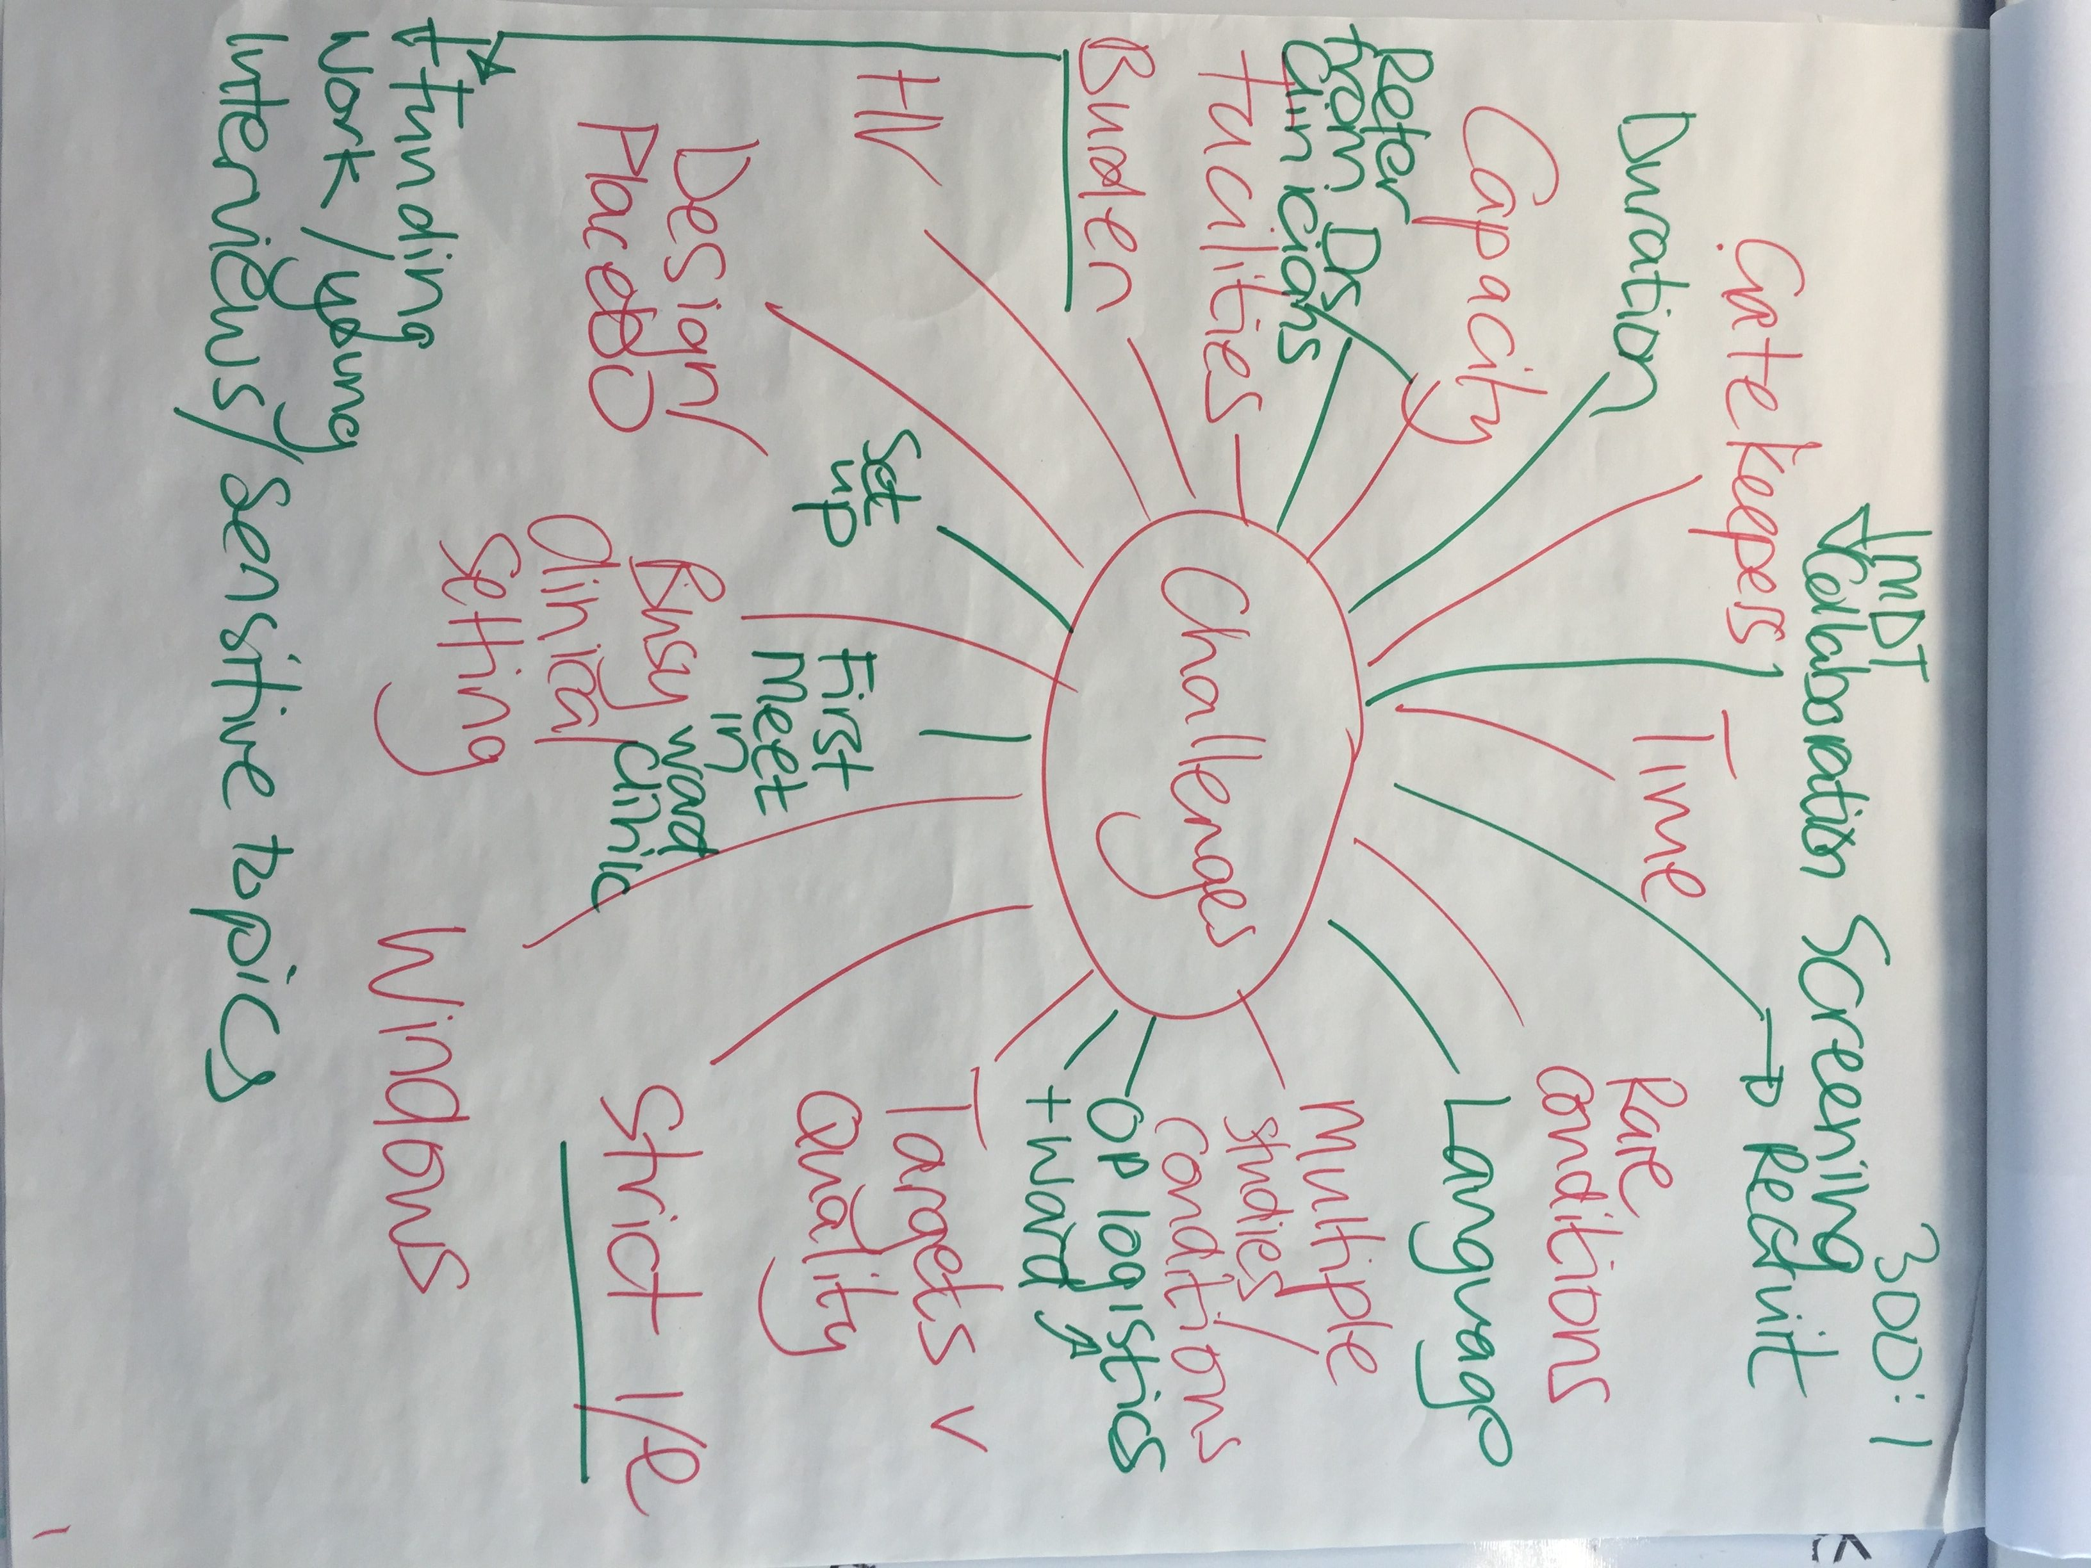


“Incorporating a patient-partner dyad in a healthy lifestyle program following total knee arthroplasty: a pilot assessment of feasibility and preliminary effects”
  Katherine Baucom, PhD (Psychology)
  Paul LaStayo, PhD, PT (Physical Therapy)
  Julie Fritz PhD, PT (Physical Therapy)
  Robin Marcus, PhD, PT (Physical Therapy)
Notes:
Our charge today is to talk about recruitment challenges, in particular some of the challenges we have experienced in our own respective pilot projects, one of which we have worked together on…Incorporating…
Intro self (dyed in wool PT whose rehabilitation research spans > 3 decades) and Katie (clinical psychologist whose interests lie in couples relationships)
Capitalize on pt/partner pairs ”dyads”, i.e., the support of a partner, might increase the likelihood a TKR patient will engage in a healthy lifestyle program

Slide 16
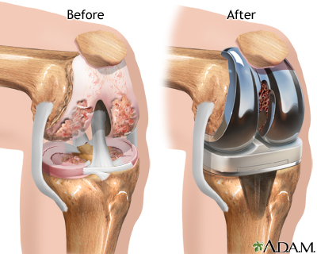
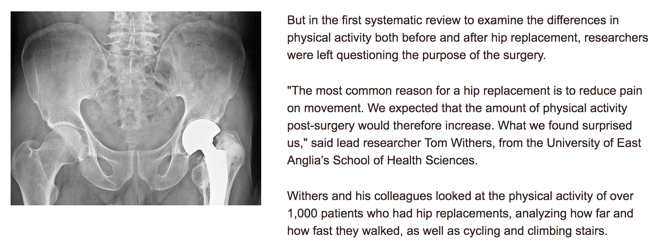
Joint Replacement: a success?
Body Weight and Physical Activity
Clinical Rehabilitation, 2016
Notes:
TKR is wildly successful in eliminating knee pain and it is growing exponentially. Greater than 6 fold increases are expected by 2030
What we do know is:
Standard rehabilitation with patients following TKA is NOT mitigating post-operative weight gain and the physical inactivity and health deficits that persist in a majority of patients.
With Katie’s help we expected the inclusion of partners in a lifestyle intervention will increase their support of patients, and that TKA recipients will be better able to translate the pain relief of TKA into lasting healthy lifestyle changes.

Slide 17

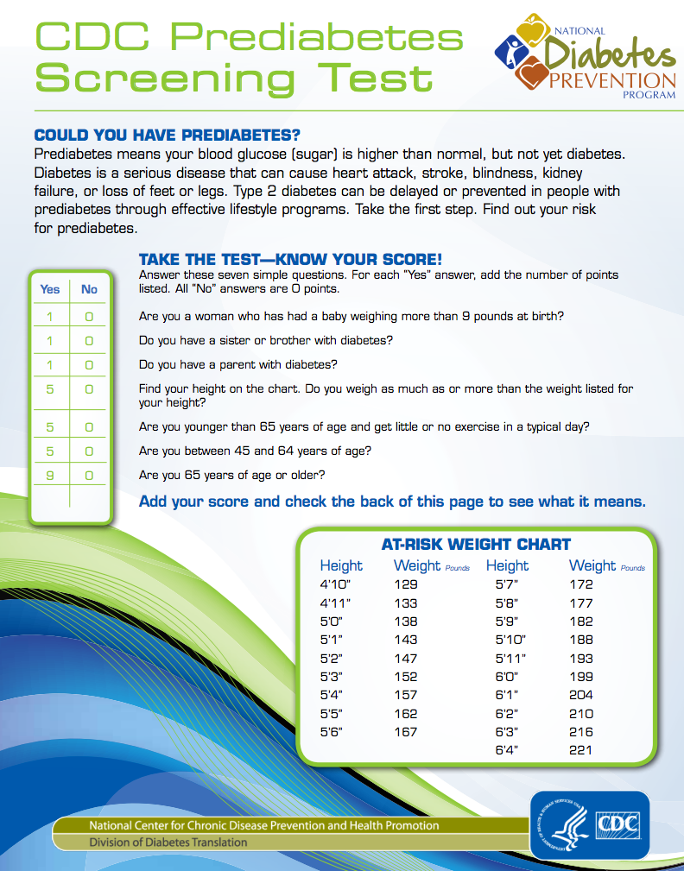
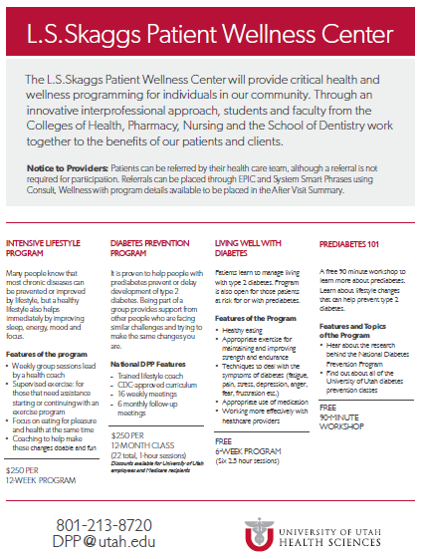
Who: TKR patients & partners
What: Mitigate T2DM
Why: Enhance “post-op rehab”; at-risk patients; enhance healthy behaviors
How: National Diabetes prevention program…w/partner
Where: U of U
When: Peri-operative period
Notes:
Partner: anyone considered a romantic partner, a relative, or friend
History of:
Working with ortho and TKA-
Funding + Recruitment (infiltrating clinics)
Papers with TKA
Collaborative experiences across campus
Katie-patient/partner dyad

Slide 18
NOA- March’15 & IRB approved -April ‘15
Amend #1-May ’15; added hip
Amend #2 and #3 -July ’15; post-op
Amend #4 –Sept ’15; EPIC
November ’15-Cohort #1- started DPP in Dec ‘15
Pre-op; 0/22
“Joint Camp”
Pre-op; 0/64
Post-op; 0/63
10 individuals consented--DNS
“Surg Clinic”
DPP
Post-op; 16/65
8 pairs consented– 2 pairs DNS
Notes:
After adding THR we made contact with at least 1 patient per day….6 mos we had our 6 pairs for Cohort #1, i.e., 12 adults with (only the patients needed to be at risk for prediabetes per CDC screen). So our ~6% accrual rate is within our historical rates of 5% we have experienced, and the 10% which is out there as a general rule of thumb. “In the NDPP the percentage entering screening who were ultimately randomized was similar for the minority groups (2.0%) and the nonminority group (2.7%).”
Lasagna’s Law (first described by Louis Lasagna in 1970) or the idea that the number of patients who might participate in a research study falls dramatically as soon as the research commences.
Needed a cohort to start a DPP
Used car salesman analogy: Often need pt to go home to ask a partner (leaving the lot); Cant start tehg DPP until we get more people (wont sell car till we get 5 other pairs to also want this car.
EPIC amendment:
*how many patients at the PA's clinic are 2 weeks following surgery since we are only enrolling patients who have recently undergone a knee or hip replacement
*how many of these patients that are 2 weeks following surgery live in the Salt Lake valley region
*how many of these patients have a body mass index greater than or equal to 25 (aka overweight)

Slide 19
Cohort #1- 6 pairs
  3 pairs dropped out in the first 2 weeks
  3 pairs continued for the duration (>1 yr)
Cohort #2- 6 pairs from Feb-April ’16 (also had 20 consent but DNS)
  3 pairs dropped out in the first 2 weeks
  3 pairs >1/2 way thru (>6 mos)
Notes:
Learned to recruit as we accrued in ½ the time with a doubling of our accrual rate
But we learned nothing about retention as 50% dropped out in first 2 sessions again
12 patient/partner dyads with an equal mix of:
partner types,
males/females
age and BMI
Further…the main metrics of the NDPP did not move

Slide 20

Preliminary Effects…and Feasibility
Lifestyle intervention with TKA recipients/partners
+/-- body weight after surgery
+/-- level of physical activity after surgery

Slide 21
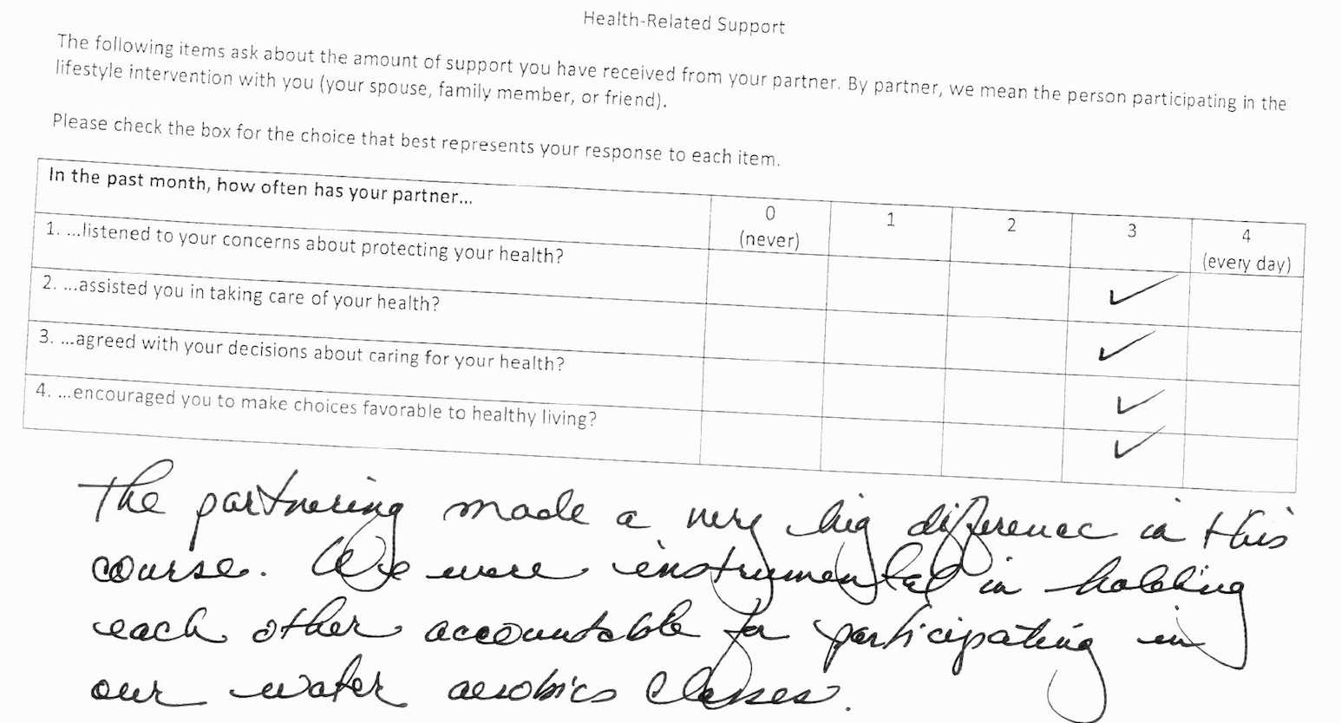
Preliminary Effects…and Feasibility

Slide 22

Rehabilitation Research Resource to Enhance Clinical Trials Workshop (Sept, ‘16)
Keeping health care providers and clinical staff on point regarding RECRUITMENT
Utilizing incentives and assistance in transportation/child care in RETENTION
Notes:
Lasagna’s Law (first described by Louis Lasagna in 1970) or the idea that the number of patients who might participate in a research study falls dramatically as soon as the research commences.

Slide 23

Recruitment Musings…
Aiming high is OK…
      …but be patient, respectful and nimble
      …recruiting 2 can be harder than 1
      …don’t underestimate health beliefs & priorities
          HEALTH IS A TOUGH SELL
Good/bad news…
      …long-term interventions & f/u
      …early effects sizes
      …translation and pragmatism

Slide 24

My Friend’s Mom and “Success”
“Paul…If you want to be successful in life you might want to consider lowering your goals”
Projected Participant Accrual
and/or
Recruitment Duration
Notes:
Sample size expectations and….plan for 1) more time than you think you need to recruit; and 2) oversample
Lasagna’s Law (first described by Louis Lasagna in 1970) or the idea that the number of patients who might participate in a research study falls dramatically as soon as the research commences.

Slide 25
R &R Challenges
Notes:
Many challenges: 1) Dyads require 2 people; 2) Busy clinic; 3) patients focused on surgery; 4) Health is a hard sell…esp when they did not know that had a fomralized health risk, e.g., diabetes
Lasagna’s Law (first described by Louis Lasagna in 1970) or the idea that the number of patients who might participate in a research study falls dramatically as soon as the research commences.

Slide 26
Today’s Agenda
Poster Session
Presentation & Discussion
Challenges in recruiting families for health research
Introducing the 2017 Pilot Grant Awardees

Slide 27
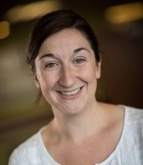
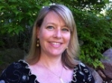
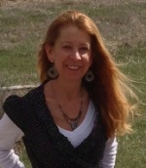
The Role of Parents in Preparing Youth with Autism Spectrum Disorder for Adulthood
C-FAHR Team:
Anne V. Kirby, PhD, OTR/L
Assistant Professor, Department of Occupational & Recreational Therapies (CoH)
Marissa Diener, PhD
Associate Professor, Department of Family & Consumer Studies (CSBS)
Cheryl Wright, PhD
Associate Professor, Department of Family & Consumer Studies (CSBS)

Slide 28
The Role of Parents in Preparing Youth with Autism Spectrum Disorder for Adulthood
The goal of the proposed project is to expand understanding of transition preparation activities engaged in by families of youth with autism spectrum disorder and average or above-average IQ (ASD-AIQ) and to refine an intervention designed to enhance parental self-efficacy to ultimately improve outcomes of adults with ASD.
Aim 1. Among a national sample of parents of youth with ASD-AIQ, describe transition preparation activities, satisfaction with activities, and duration and intensity of activities, and determine associations with overall sense of preparedness and parental well-being.
  Expand preliminary data findings through online survey with Interactive Autism Network recruitment
Aim 2. Refine a novel intervention for parents of youth with ASD-AIQ aimed at increasing effective integration of transition preparation activities into daily life.
  Pilot our MAPSS (Maximizing Adolescent Post-Secondary Success) intervention with a group of 5-7 families

Slide 29
Recruitment of At-Risk Youth for a Series of Interdisciplinary Studies
PI: Bruce Ellis (Psychology and Anthropology). Co-Is: Daniel Adkins (Sociology, Psychiatry), Dan Carlson (Family and Consumer Sciences), Elizabeth Conradt, Sheila Crowell, (Psychology), Lisa Diamond (Psychology and Gender Studies).
AIM: To recruit and retain a diverse research pool of adolescents and young adults in the SLC area for a range of local studies conducted by our interdisciplinary research team: DASH (Development, Stress, Adaptation, and Health) on the developmental implications of early life adversity for emotion regulation, attention, learning, problem behavior, physical health, sexuality, and stress vulnerability

Slide 30
Recruitment of At-Risk Youth for a Series of Interdisciplinary Studies
We will be recruiting two target longitudinal samples: An adolescent sample (age 14-17) through the SLC Boys and Girls Club and a young adult sample (age 18-24) through the SLC Community College
These sites were chosen because of the opportunity to recruit participants from challenging backgrounds
We will develop and refine recruitment methods for this population, allowing us to comprehensively address feasibility issues for future extramural grant proposals
We will also pilot test different data collection strategies (on site versus off-site, EMA, diary methods, physiological data collection at the U) so that we can tailor future studies and grant proposals accordingly

Slide 31
Integrating Family Caregivers into Primary Care Teams: Best Practices
Debra Scammon, PhD, David Eccles School of Business
Christie North, MBA, FACHE, Quality Incorporated
Michael Magill, MD, Family and Preventive Medicine

Slide 32
Project Aims and Methods
Aim 1: Identify clinics/providers with exemplary
processes for integrating family caregivers into care
        Identify & contact practices known to have inclusive practices
        Recommended by Advisory Committee, identified through family physicians
Aim 2: Conduct a deep dive with 10 clinics
        Observe processes in clinics
        Conduct in-depth interviews with providers
Aim 3: Develop hypotheses about best practices; identify
systematic reviews to document efficacy
        Increase caregiver preparedness for medically related tasks
        Reduce caregiver burden
Develop a Comparative Effectiveness Research proposal for PCORI
Hire a Research Assistant to assist with field work
Notes:
Our focus is on elderly patients with multiple chronic conditions
Family caregivers who spend 20+ hours/week in caregiving tasks
qualitative methods
At ASA, met family physician at U of Penn who is training residents to incorporate family caregivers into practice
Referral to clinic at Scott & White Healthcare
Clinics at U, including Cognitive Disorders, UNI Home
Working on IRB protocol for in-clinic observations and interviews

Slide 33
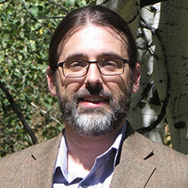
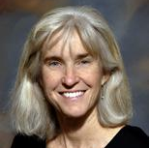
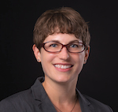
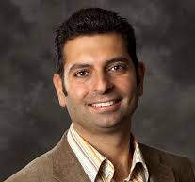
Mapping the complexity of communication in caregiver systems for advanced cancer patients
Brian Baucom, PhD
Assistant Professor, Department of Psychology (CSBS)
Lee Ellington, PhD
Associate Professor, College of Nursing (CoN)
Maija Reblin, PhD
Researcher, Moffitt Cancer Center
Panos Georgiou, PhD
Assistant Professor, Department of Electrical Engineering, University of Southern California

Slide 34
Mapping the complexity of communication in caregiver systems for advanced cancer patients
Very little is known about the ways that caregivers coordinate with others to care for cancer patients or about the motivations that drive the multiple decisions caregivers make on an on-going basis. Primary caregivers have a wide range of options for connecting, coordinating with, and communicating information to the other members of the caregiving team. The study goal is to collect pilot, qualitative data to begin understanding why and how caregivers use these options.
Aim 1. Map the network of communication methods (e.g., in-person, phone, email) used by primary caregivers to accomplish various tasks within their caregiving team.
Aim 2. Identify factors that influence decisions about the method and content of communication
Aim 3. Document the downstream implications of these decisions for the patient’s treatment and the primary caregiver’s emotional well-being.

Slide 35
Pilot Grant Awards (Fall)
Research Fellows

