Slide 2
Year 1 Year-in-Review April 15, 2015

Slide 3
Spring 2014
Idea & Initial Proposal
Summer 2014
Executive Committee
Fall 2014
Kick-Off Meeting
Symposium & Research Mixer
Winter 2014-2015
Job Interviews
Student Interest Groups
Search Committee
Pilot Grant Program
It has only been a year…..
What is next? What else can we accomplish?

Slide 4
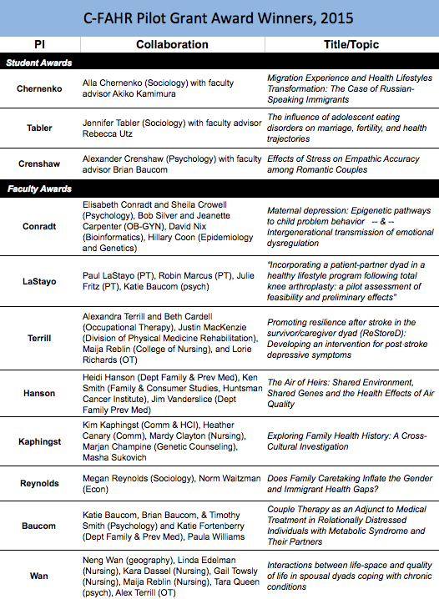
Research
C-FAHR will re-issue a
pilot grant program
in Year 2.

Slide 5
Quant Methodologist Intervention Scholar
Stay tuned for the results of this year’s search efforts!
Next year we will be searching for position(s)

Slide 6
Undergraduate “Families & Health” BlockU
To start in Fall 2015
--------------
Continued exploration of courses, workshops, or potential certificates to enhance graduate training across disciplines

Slide 7
Ideas?
Priorities?

