Slide 1
Discussion:
Integration Across Domains
November 14, 2016

Slide 2
Social & Environmental Context
Health Behavior
Health Outcome
1
1

Slide 3
Chronic conditions share a common set of behavioral determinants
Clustered within people
Driven by shared mechanisms
Influenced by shared environments
Tobacco Use
Alcohol use
Dietary behavior
Sedentary Behavior
Chronic
Conditions
(e.g., cancer, cardiovascular, diabetes, obesity)
Cross-cutting behavioral research is needed
Minimize redundancies in research
More effective behavioral intervention
Discussion of Reading:
Klein, Grenen, O’Connell, Blanch-Hartigan, Chou, Hall, Taber, Vogel. 2016. Integrating Knowledge Across Domains to Advance the Science of Health Behavior: Overcoming Challenges and Facilitating Success.

Slide 4
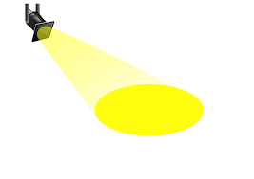
Research Spotlight

Slide 5
Fostering changes in multiple behaviors: A discussion and examples from families at elevated risk for melanoma
Results from the Utah BRIGHT Project
Lisa G. Aspinwall, Ph.D.
Tammy Stump, Ph.D.
Jennifer M. Taber, Ph.D.
Wendy Kohlmann, M.S., CGC
Marjan Champine, M.S., CGC
Danielle Drummond
Emily Scott
Dexter Thomas
Yelena P. Wu, Ph.D.
Sancy A. Leachman, M.D., Ph.D.
Research supported by the National Cancer Institute, R01 CA158322,
National Center for Research Resources and the National Center for Advancing Translational Sciences, National Institutes of Health, 8UL1TR000105,
National Cancer Institute Cancer Center Support Grant 5P30CA420-14,
Utah Cancer Registry, Utah Population Database, & Huntsman Cancer Foundation.
Notes:
National Center for Research Resources and the National Center for Advancing Translational Sciences, National Institutes of Health, 8UL1TR000105 (formerly UL1RR025764)
Originally understanding adherence to multiple health behaviors:
A discussion and examples from families at elevated risk for melanoma
Huntsman Cancer Institute CCPS Pilot Project Initiative,
University of Utah Funding Incentive Seed Grant, &
Does melanoma genetic test reporting provide informational and motivational benefits compared to family history-based counseling alone?

Slide 6
Familial melanoma as a model for understanding proactive management of hereditary cancer risk
For most hereditary cancers, main recommendation = accelerated screening
Also prophylactic surgery
In the unique case of melanoma, genetic vulnerability interacts with personal behavior (UVR exposure) to influence disease risk
Thus, both early detection and actual prevention may be possible for members of high-risk families
This provides an opportunity to understand adherence to both kinds of behavior
Notes:
Little is known about beliefs & behaviors of members of melanoma-prone families
Transition to clinical testing is just beginning

Slide 7
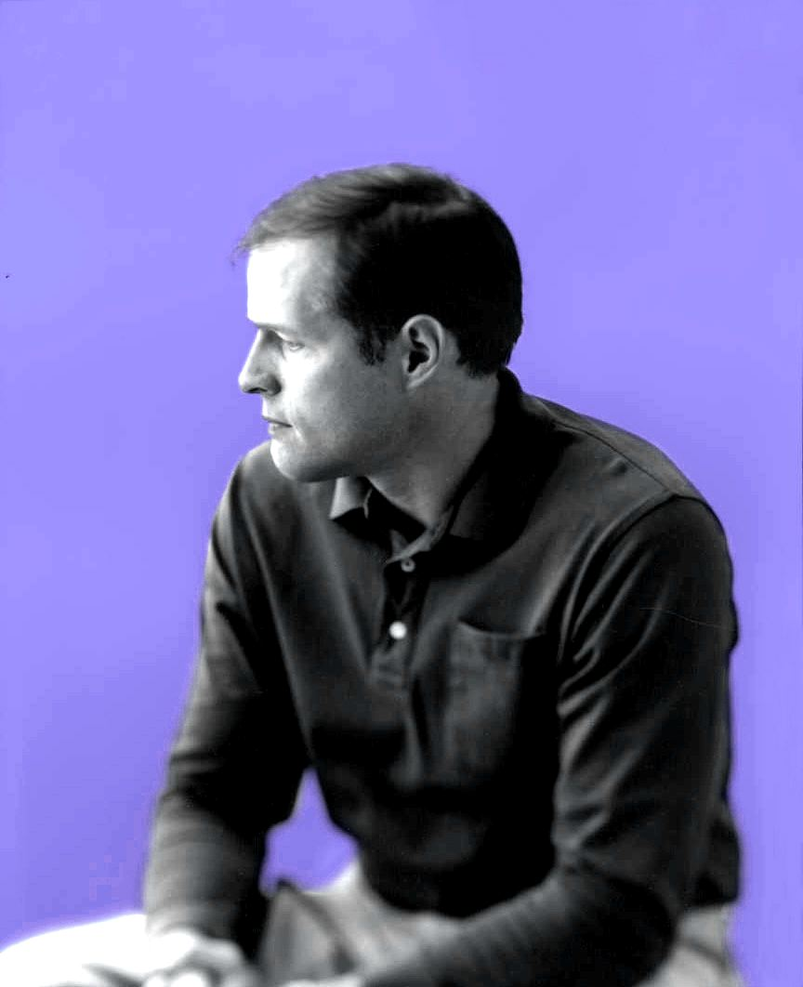
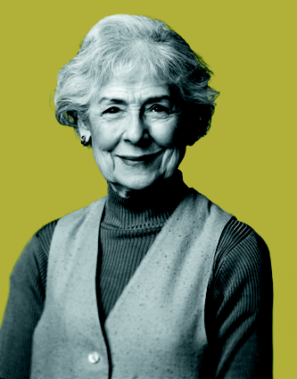
Melanoma risk in p16 mutation carriers
By age 50
By age 80
Risk in general population
1%
1%
Risk in p16 mutation carriers
in the United States
~50%
~76%
J Natl Cancer Inst 2002; 94: 894-903
Notes:
This is the actual slide shown to members of high-risk families in genetic counseling sessions at the high-risk cancer clinics at the Huntsman Cancer Institute.
CDKN2A/p16, a tumor suppressor that regulates cell cycle and senescence
Risk of Melanoma in p16 Mutation Carriers
the people most at risk for melanoma are p16 carriers and other members of melanoma-prone families
participants in the study were members of the original Utah pedigrees whose tissue samples were used up to identify the genetic bases of familial melanoma
this is the information they are shown in the actual genetic counseling session.
The risk of developing melanoma is 1% by age 80 in the general population. In contrast, the risk of developing melanoma by age 80 in the United States increases to 76% in individuals with a documented p16 mutation.
In addition, individuals who carry p16 germline mutations have a greatly increased risk of developing multiple primary melanomas (MPMs). Up to 15% of individuals with MPM have p16 mutations.
11-17% risk of pancreatic cancer
Finally, for a subset of participants who test positive for the p16 mutation, their particular genetic mutation (name*) is highly suspected to carry an additional risk for pancreatic cancer, a particularly aggressive cancer (refs *). This additional risk was unknown to participants in our study prior to genetic test reporting and counseling.
References:
Bishop DT, Demenais F, Goldstein AM, et al. Geographical variation in the penetrance of CDKN2A mutations for melanoma. J Natl Cancer Inst. 2002;94:894-903.
Monzon J, Liu L Brill H, et al. CDKN2A mutations in multiple primary melanomas. N Engl J Med. 1998;338:879-87.
Ries LAG, Eisner MP, Kosary CL, et al (eds). SEER Cancer Statistics Review, 1973-1999, National Cancer Institute. Bethesda, MD. Available at: http://seer.cancer.gov/csr/1973_1999/. Accessed March 9, 2003.

Slide 8
How do prevention and screening behaviors differ?
Health promotion vs. illness detection
Keep your good health vs. find out you are ill
Daily vs. monthly practice
Interference with daily activities
Consequences of nonadherence
Immediate vs. delayed vs. really delayed
SSEs can be difficult to perform, but vital
If detected early, melanoma survival rate is 92-97%; if not, only 15-20%
Do participants have a diagnosis vs. at risk?
Adherence lower among unaffected family members
Notes:
*Need to figure out whether this slide should be how health behaviors differ from each other, as a way of discussing different health conditions, or more focused on how prevention and screening behaviors likely differ.
Social factors – is the behavior stigmatized, valued, shared?
Further, SSEs are free and noninvasive, quite different from other forms of screening.
*No appointment needed – maybe that is the problem. You can do it later, and you will feel absolutely fine.
*The whole point of predictive genetic testing is to get people to behave/adhere as though they have the disease if doing so would be useful*
This is the 5 year survival rate
*Melanoma prevention affords an opportunity to study adherence to multiple behaviors within the same person and same family*
Benefits of adherence
Immediate versus delayed
If you don’t perform a monthly skin exam, you are fine, and you stay fine.
If you don’t adhere to photoprotection, you might get sunburn, or you might sport an attractive tan – the consequences are far removed.
*The importance of studying people at extremely elevated risk for illness but who are not going to have no symptoms and to actually would be just fine for a long time*
Signs & symptoms (or lack thereof) from poor adherence
Not immediate, sunburn, tan
Notion of cumulative damage
*Maybe there are beliefs about the time in one’s life at which you need to spend a lot of time worrying about your health – it’s typically not ages 16 to 30, maybe we should be marveling at the good adherence among people in their early thirties.*
*What are people’s beliefs about whether damage is reversible – smoking, tanning, we can always lose weight, but what about heart disease?*

Slide 9
Adoption of precautions depends on costs & benefits over time
Cost | Benefit | Examples
minimal | immediate
short-term effort | immediate
requires consistent effort | immediate
requires consistent effort | delayed
Weinstein (1988) Precaution Adoption Model
Notes:
Weinstein (1988) points out that precaution adoption is broader than health – it applies to occupational safety, natural hazards preparedness, and crime prevention, as well as to health promotion.
*applicability to climate change?*
Switching from an authoritative toothpaste to Florida in toothpaste; giving acetaminophen rather than aspirin to a child with the flu to reduce the risk of Reye’s syndrome
obtaining a vaccination or installing a smoke detector – short-term efforts , some cause immediate benefits.
use of dental floss and automobile seatbelts
lifestyle modifications like dietary change in smoking cessation – beneficial in the long run, but costly for a considerable period of time

Slide 10
The Utah BRIGHT Project Behavior, Risk Information, Genealogy & Health Trial
BRIGHT is an ongoing NCI-funded study that compares outcomes of p16 testing to counseling based on family history alone
128 unaffected members of melanoma-prone families with 3 or more melanoma cases
Families with a known p16 mutation, or
Control families known not to carry p16 (no genetic cause of their familial cancer identified)
They will receive equivalent counseling about risk (30-70x population risk) and management
But only p16 family members will receive test results

Slide 11
How are prevention and screening correlated at baseline?
.30
*** p<.001
Notes:
All participants have 3 1st- or 2nd-degree relatives with melanoma
Lifetime percent risk estimates are 60% and up on average
At baseline, .295***

Slide 12
Practice of prevention and screening at baseline
Group | Neither | Sun protection only | Screening only | Both
Younger 16-30, n=50 | 34% | 34% | 4% | 28%
Older 31-69, n=64 | 23% | 39% | 8% | 31%
Notes:
*Percentages rounded
Need to define age groups – 16-30, 31-69
Also that adherent in this metric = a 4 or 5 on stages of change for the behavior
Nonadherent = values of 1-3 (not intending to intending to in the next month)
Figure out what the overall spread is, stratified by age:
Does age stratification make a difference at baseline?
*Point out that this is similar to the rate of about one third of these family members being highly adherent to protection and screening in our 1st study of more than 60 family members, but that included people with a history of one or more melanomas, tho we saw the same pattern among unaffected family members.

Slide 13
What does genetic testing do?
Thought to alert people to their risk prior to the onset of illness
However, lifetime percent risk estimates already >60%
Effects difficult to distinguish from accompanying education
Is there something special about a genetic cause?
Should it affect some behaviors > others?
Genetic testing promotes accelerated screening
What about self-exams?
What about prevention?
Notes:
Alternate approach – shouldn’t beliefs about perceived susceptibility, illness severity, genetic determinism, etc. affect adherence to all behaviors equally?
Shouldn’t individual factors like executive function, age, conscientiousness, family history also show a unidimensional relationship to adherence?
If you’re going to take your risk seriously, shouldn’t you do everything that is recommended?
Here’s the problem:
It doesn’t increase risk – perceived risk is already high
Baseline adherence among unaffected family members is highly variable and often poor
Reported adherence to sun protection and screening increases following genetic testing, but why?

Slide 14
Perceived lifetime risk “What do you think are the chances that you will get a future melanoma during your lifetime?”
%
Group
Time of Assessment
Group (F(2,109)=47.95, p<.0001); Group x Time (F(6,327)=25.77, p<.0001)
*= significantly different from baseline, p<.05
Notes:
*These means were verified on 9. 23. 2016 – they are controlled for age and FDR.
Interestingly, there is no significant main effect for either age or FDR.
There are some interactions of FDR in time, and age and time that we need to follow up, as well as to test FDR by group by time and age by group by time.
---9.23. 2016: ran age and FDR as covariates with covariate interactions with group and time, no two-way interactions of Group by FDR or age by FDR or age by group with the continuous measure of age in all cases.
There is a marginal 3-way interaction of age by group by time with age as a continuous measure, p<.08. needs to be explicated, except that it is marginal.
No 3 way interactions involving, time, and FDR.
Updates 10.25. 2015:
No test controls drop significantly from their baseline at the 2nd and 3rd visits, but do not differ from baseline by visit 4
Carriers are elevated from baseline of visit 4
*= Significantly different from baseline, p <.05
*Definitely need to look at time by FDR and time by age interactions
.

Slide 15
Practice of prevention and screening at 1 year
Group | Neither | Sun protection only | Screening only | Both
Younger Carriers | 12% | 47% | 12% | 30%
Older Carriers |  |  |  | 100%
Younger Controls | 15% | 40% | 5% | 40%
Older Controls | 16% | 24% | 4% | 56%
Younger Noncarriers | 54% | 23% | 8% | 15%
Older Noncarriers | 7% | 21% | 4% | 68%
Notes:
the featured slide rounds the percents up or down to simplify
Notice that this is a huge problem – only 42% of younger carriers are screening, but 77% report consistent sunprotection
Among controls at risk, similar adherence among the young
On the plus side, 100% of the older carriers are now in the both

Slide 16
How are prevention and screening correlated at 1 year?
At 1-year follow-up:
.38
*** p<.001
Notes:
At baseline: .30***

Slide 17
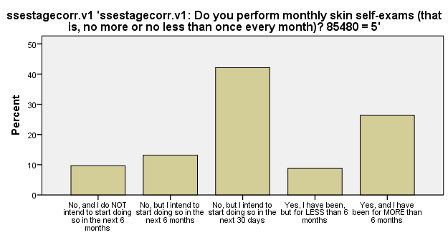
What makes a particular health behavior a priority?
The messy desk problem (Weinstein, 1988)
Notes:
Little is known about beliefs & behaviors of members of melanoma-prone families
Transition to clinical testing is just beginning

Slide 18
Priority of skin cancer screening “Examining my skin (checking myself for skin changes) is a priority to me”
Very much
Not at all
Increase in Risk Compared
to General Population
70X
30-70X
2X
Among older participants, carriers >controls and noncarriers.
No differences among younger participants.
Notes:
*This raises 2 questions – why are only older carriers prioritizing screening, and why do we not see the age difference in the no test controls?*
*Need to fix the legend, so it doesn’t show red but instead just a filled in box*
There is a main effect of time, such that the grand mean goes from 3.69 at baseline to 4.17 at visit 2, to 4.03 at one month, and 3.78 at 1 year.
There are significant main effects of group and age, and a significant group by age interaction, F (2, 108) = 4.283, p <.016.
*Need to be careful in how we talk about these findings, because there are no interactions of the groups over time. Could reflect a pre-existing difference. Need to see what happens when we consider propensity scores.*

Slide 19
Stages of change for monthly SSE: Ages 16-30 vs. 31-69
*
Yes,
for > 6 mo
Yes,
for < 6 mo
No, but intend to start in 30 days
No, but intend to start in 6 mos
SSE = skin self-examination
Notes:
*Corrected means with the use of SSE stagecorr.v1 thru .v4 to handle two overscreeners who did not intend to change this behavior*
New analysis on 9.23. 2016:
There is a significant effect of group by FDR by age, using the continuous measure on stages of change for monthly SSE: F (2, 102) = 4.75, p <.011.
There is also a group by FDR effect, F (2, 102) = 4.579, p <.012.
Additionally, there are significant main effects for time, but not any higher order interactions involving time by group.
Lga note – I wonder if this is the same thing we found a baseline where there is higher screening among younger people if more FDRs.
I’ve already done the regression at baseline (without group) and would need to repeat it at the other 3 stages as well to figure out what the interaction was.
Note that the interaction does not include time.
-----------------------
The following question is about protecting yourself from sun exposure.
There are several ways to protect yourself from the sun:
- by using sunscreens with a Sun Protection Factor (SPF) of 30 or more
- by wearing protective clothing (for example, a hat with a wide brim, shirts, and long pants)
- by avoiding or limiting exposure to the sun during the mid-day hours
1. Do you protect yourself from exposure to the sun consistently according to that definition?
YES, and I have been for MORE than 6 months.
YES, I have been, but for LESS than 6 months.
NO, but I intend to start doing so in the next 30 days.
NO, but I intend to start doing so in the next 6 months.
NO, and I do NOT intend to start doing so in the next 6 months.

Slide 20
Next Steps
Understand what leads unaffected people to prioritize specific risk-management behaviors at particular times in life
Understand patterns of belief and behavior among younger family members
Structured interviews at baseline and 1 year
Develop interventions to support sun protection and screening earlier in life
Notes:
*If it’s just age, why do we not see parallel improvement among older no test controls?
*Nice segue to development of interventions to help children, teens, and it looks like we should be focusing on young adults as well.
*Consider adding the following: with carryover to management of risk in children and grandchildren*
*No evidence of adverse effects on fatalism with respect to risk and treatment outcomes, cancer worry,*
*still need to look at depression and anxiety*
LGA*Will update this to comment on what is not different – risk estimates, reality of risk between carriers and controls. They also don’t differ by group on control perceptions.*
*Ultimately, will be matching on number of 1st and 2nd degree relatives, age, gender,…*
*Also point out importance of preventing childhood and adolescent sun exposure*
These results statistically controlled for both age & # of first-degree relatives w/ melanoma

Slide 21
Melanoma prevention in at-risk pediatric populations: Developing strategies to support preventive behavior implementation across melanoma preventive behaviors
Yelena P. Wu, phd
Division of Public Health
Department of Family & Preventive Medicine
Cancer Control and Population Sciences, Huntsman Cancer Institute
November 14, 2016

Slide 22
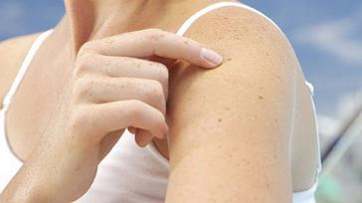
Melanoma prevention & kids
Typically an adult-onset disease
Modifiable risk factors in childhood
Ultraviolet radiation exposure
Severe sunburns
Prevention & screening
Use sunscreen, reapplication
Physical barriers for UVR
Skin self-examinations
Total body skin exam
Adherence is poor
American Academy of Dermatology; Dennis, 2008; Oliviera, 2006; Pustisek, 2010; Wu, 2014

Slide 23
Funding: NCI K07 CA196985, Primary Children’s Hospital Foundation, DFPM

Slide 24
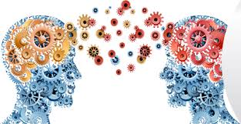
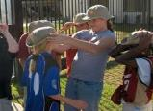
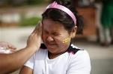
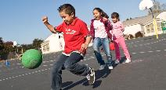
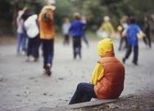
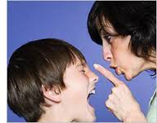
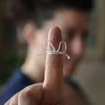
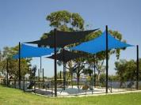
Policies
School
Law
Family
Child
Peers
Healthcare
Mass media
Notes:
Personal preference
Knowledge
Family modeling
Peer influence

Slide 25
Identify factors linked to preventive behavior adherence
Test innovative interventions to improve adherence
Decrease children's risk for melanoma
Funding: NCI K07 CA196985

Slide 26
FLARE Study
Family-focused intervention for children at elevated risk for melanoma due to family history
Targets changes in multiple health behaviors
3-session, Skype-delivered intervention
Risk communication
Preventive behavior education
Strategies to address families’ barriers to preventive behavior adherence

Slide 27
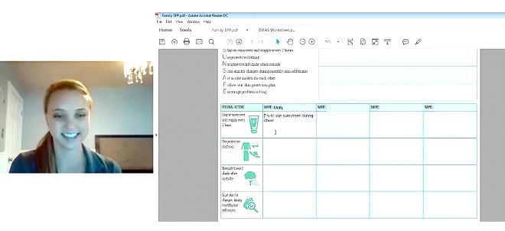
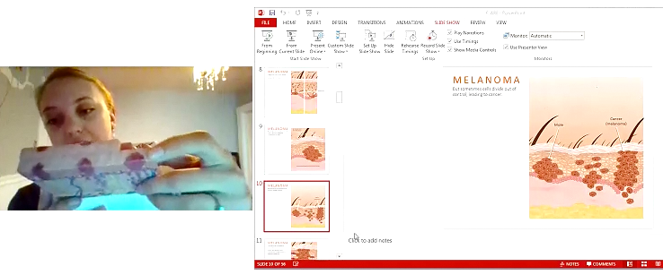
FLARE format

Slide 28
Risk communication & preventive behavior education

Slide 29
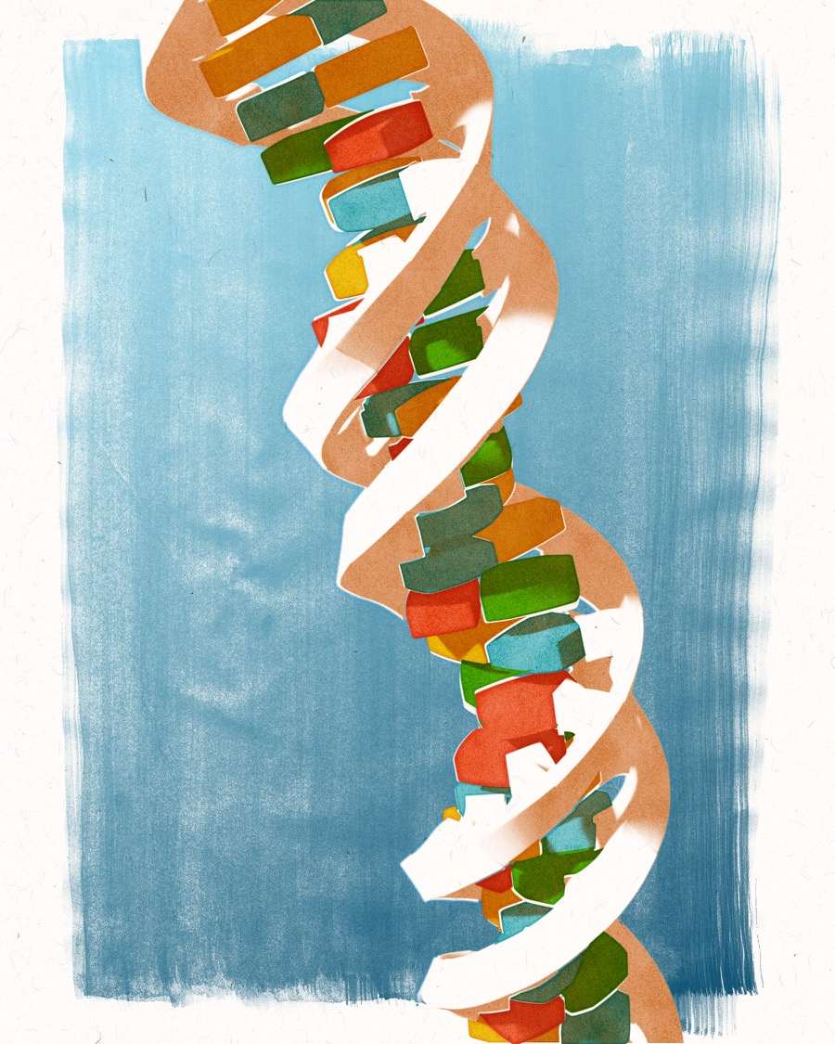
OVERVIEW
Traits & the Environment
DNA & Genes
Mutation
Melanoma
Regulating Cell Growth
Genetic & Environmental Risk
What you can do

Slide 30
WHAT YOU CAN DO
There are things that everyone, including children, can do to reduce their melanoma risk:
1. Protect your DNA
2. Learn to recognize unusual moles or spots
3. Conduct regular screening

Slide 31
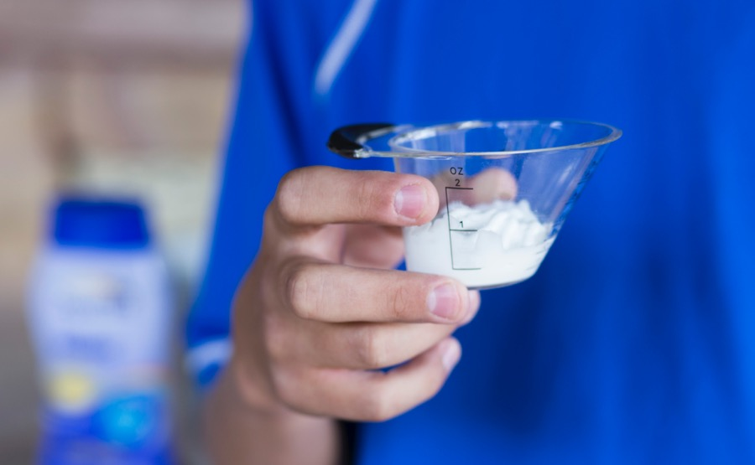
WHAT YOU CAN DO
Protect your DNA
Use 1 ounce of sunscreen each time you apply

Slide 32
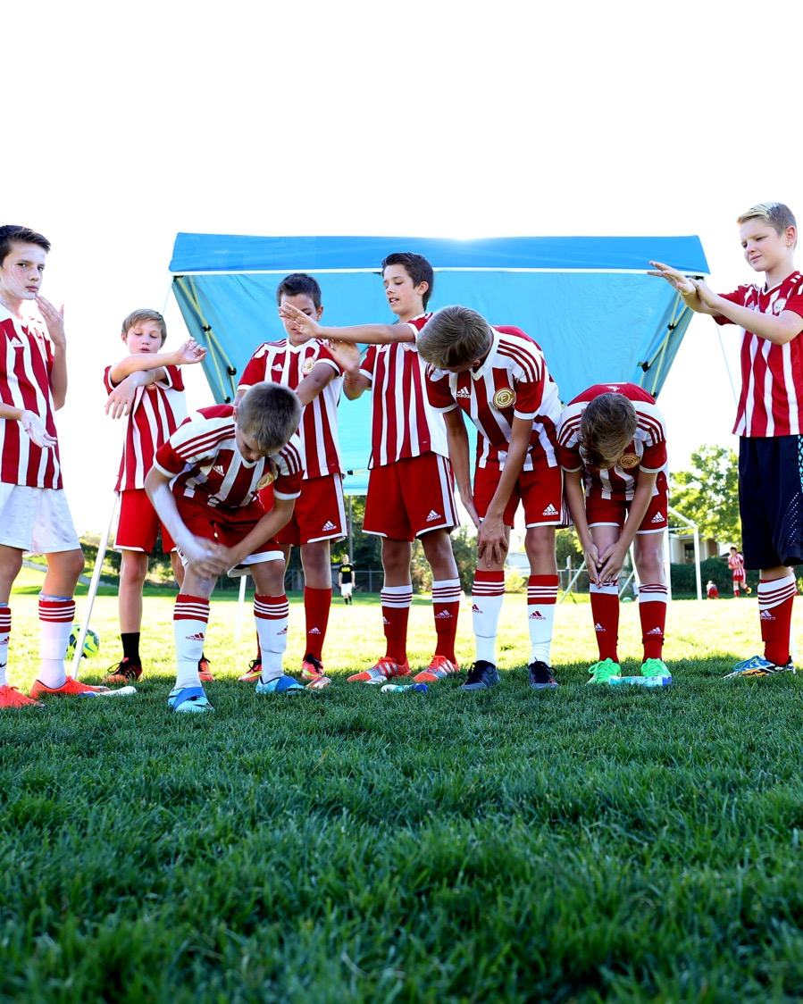
WHAT YOU CAN DO
Protect your DNA
Seek shade whenever possible.

Slide 33
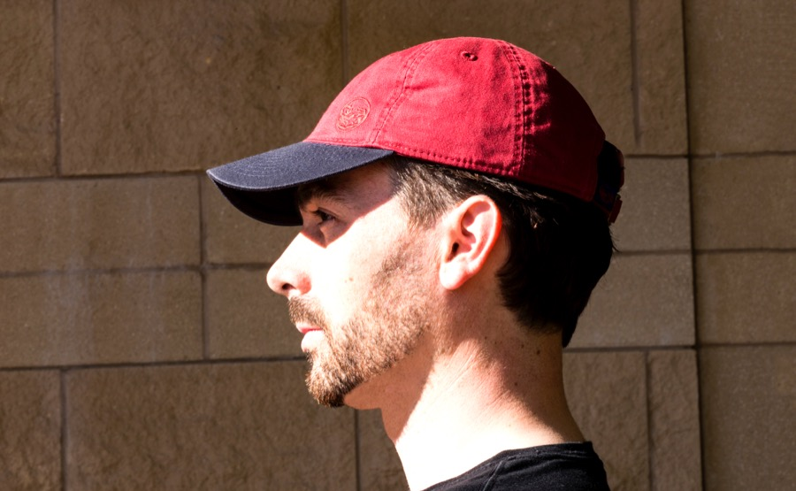
WHAT YOU CAN DO
Protect your DNA
Physical barriers:
Wear a hat with a 4-inch-wide brim all the way around
Wear sunglasses with UV protection
Good barriers
Poor barriers

Slide 34
Strategies for Addressing Families’ Barriers to Adherence

Slide 35
FLARE Study
Behavioral & organizational strategies
Forgetting, discomfort, limited time, incomplete sunscreen application, managing child behavior
Routine changes
Communication strategies
Within family communication, clear responsibilities & skin protection plan
Consistency across caregivers
Handling peer opposition
Problem-solving skills for family-specific barriers
Notes:
Behavioral & organizational strategies, problem-solving skills, communication techniques

Slide 36
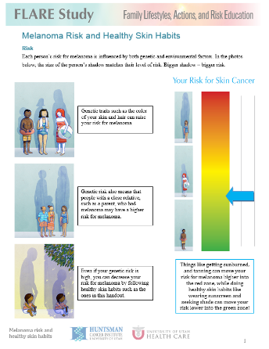
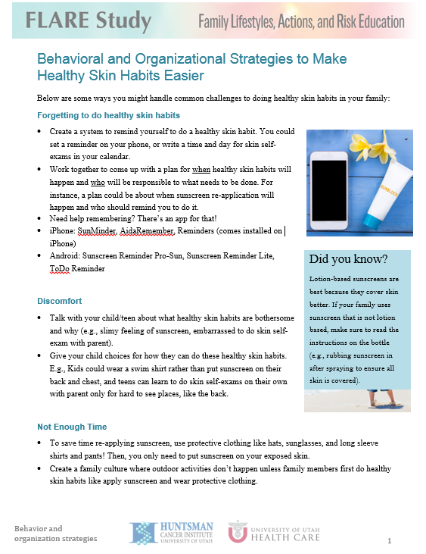

Slide 37
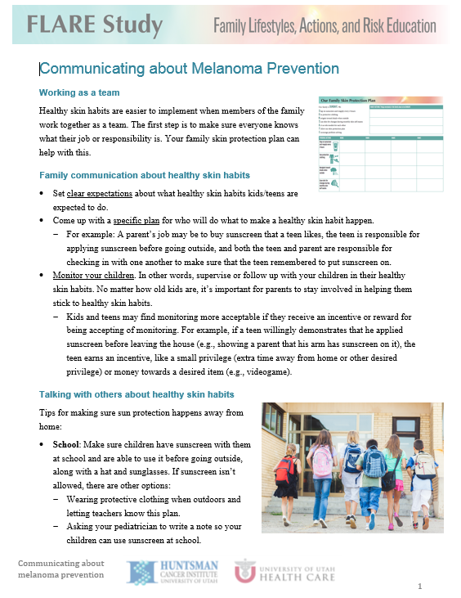

Slide 38
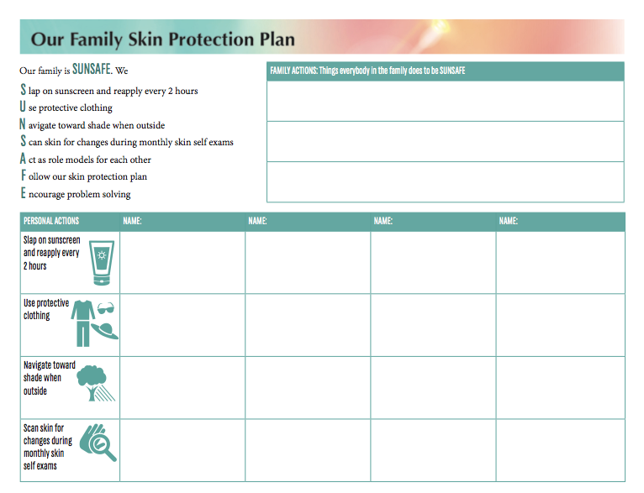

Slide 39
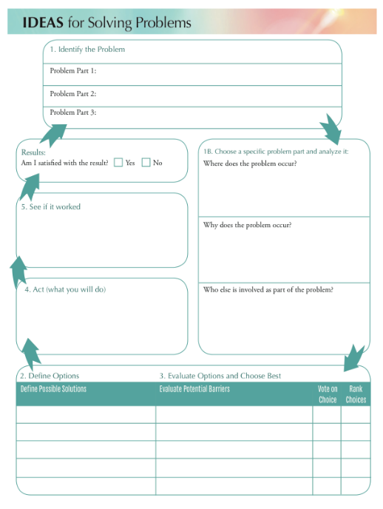

Slide 40
Your Questions and Comments
Lisa.Aspinwall@utah.edu
Yelena.wu@utah.edu

Slide 42
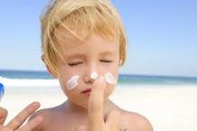
Poor adherence to melanoma preventive behaviors
Children with a parent with melanoma are no better at preventive behaviors than general population
42% use sunscreen
39-51% with recent sunburns
Our pilot data from p16 families (highest risk group)
80% inconsistent sunscreen use
90% inconsistent use of long sleeves
75% at least 1 painful/red sunburn in last year
40% doing monthly self skin-exams
Geller, 2002; Glenn, 2015
Notes:
What I had in last year’s presentation:
28-54% of adults with first-degree relative with melanoma use sunscreen/physical barriers regularly
Initial results with children (BRIGHT Kids)
80% inconsistent sunscreen use
90% inconsistent use of long sleeves
75% at least 1 painful/red sunburn in last year
40% doing monthly self skin-exams

Slide 43
SPARK Study: 39 parents, 37 children
 | n | %
Mother Father | 32 7 | 82 18
Personal history of melanoma (parent) | 36 | 92
Child’s race: White | 39 | 100
Child’s sex (female) | 12 | 32
 | Mean | SD
# minor children in family | 2.4 | 0.8
Age of child participant | 11.3 years | 2.6

Slide 44
Study Design
Baseline
Session 1
Session 2
Session 3
Post-assess
Follow-up
2 week intervals
4 weeks
REDCap assessments

Slide 45
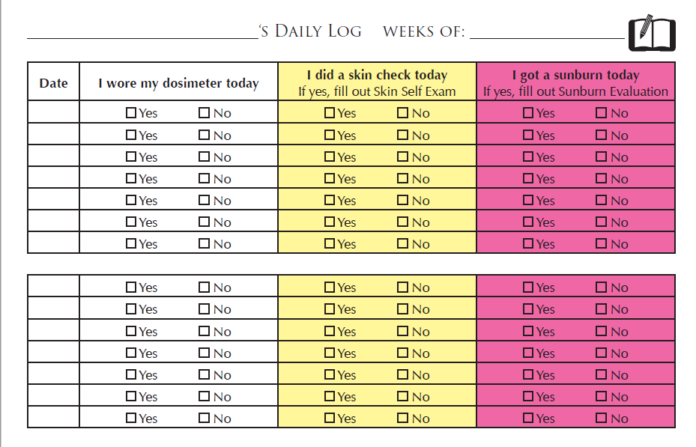
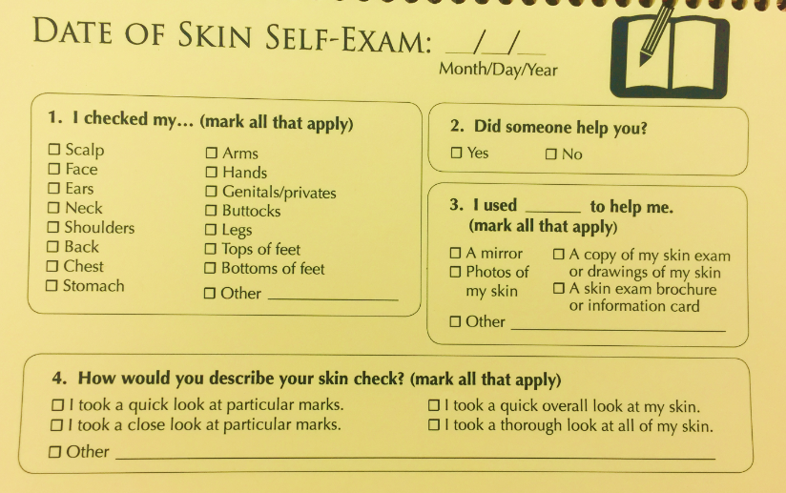
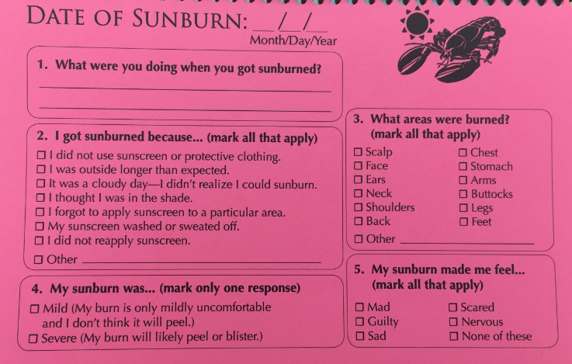

Slide 46
What can we learn from other studies or interventions to apply to our own research interests?
Is there a value in integrating findings and research efforts across health domains?

Slide 47
These are some current funding opportunities that have “crosstalk” flavored throughout:
Leveraging Cognitive Neuroscience Research to Improve Assessment of Cancer Treatment Related Cognitive Impairment (PAR-16-212 [R01] and PAR-16-213 [R21])
Predicting Behavioral Responses to Population-Level Cancer Control Strategies (PAR-16-257 [R21])
Improving Smoking Cessation in Socioeconomically Disadvantaged Populations via Scalable Interventions (PAR-16-201 [R21] andPAR-16-202 [R01])
Innovative Approaches to Studying Cancer Communication in the New Media Environment (PAR-16-248 [R21] and PAR-16-249 [R01])
Cancer-related Behavioral Research through Integrating Existing Data (PAR-16-255 [R21] and PAR-16-256 [R01])
Stimulating Innovations in Behavioral Intervention Research for Cancer Prevention and Control (PAR-16-278 [R21])
NCI Behavioral Research Program

Slide 48
C-FAHR
Call for Proposals
2016-2017

