Slide 1


Fall Symposium
September 12, 2016

Slide 2

The Cluster is Complete
Kim Kaphingst
Daniel Adkins
Bruce Ellis
Pascal Deboeck

Slide 3
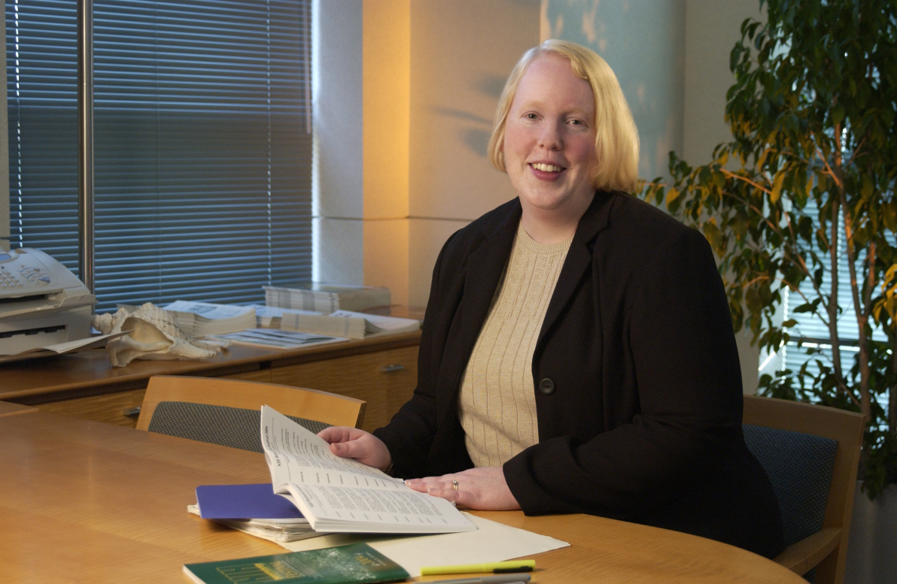
Kim Kaphingst

Slide 4
Bruce J. Ellis, Ph.D.
Departments of Psychology and Anthropology
Cross-disciplinary focus
  Developmental psychology
  Biological Anthropology
I seek to leverage knowledge from both evolutionary biology and developmental science
  address issues in developmental psychopathology
  especially in relation to child and adolescent health
Empirical work examines the impact of fathers, family relationships, and socioecological conditions
  children’s biological stress responses
  timing of pubertal development
  risky adolescent behavior and cognition
  related health outcomes.

Slide 5
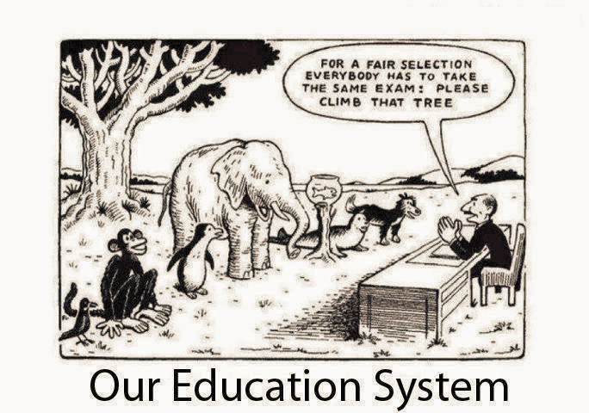
Research Network on Adaptations to Childhood Stress
  (Robert Wood Johnson Foundation)

Slide 6
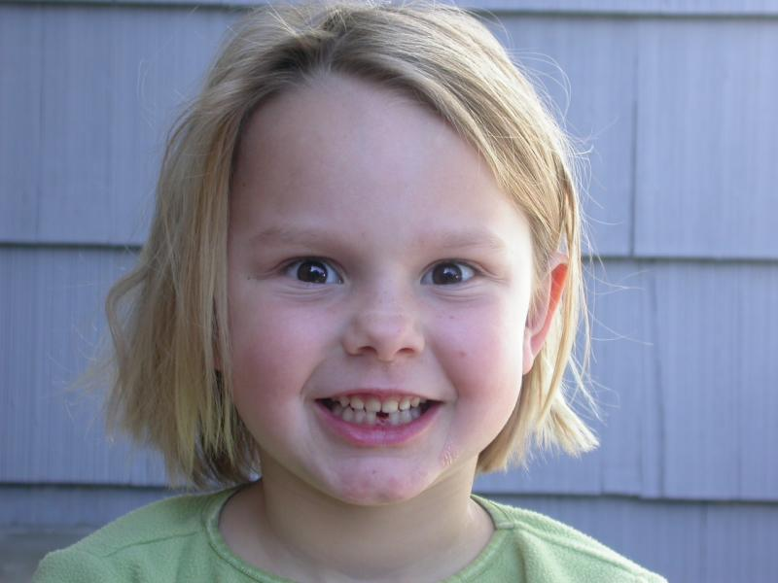
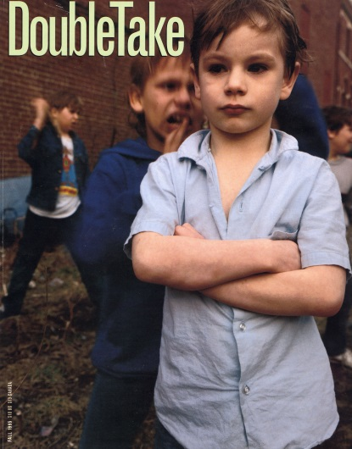
Developmental Programming
  Developmental programming of sexual and reproductive strategies
  Special influence of fathers on daughters
Biological sensitivity to context
  An exaggerated susceptibility to both protective and harmful aspects of social environments
Maskrosbarn (Sw): dandelion child
Orkidebarn: orchid child

Slide 7
Daniel E. Adkins, PhD
Department of Sociology,
College of Social and Behavioral Science
Department of Psychiatry,
School of Medicine

Slide 8
Intellectual Trajectory
PhD Sociology, UNC-Chapel Hill
  Studied Statistics (particularly SEM and longitudinal modeling), Inequality, and Demography; NIMH F31 training in GxE at the Carolina Population Center
Assistant Professor, VCU Center for Biomarker Research and Precision Medicine
  NIMH K01 training in Statistical Genetics and Bioinformatics; Conducted research in Psychiatric genomics and Epigenomics
  -Adkins et al., Social Forces, 2009 -Adkins et al., TRHG, 2015

Slide 9
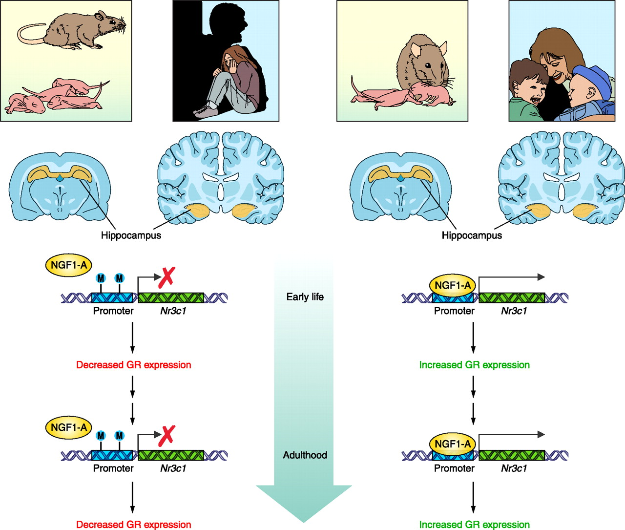
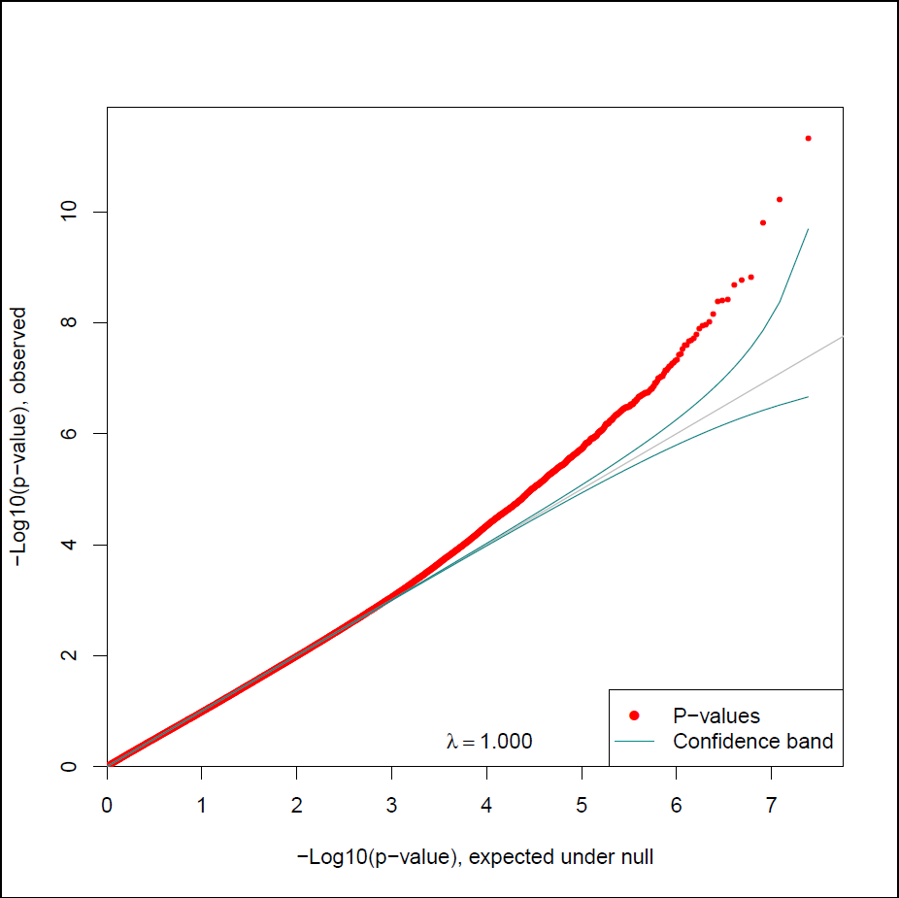
Current Research Interests
Integrating social inequality perspectives on stress with genomic big data to map how social disadvantage becomes epigenetically encoded, thus influencing downstream gene expression, health and behavior.

Slide 10
Pascal R. Deboeck
Department of Psychology

Slide 19
The Cluster is Complete
Kim Kaphingst
Daniel Adkins
Bruce Ellis
Pascal Deboeck

Slide 20
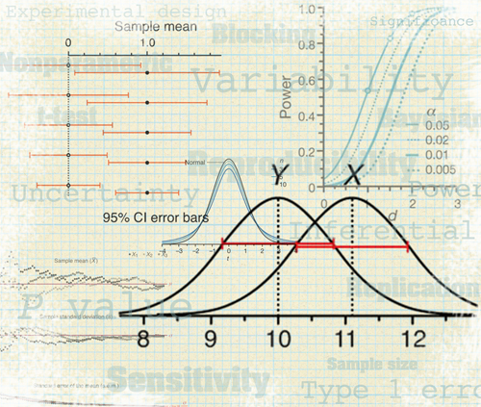
Statistical Consultation
Provided by faculty members, Daniel Adkins & Pascal Deboeck
See C-FAHR blog for more information
http://c-fahr.blogspot.com/2016/09/statistical-consultation-for-c-fahr.html
FREE to C-FAHR members.

Slide 21

Summer Methods Workshop
An Applied Introduction to Dynamical Systems Modeling of Families and Health Data
June 20-24
Jonathan Butner & Brian Baucom

Slide 22

Student Research Awards
Spring 2016
Student PI | Faculty Advisors |  | Title/Topic
Ashley Elrick |  | K. Kaphingst Communication | Examining Health Topic Avoidance Within Families to Inform Intervention Development
Chelsea Gourley & Ashley Donham |  | M. Diener Human Devlpmnt & Social Policy | Child Life’s Role in Managing the Stress of Pediatric Diabetes
Robert Kent de Grey |  | B. Uchino Psychology | Development and Validation of an Online Social Support Measure
Djin Lai |  | L. Ellington Nursing | A Feasibility Study: Dyadic Coping and Concordance of End of Life Decisions in Home Health Patients and their Family Caregivers
Brendan Ostlund |  | L. Conradt & T. Drew Psychology | Brains in Bloom (BiB) Study
Corinna Trujillo Tanner |  | M. Caserta Nursing | Posttraumatic Growth among Older Adults with Vision Loss Caused by Age Related Macular Degeneration
Rumei Yang |  | L. Edelman Nursing | Fear of Falling in Older Adults and Corresponding Fears in Family Caregivers: Dyads Coping with Fall Risks
Coming soon!
Fall/Winter 2016 request for proposals (pilot funds)

Slide 23
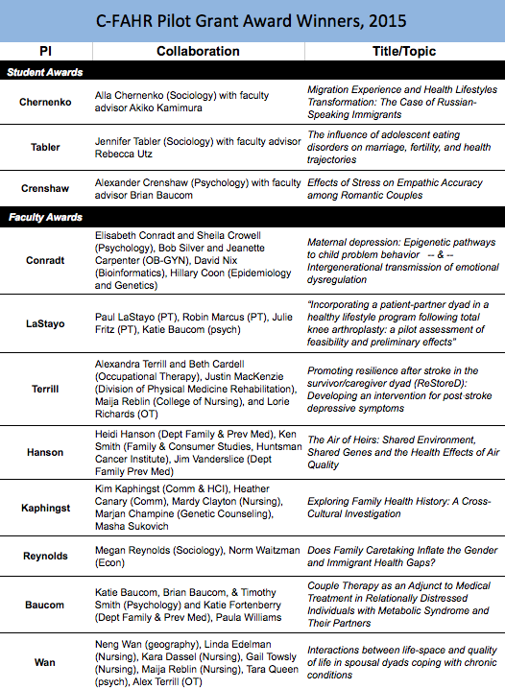
Research Presentation

Slide 24
Promoting Resilience after Stroke in the survivor/caregiver Dyad (ReStoreD):
Developing an intervention
Alexandra Terrill
Beth Cardell
Lorie Richards
Justin MacKenzie
Maija Reblin

Slide 25
Introduction
Stroke is the leading cause of physical and cognitive long-term adult disability. Many stroke survivors rely on a spousal caregiver for long-term support.
Depressive symptoms post-stroke occur in 30-50% of survivors and caregivers, and have major consequences on function and quality of life.
Research in stroke survivors and caregivers has highlighted the interconnected nature of a couple’s emotional health.
Stroke survivors and caregivers face significant challenges, yet interventions to support couples after stroke are largely lacking.
Our study aimed to address this gap.

Slide 26

Objective
The purpose of this study was to (1) develop and (2) test the feasibility of an 8-week dyadic intervention based on positive psychology for couples coping with post-stroke depression.

Slide 27
Why Positive Psychology Intervention (PPI)?
Sustaining well-being in both partners is important for engagement in rehabilitation and community re-integration.
Resilience plays crucial role
A potential way to enhance resilience is through PPIs:
  Promote psychological strengths and resources to increase well-being
  PPIs are brief, self-administered activities with minimal adverse effects, are less expensive and time consuming than psychotherapy
  Though not yet tested in stroke, PPIs are effective at reducing depression and increasing well-being in various populations.

Slide 28
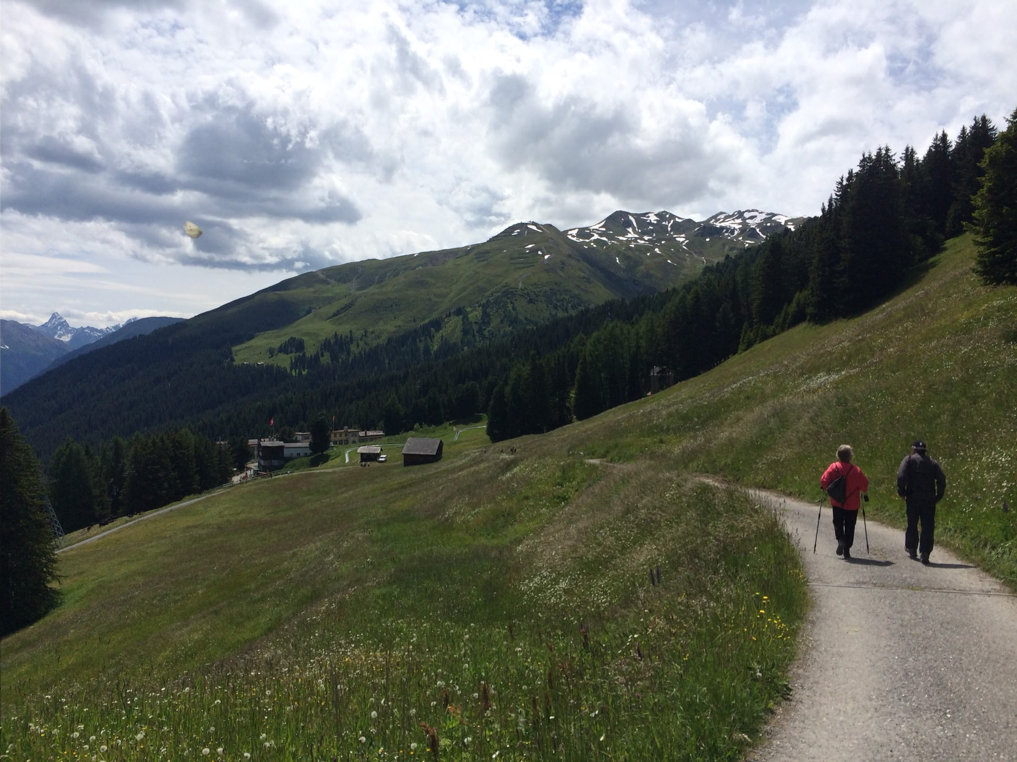
Methods: Development (Aim1)
Created PPI activity booklet and tracking calendar based on existing PPI used in individuals with spinal cord injury
Activities selected based on empirically supported evidence for improving depressive symptoms and/or increasing well-being
Material reviewed by 5 stakeholders.
PPI Activities
Expressing gratitude | Savoring
Practicing acts of kindness | Working toward goals
Fostering relationships | Spirituality
Focusing on the positive
Expressing gratitude: Practicing acts of kindness: Fostering relationships:. Focusing on the positive: Working toward a goal: Spirituality:

Slide 29
Methods: Feasibility (aim 2)
Four dyads randomly assigned to PPI group, one to active control. Participants engaged in an 8-week self-administered intervention, completing two PPI activities alone and two together each week.
  Provided activity booklet and tracking calendar to help complete activities at home and we made weekly check-in calls.
  3 In-person assessments: pre-, post-intervention, and 3-month follow-up. Self-report and interactive tasks.
Main Outcome Measures: Feasibility of study design, recruitment and study procedures, and acceptability of the intervention (feedback questionnaire/interview).

Slide 30

Results

Slide 31
Participants were recruited through University-affiliated outpatient rehabilitation clinics and participant databases (in-person and mailed letters).
n=89
9% response rate to recruitment letters
Responded n=8
63% of respondents were eligible
Eligible n=5 couples
Inclusion criteria: Couples consist of one partner who had a stroke >6 months ago and a cohabiting partner who self-identifies as caregiver and is also willing to enroll. One or both partner(s) report depressive symptoms.
Exclusion criteria: Significant cognitive (MoCA <19), language, and/or perceptual impairment that would interfere with ability to read and understand printed instructions.
100% enrollment of eligible participants
Enrolled n=5 couples
Withdrew (health changes in caregiver) n=1
80% retention
Completed baseline, 8-week post-intervention, and 3-month follow-up
n=4 couples

Slide 32

Participant characteristics
Five heterosexual married couples (10 individual participants)
Predominantly White (80%) and well-educated (50% had a 4-year college degree or higher)
Mean age = 53.5 years (range 36 - 84).
Couples’ relationship duration ranged from 15 to 65 years (mean = 35 years).
Time since stroke ranged from 18 months to 5 years.
Stroke types/locations varied

Slide 33
Results: Adherence and Acceptability
Participants engaged in activities for at least 6 out of 8 weeks.
Preliminary questionnaire and interview data reflected participant satisfaction and benefit in mood, affect, dyadic coping, and quality of life.
Feedback Survey | Stroke Survivor | Partner Caregiver | Overall
 | M (SD) | M (SD) | M (SD)
Overall benefit of the intervention (0-4) | 3.5 (.58) | 3.0 (.82) | 3.25 (.71)
Negative effects related to the intervention (0-4) | 0.75 (.96) | 0.50 (1.0) | 0.63 (.92)
Positive effects related to the intervention (0-4) | 3.25 (.50) | 3.25 (.50) | 3.25 (.46)
Satisfaction with the intervention (0-4) | 3.75 (.50) | 3.25 (.96) | 3.50 (.76)
Difficulty in completing required number of weekly activities (0-4) | 1.00 (1.16) | 1.75 (1.50) | 1.38 (1.30)

Slide 34
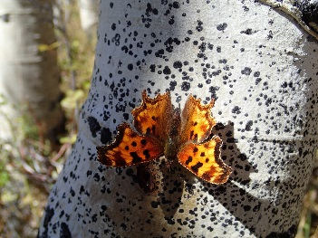
Feedback (stroke survivor)
“It’s hard to look at what’s eating at you, and then to try to change that, because it’s easier just to sit and do nothing than to show gratitude, to help people out, to savor things, to do all those things on that list.”
“... I was surprised that I’m very grateful to be alive... showing gratitude for others, for my wife, for my child, for my family, you can get stuck in this hole where everything is about you, and I was, am sick of that hole. So, doing the activities, it helped me tremendously. “

Slide 35
Feedback (caregiver)
(about survivor)“I know that it’s helped him with the stroke and the way that his brain works. I know that it’s helped him a lot to just have that time to focus, to stay positive... It just kind of re-boosts his energy.”
(about self)”...that sets the tone for house life, family life, school life, so, with me being more centered and calm, and happy, because I’ve felt good and at peace, then I’ve been able to not get stressed and not get angry. Not saying that I never did over the last 8 weeks, but not as much. And it was easier to just overlook certain things that would normally kind of bother me... I’m like, eh, not that big of a deal, I’ve already mentally prepared for that.”

Slide 36
Conclusions...
The PP intervention is feasible for implementation with couples coping with stroke sequelae.
This represents a first step in a novel dyadic approach in this population.
Response rate, loss of enrollment due to eligibility, attrition, and feedback will be used to inform the planned larger pilot trial.

Slide 37

...and what’s next
Larger randomized wait-list controlled pilot trial with 25 couples
  R03 application currently under review
  Effectiveness for improving mood and well-being
  Explore potential mechanisms
Telehealth
Apply to different rehab populations
  Proposal currently under review
*Contact email: alex.terrill@hsc.utah.edu

Slide 38

Thank you: C-FAHR
Our participant couples
Collaborators: Cindy Berg, Beth Cardell, Justin MacKenzie, Jennifer Majersik, Maija Reblin, Lorie Richards
U of U Clinics:
Life Skills Clinic
Neurology Stroke Clinic
Rehabilitation & Wellness Clinic
Stroke Rehabilitation Clinic
A fantastic team of graduate students:
Jackie Einerson*
Stacey Bateman
Meghan Berry
Robyn Carver
Clint Ctibor
Kaitlin Huntington

Slide 39
References
Ayerbe, L., Ayis, S., Wolfe, C. D., & Rudd, A. G. (2013). Natural history, predictors and outcomes of depression after stroke: systematic review and meta-analysis. Br J Psychiatry, 202(1), 14-21.
Bakas, T., Clark, P. C., Kelly-Hayes, M., King, R. B., Lutz, B. J., & Miller, E. L. (2014). Evidence for stroke family caregiver and dyad interventions: a statement for healthcare professionals from the American Heart Association and American Stroke Association. Stroke, 45(9), 2836-2852.
Bolier, L., Haverman, M., Westerhof, G. J., Riper, H., Smit, F., & Bohlmeijer, E. (2013). Positive psychology interventions: a meta-analysis of randomized controlled studies. BMC Public Health, 13, 119.
Grant, J. S., Clay, O. J., Keltner, N. L., Haley, W. E., Wadley, V. G., Perkins, M. M., & Roth, D. L. (2013). Does caregiver well-being predict stroke survivor depressive symptoms? A mediation analysis. Top Stroke Rehabil, 20(1), 44-51.
McCarthy, M. J., Lyons, K. S., & Powers, L. E. (2011). Expanding poststroke depression research: movement toward a dyadic perspective. Top Stroke Rehabil, 18(5), 450-460.
Perrin, P. B., Heesacker, M., Stidham, B. S., Rittman, M. R., & Gonzalez-Rothi, L. J. (2008). Structural equation modeling of the relationship between caregiver psychosocial variables and functioning of individuals with stroke. Rehabilitation Psychology, 53(1), 54-62.
Sin, N. L., & Lyubomirsky, S. (2009). Enhancing well-being and alleviating depressive symptoms with positive psychology interventions: a practice-friendly meta-analysis. J Clin Psychol, 65(5), 467-487.

Slide 40
Research Presentation

Slide 41
Does Family Caregiving Inflate the Gender and Immigrant Health Gaps?
Megan M. Reynolds & Norman J. Waitzman
September 12, 2016

Slide 42
Background
Popularity of “healthy migrant” hypothesis
Exploration of hypothesis generalizability vis-à-vis ethnic origin and gender
Findings on gender health gap within foreign- and native-born (FB, NB) populations (JHSB, 2012)
Mediating role of contact with healthcare system
Candidate explanation for healthcare contact differential: family care responsibilities (FCR)

Slide 43
C-FAHR Proposal
Focus on health at family level
NHIS-MEPS advantages for causal inference
Research assistance with NHIS-MEPS
Data access issues
Exploiting existing NHIS strengths

Slide 44
Methods
Merging & appending household, family, person and sample adult files
Conceptualization & operationalization of FCR
  child, play limitations, special education, elder, activity limitation, poor health, care visits 10+
Conceptualization & operationalization of healthcare contact
  pap, cholesterol, blood sugar, blood pressure
Hypothesizing mechanisms
  H1a,b: exposure to FCR will be greater for women and NB
  H2a,b: vulnerability to FCR will be greater for women and NB
Testing differences
  summary statistics, cross-tabulation, multivariate logistic regression, marginal effects contrasts

Slide 45
Testing Assumptions
Is FCR associated with healthcare contact?
Cholesterol as outcome
Support from bivariate analysis (6 of 7 FCR measures)
Additional support from multivariate analysis (7 of 7 FCR measures)

Slide 46
Testing H1a
Hypothesis: exposure to FCR will be greater for women
Test: comparison of male and female proportions for seven FCR variables
Results: 7 of 7 greater for women; supportive of hypothesis

Slide 47
Testing H1b
Hypothesis: exposure to FCR will be greater for NB
Test: comparison of native-and foreign-born proportions for seven FCR variables
Results: 6 of 7 greater for NB (not children); supportive of hypothesis

Slide 48
Testing H2a
Hypothesis: vulnerability to FCR will be greater for women
Test: cross-tabulation of seven FCR variables by gender, logistic regression of cholesterol check on interaction of gender*FCR and confounders, test of significant difference between men and women in the marginal effect of seven FCR variables on probability of cholesterol check
Results: 3 of 7 greater vulnerability for men (elder, poor health, care visits 10+), rest NS; not supportive of hypothesis

Slide 49
Testing H2b
Hypothesis: vulnerability to FCR will be greater for NB
Test: cross-tabulation of seven FCR variables by nativity, logistic regression of cholesterol check on interaction of nativity*FCR and confounders, test of significant difference between native- and foreign-born in the marginal effect of seven FCR variables on probability of cholesterol check
Results: 3 of 7 greater vulnerability for FB (special ed, activity limitation, elder), rest NS; not supportive of hypothesis

Slide 50
Conclusions
Findings supportive of exposure hypotheses
Findings contrary to vulnerability hypotheses
Points to exposure as driver of observed link between FCR and healthcare contact
Vulnerability findings potential explanations
  strong gender norms around health-seeking behaviors for women render FCR less meaningful for healthcare contact
  societal barriers around healthcare access for FB render FCR more meaningful for healthcare contact
Confidence afforded by cholesterol as healthcare contact measure

Slide 51
Future Directions
Research
  More direct measures of FCR
  Alternative measures of healthcare contact
  Relationship to diagnoses
  Role of individual healthcare coverage
  Role of state-level healthcare policy
  Sensitivity to age, SES, race
Funding
  Agency for Healthcare Research and Quality (R03, Fall)

Slide 52
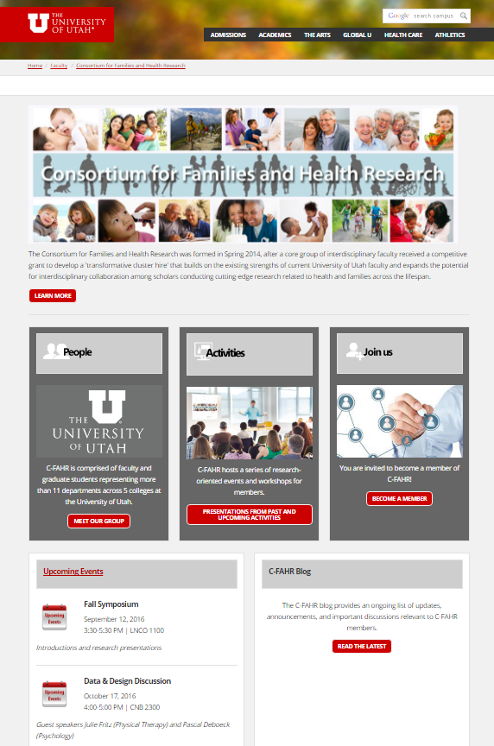
New Website
http://www.utah.edu/faculty/c-fahr/
Refer to our website for a list of our monthly events:
    http://c-fahr.blogspot.com/2016/08/2016-2017-events.html
Encourage your colleagues to become members:
    http://www.utah.edu/faculty/c-fahr/membership/index.php
Coming soon! An intranet for members-only resources.
Reach out to us with ideas, suggestions, interests:
    C-fahr-info@utah.edu

Slide 53
Mix, Mingle.
We challenge you to meet one new person before leaving!

