Slide 1
Spring 2016
Year in Review

Slide 2
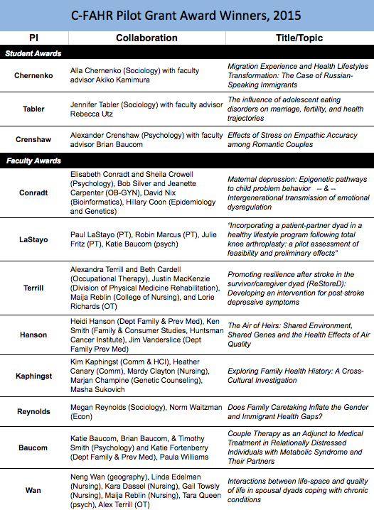
Interdisciplinary Research
Collaborations

Slide 3
Investigating family communication about health among Caucasians, Latinos, and Pacific Islanders.
Ashley Elrick, Heather Canary, Manusheela Pokharel,
Mardie Clayton, Masha Sukovic, Marjan Champine,
Kimberly Kaphingst

Slide 4
Investigating Family Communication about Health among Caucasians, Latinos, and Pacific Islanders
Ashley Elrick, Heather Canary, Manusheela Pokharel, Mardie Clayton, Masha Sukovic, Marjan Champine, Kimberly Kaphingst
April 25th, 2016

Slide 5
Family health history (FHH) provides critical risk information
Family history information can be used to tailor prevention and screening recommendations
Screening guidelines for skin, breast, colorectal, ovarian, and prostate cancer based on family history
Notes:
prevention and promotion activities, screening /precaution recommendation,

Slide 6
Communication critical to use of family history
Communication between providers and patients
Health care providers do not collect detailed FHH (Flynn et al., 2010; Murff et al., 2004, 2007)
Communication within families
Just 29.4% of U.S. adults collect FHH information (CDC, 2004)
Interventions to improve communication needed
Notes:
prevention and promotion activities, screening /precaution recommendation,

Slide 7
Family health history tools
Over 75 FHH tools developed (Wang, Gallo, Fleisher, & Miller, 2011)
Few studies evaluate their use in a public setting (Petruccio et al., 2008)
Most developed with little patient or community input

Slide 8
Research gaps
Majority of previous studies focus on Caucasians
(e.g., Hovick, 2014; Kelly et al., 2015; Parrott, Hong, & Greenberg, 2015; Rauscher & Hesse, 2014)
If not, the focus is on African Americans
(e.g., Hovick et al., 2014; Thompson et al., 2015; Thompson et al., 2013; Yamasaki & Hovick, 2015)
Other racial and ethnic groups are rarely included
Notes:
These are the groups with low literacy and need for collecting FHH
It is important to understand the family process involved in collecting FHH, especially for developing tools, marketing strategies, interventions, and screening procedures. We must acknowledge that a one size fits all model might not work for most families or a variety of racial and ethnic groups.

Slide 9
Study Aims

Slide 10
Aim 1) Investigate understanding of FHH and shared familial risk, family communication about health, and family roles related to health within and across family dyads.
Aim 2) Explore how factors examined in Aim 1 are related to participants’ responses (i.e., acceptability, usability, interest) to FHH tools based on the biomedical and the social contextual approach.
Notes:
Manu

Slide 11
New Multidisciplinary Team
Health communication and genetics (Kimberly Kaphingst; PI)
Family and health communication (Ashley Elrick)
Family systems and communication (Heather Canary)
Qualitative methods (Kaphingst, Canary)
Nursing and health communication (Margaret Clayton)
Genetic counseling (Marjan Champine)
Intercultural communication (Masha Sukovic)

Slide 12
Methods

Slide 13
Study Sample
30 family dyads
10 dyads for three racial and ethnic groups
Caucasian, Hispanic/Latino, Pacific Islander
Combination of siblings and parent-child dyads
90+ minutes long interviews
Individual & dyadic interview
Notes:
Ashley
The dyads include various family member combinations consisting of siblings (i.e., sister/sister, brother/brother, sister/brother) and parent-child (i.e., mother or father with daughter or son)
Participants received a $50 gift card each in thanks for their time.

Slide 14
Recruitment
Campus flyers
Community groups
Word of mouth

Slide 15
Individual and joint interviews
Allow for a unique perspective
(Eisikovitz & Koren, 2010):
Individual- personal stories & sensitive topics
Joint- shared narrative & examine of roles
Notes:
The individual interview allows for personal stories and to discuss topics that are sensitive or not shared with others while the joint interview creates a joint picture with shared narrative and examination of the roles in the relationship

Slide 16
Interview Structure
Welcome materials
Individual Interviews
Family health history questionnaires
Surgeon General: “My family health portrait”
Genetics Alliance: “A guide to family health history”
Joint Interview
Reflections on Interview
Notes:
The first person interviewed is always the individual that contacted the research scheduler and the additional family member is taken to a room next door to review the family health history questionnaires. Once the first individual interview is complete, the participants switch locations for the second portion of the interview. Finally, the family members are brought together for a dyadic interview at the end.
During the individual interviews, the protocol covers topics such as who do they consider family, what is health, what health topics are and are not discussed, the different roles of family members related to health, and thoughts on genetic testing. For the dyadic portion of the interview, both family members are asked questions about the diseases or conditions that run in the family, decision making, strategies or barriers to sharing health information, reactions on the family health history questionnaires they reviewed, and thoughts on prenatal and newborn screening.

Slide 17
Coding Approach & Development
Coding interview transcripts
Developed codebook based on:
Prior literature
Research objectives
Theoretical perspectives
Participant responses
Detailed description and examples of each code
Constant comparative method

Slide 18
Coding Process
Team coding of 2 transcripts
Initial codebook development
Two coders independently coding each transcript
Dual coding of 20% to calculate inter-coder reliability
Notes:
Ashley
Caucasian sibling and Pacific Islander sibling dyads (team coding)
Hispanic sibling dyad (1st independent coding)
Cohen’s Kappa & percent agreement
Individual coding with independent coding of 20% to ensure continued reliability

Slide 19
Preliminary Results

Slide 20
Participants
Caucasian |  | Hispanic/Latino |  | Pacific Islander
Sibling | Parent/Child | Sibling | Parent/Child | Sibling | Parent/Child
(1) Sister-Sister | (4) Mother-Daughter | (3) Sister-Sister | (2) Mother-Daughter | (2) Sister-Sister | (1) Mother-Daughter
(1) Brother-Brother | (1) Father- Daughter | (1) Brother-Brother | (2) Mother- Son | (2) Brother-Brother | (1) Mother- Son
(2) Sister-Brother | (1) Father-Son | (1) Sister-Brother | (1) Father- Daughter | (1) Sister-Brother | (2) Father- Daughter
 |  |  |  |  | (1) Father-Son

Slide 21
Participants Demographics
Age: 35 years old (Range 18-74)
Gender: 62% Female; 38% Male
Marital Status: 48.3% Married; 41.7% Never Been Married
Religion: 63% LDS; 18% No affiliation; 10% Catholic
Education: 18% up to a HS diploma/GED; 67% Some college or college degree; 25% Some graduate courses or graduate degree

Slide 22
To investigate the awareness of shared familial risk of disease
Shared knowledge, gaps, and the gender or cultural differences influence the knowledge of the familial risks
Example: Shared knowledge
Daughter Dyad: And obviously, there’s something with the women’s reproductive equipment because….
Mother Dyad: Everybody ends up with a hysterectomy don’t they?
Daughter Dyad: Yeah
Notes:
Transcript #3

Slide 23
Example: Shared knowledge
Mother Dyad: Cancer, yeah, and uh… yeah breast cancer.
Sister 1 Dyad: Diabetes
Sister 2 Dyad: Diabetes
Sister 2 Dyad: Alzheimer’s might just because of Grandma.
Sister 1 Dyad: Yeah.
Sister 2: And then I feel like high blood pressure, maybe high cholesterol and all those heart related problems.
Sister 1: I would agree.
Notes:
Transcript #12
Transcript #4

Slide 24
Example: Difference in Understanding
Sister 2 Dyad: Yeah. Our uncles on my dad’s side have diabetes. I don’t know if you know this, dad has diabetes…...
Sister 1 Dyad: Does he really?
Sister 2 Dyad: He has….
Sister 1 Dyad: Since when?
Sister 2 Dyad: A few months. Don’t tell him I told you. Don’t tell him.
Sister 1 Dyad: I’m surprised Mom didn’t tell me.
Notes:
Transcript #4

Slide 25
Example: Difference in Understanding
Daughter Dyad: I think in some ways it can be limiting because she knows all the things that I don’t know and I know that she doesn’t know so sometimes we can cross and learn from each other, but there are also a lot of things that we do not even think to talk about.
Daughter Dyad: Dyslexia.
Mother Dyad: No!
Daughter Dyad: Oh yeah….
Notes:
Transcript #12
Transcript #12

Slide 26
Examples: Gender
Brother 1 Dyad: Yeah, I mean, if anything, when it comes to if a guy has a “guy issue” per se, or if a girl has a … I could see someone saying something and then someone from the other gender being like, “Oh gross.” But it’s just a joke, and if it was a serious matter, then it’s...
Sister 1: Yeah, like I wouldn’t– I probably wouldn’t want to ask my uncles or my brothers, just because it’s stuff that has to do with the body, and you don’t really talk to the males about that. Something that I’d talk to my mom or my aunts about
Notes:
Transcript #19
Transcript #14

Slide 27
Examples: Culture
Brother 1: Well, I just think it just goes back to culture. There’s really no filter, sometimes. You know, and it’s just if we have diarrhea, you tell someone, “Oh, I have diarrhea.” And, you know, <laugh> it’s just like very– I think it’s different from culture from an American culture, where it’s like, well, if your stomach– you just say your stomach’s sick. You don’t say you have diarrhea.
Notes:
Transcript #19

Slide 28
Discussion

Slide 29
Ongoing Analysis Plans
Continuing coding based on our codebook
Memos and annotations for interesting quotes, ideas, queries, or analysis ideas
Notes:
Manu

Slide 30
Future Plans
Papers Proposed
Shared knowledge of FHH
Family roles related to FHH
FHH tools and perceptions
Differences in health beliefs by culture
Family communication and topic avoidance
Grants
NIH
Notes:
Ashley

Slide 31
Acknowledgements
Research Team- Heather Canary, Manusheela Pokharel, Mardie Clayton, Masha Sukovic, Marjan Champine
Participants
Community Faces of Utah
C-FaHR Pilot Grant Funding

Slide 32
Spring 2016
Year in Review

Slide 33
An interdisciplinary group of researchers interested in families and health across the life course.
How can the family be used as a vehicle for promoting health and/or managing to chronic illnesses?
How do these family-based outcomes and strategies vary across developmental life stages (infancy, childhood, adolescence, across adulthood)?

Slide 34
Spring 2014
Idea & Funding
Summer 2014
Executive Committee
Fall 2014
Kick-Off Meeting
Symposium & Research Mixer
Winter 2015
Student Interest Groups
Pilot Grant Program
2015-2016
Cluster Hiring
Membership Recruitment
It has not been that long …..
What is next? ………………

Slide 35
Research Fund
May 1 – Graduate Student Research Award
up to $1000 to support research needs of grad student
1 page proposal, plus letter of support from faculty advisor
Students and faculty must be C-FAHR member; membership application can be submitted along with proposal
Pilot funds for collaborative research projects will be available again…. later this summer, early fall. Stay tuned.

Slide 36
Summer Methods Workshop
An Applied Introduction to Dynamical Systems Modeling of Families and Health Data
June 20-24
Jonathan Butner & Brian Baucom

Slide 37
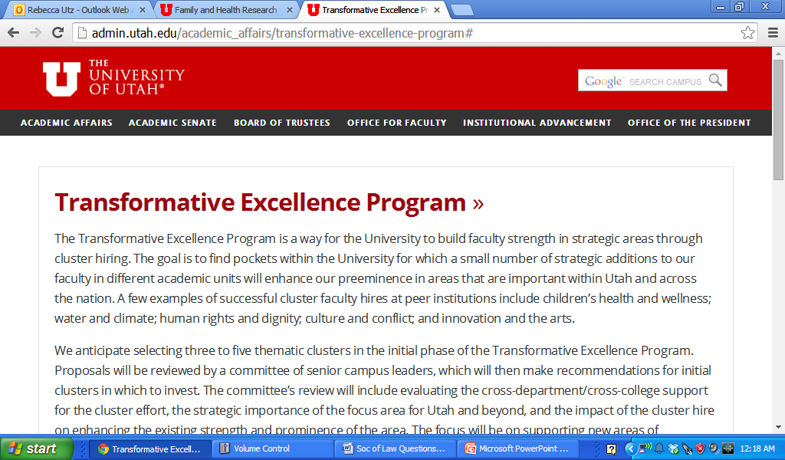
Cluster-Hiring
Kim Kaphingst
Daniel Adkins
Bruce Ellis
Pascal Deboeck

Slide 38
Ideas?
Opportunities?

