Slide 1
Communication & Health

Slide 2
Ascher Munion – Psychology
a.munion.psych@gmail.com

Slide 3
Past Research
Individual differences in exploration’s relationship to navigational Success
Characterization of contributions to Type 1 Diabetes Regulation (Self- and Social- Regulation)
Characterization of stable structures of regulation pattern in Type one Diabetes for teens transitioning to adult care.

Slide 4
Future Directions
Integrating Machine learning and Dynamical Systems models
    Determine if fundamental voice frequency can be used as a proxy for social support and how changes within fundamental frequency relates to the process of type one diabetes regulation

Slide 5
  Pascal R. Deboeck
  Associate Professor, Department of Psychology
  pascal@psych.utah.edu

Slide 6
Past & Current Research
Methods for Modeling of Intensive, Repeated Observations
  Integration of statistics, dynamical system theory, methods for analyzing repeated observations, and rich theories about change
Modeling of Time as Continuous
  Estimation of effects that independent of observation intervals, an how effects change as a function of observation interval

Slide 7
Past & Current Research
  Modeling of Substantive data with repeated observations
    the interplay of stress and affect and its relation to resiliency and health outcomes in later life
    changes in adult attachment
    momentary derivative estimates to gauge driver attention
    modeling of novel glaucoma diagnostics
    psychopharmacological adherence
    maternal depression symptomatology and child behavior
    human movement in dance and conversation.
    Shifting from only mean-difference questions to add questions about differences in variance and covariance over time

Slide 8
Past/Current Research
Leveraging advances in data mining techniques to better understand how various fall risk factors interact, and how this interaction gives rise to a unique fall prediction system.
Leveraging longitudinal data from Chinese National Aging Study to explore whether spouse’s depression is associated with their partner’s social activity participation and physical activity behaviors.

Slide 9
Exciting Findings or Directions for Future Research
C-FAHR Graduate Fellow
Better understanding whether or not the mutual influence of fear of falling exists in the family caregiver-older adults dyads, and how this mutual influence can affect each dyadic member’s well-being

Slide 10
Name, Department, Contact Info
Rumei Yang
College of Nursing
rumei.yang@hsc.utah.edu

Slide 11
Sarah Hargus Ferguson, Ph.D., CCC-A
Department of Communication Sciences and Disorders sarah.ferguson@hsc.utah.edu

Slide 12
Past/current research:
Talker factors affecting speech perception
Understanding the speech signal
  Clear speech
  Foreign accent
  Dialects
Making judgments about the talker
  Age
  Emotion
  Gender
How talkers respond to instructions or speaking environment

Slide 13
Exciting Findings &
Directions for Future Research
Exciting findings
Talkers told to speak clearly are extremely variable
British English isn’t THAT bad
Spanish-accented English is though
Future directions
Repair: What talkers of all ages actually DO in response to communication breakdowns

Slide 14
Tae Kyoung Lee, Ph.D
Assistant Professor
Department of Communication
Tae.lee@utah.edu
801-213-3449
Tae Kyoung Lee

Slide 15
Past/Current Research
Messages
Persuasion
Psychological Process
Processing
Conscious vs. unconscious
Narrative engagement
Depth of processing
Message Types
Narrative (vs. non-narrative)
Narrative plot / character
Message cues
Gain- vs. loss-framed
Persuasion
Learning
Attitude change
Behavior change
Information seeking
Message sharing
Context
Obesity
Skin cancer
HPV vaccine
Tae Kyoung Lee

Slide 16
Directions for Future Research
Relationship between caregivers and patients
Biophysical measures
Social media
Tae Kyoung Lee

Slide 17
Environment & Health

Slide 18


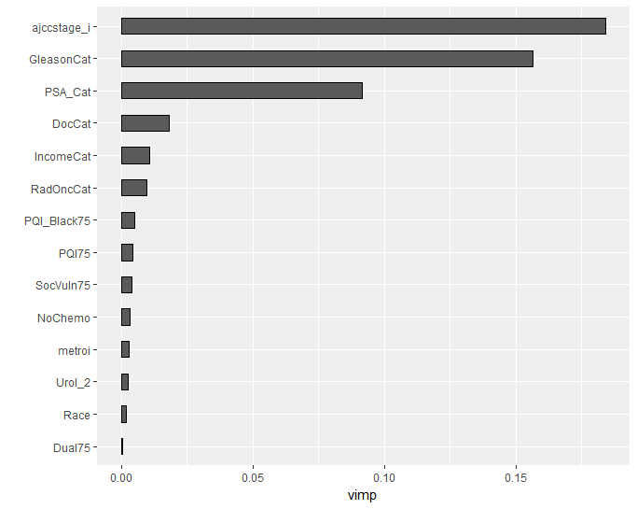
Current Research Projects
Familial Cancer Clustering in Urothelial Cancer- Using UPDB, identified cancer risks in relatives based on degree of relation to probands with urothelial cancer.
Lethal Prostate Cancer-

Slide 19
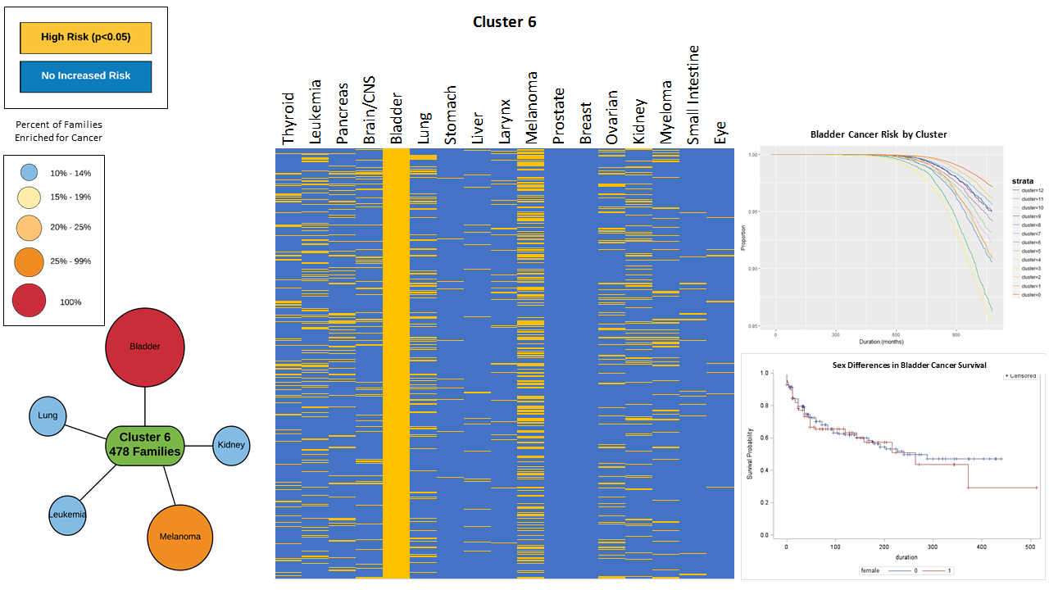
Future Research
Spatial Bladder Cancer Clustering:
Genitourinary Cancers Impact on Families: Identifying the health and clinical impact that family location provides for patients. Additionally, identifying the cardiovascular and psychological impact that a cancer diagnosis has on relatives of varying distance of relation and age.

Slide 20
Urologic Oncology Health Services Research Group
Brock O’Neil MD;
Brock.ONeil@hci.utah.edu
Heidi Hanson PhD;
Heidi.Hanson@hci.utah.edu
Will Lowrance MD, MPH; Will.Lowrance@hci.utah.edu

Slide 21
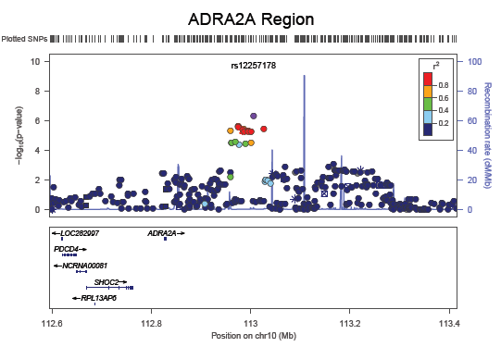
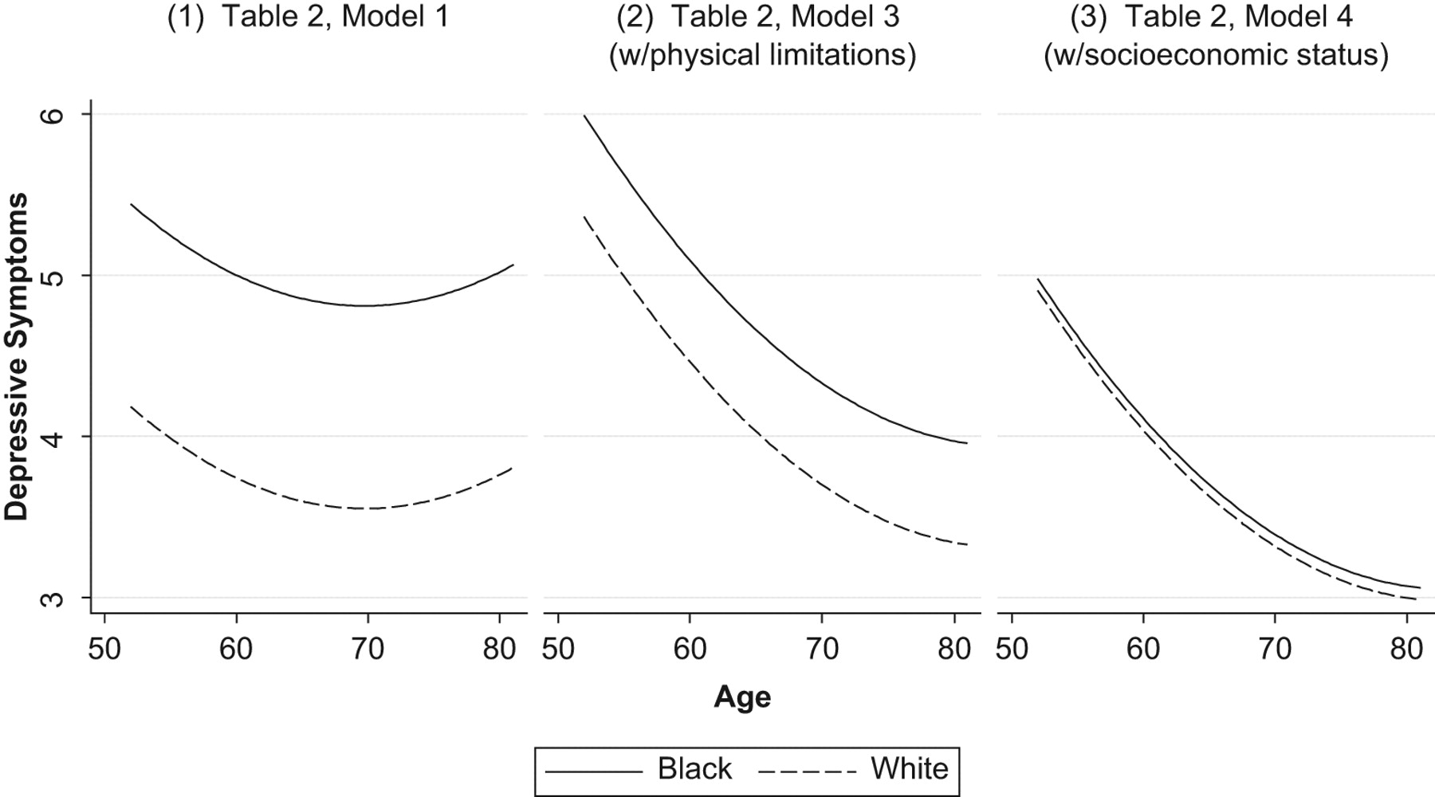
Past quant work
Statistical genomics (eg, Mol Psych 2011; Genome Biology 2015)
Health trajectories (eg, JHSB, 2011; JHSB 2013)
Structural equation modeling and psychometrics (eg,
Soc Forces, 2009; Addict Behav 2016)

Slide 22
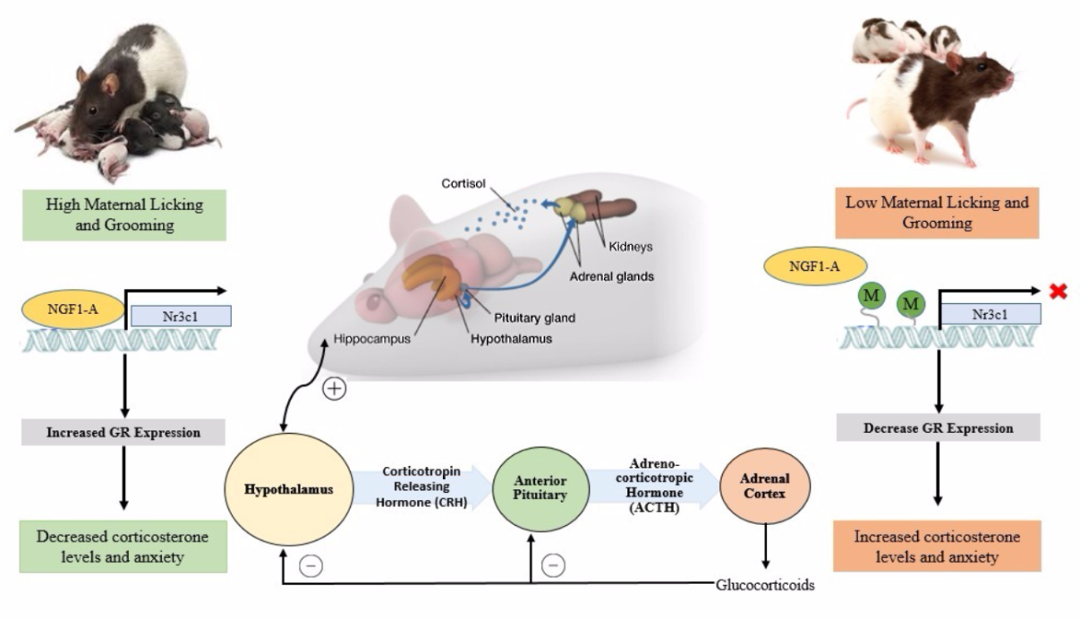
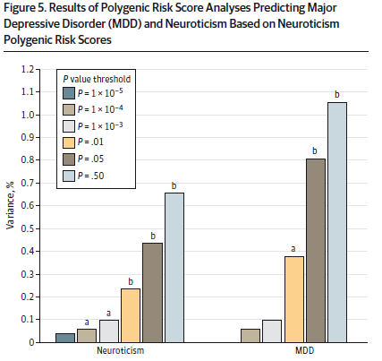
Current quant work
Social Epigenomics (eg, Oxf Handbk 2017; Dev & Psychopath forthcoming)
Method development in statistical genomics (eg, JAMA Psych R&R; JAMA Psych 2015)
Latent variable applications to clinical data (eg, under review BJOG, R&R at Psych Assess)

Slide 23
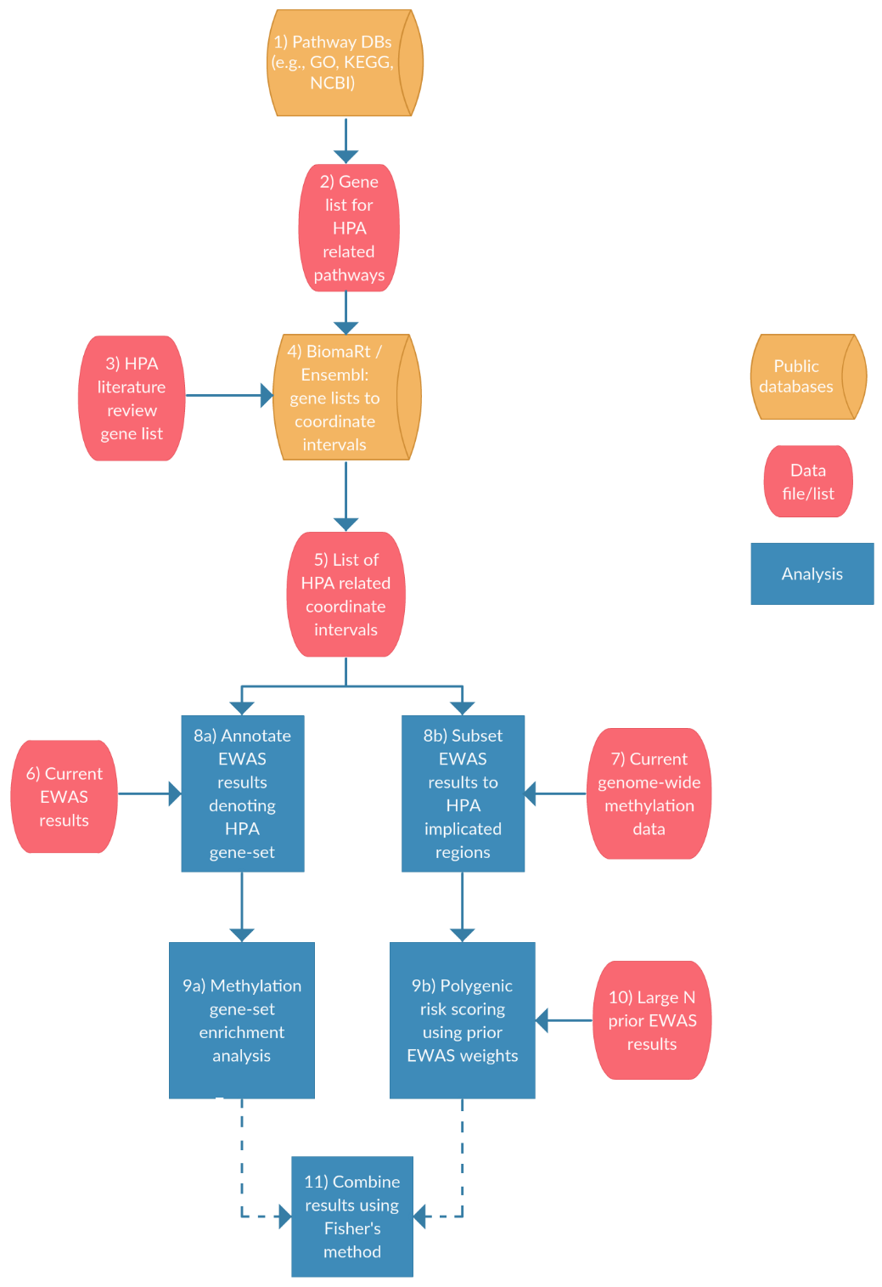
Future quant work
Polygenic methods in epigenomic data (e.g., bioRxiv papers)
Machine learning of EMR + omic data (eg, AJP, 2017)
Econometric/psychometric applications to strengthen causal inference in epigenomic analyses
Daniel E. Adkins
Sociology and Psychiatry (courtesy)
danieleadkins@gmail.com
daniel.adkins@soc.utah.edu
https://scholar.google.com/citations?hl=en&user=txEgjecAAAAJ

Slide 24



Deanna Kepka, PhD, MPH
Assistant Professor,
College of Nursing &
Huntsman Cancer Institute
Director, Intermountain West HPV Vaccination Coalition
University of Utah
Office: 801.587.4565 deanna.kepka@hci.utah.edu

Slide 25
Past/Current Research – Cancer Prevention & Health Disparities focus
Environmental scan of socio-demographic factors related to receipt of the HPV vaccine in the Intermountain West with a focus on vulnerable patient populations.
Assessment of dental and dental hygiene student knowledge, training, and attitudes surrounding HPV oropharyngeal cancer and HPV vaccination delivery.
Assessment of how to design a HPV vaccination education and delivery intervention for dental practices.
Development and evaluation of an intervention to improve cancer screening and cancer prevention education among low-income service industry employees in salt lake city.
Evaluation of radon knowledge and radon education messages in Utah with a focus on rural Utahans.

Slide 26

Directions for Future Research
Implementation and evaluation of a multi-level HPV vaccination intervention, I Vaccinate, at primary care clinics that are underutilizing the HPV vaccine in the Intermountain West.
Implementation and evaluation of a HPV vaccination education and vaccine delivery intervention for dental practices that are affiliated with primary care settings in the United States.
Large tele-phone or eHealth delivered cancer prevention and cancer education intervention for low-income service industry employees.
Development of community based radon and community health education campaign to improve radon knowledge, testing, and mitigation in Utah.

Slide 27
  Spatiality, Neighborhood
  and Health Inequality
  Dennis Wei, Professor
  Department of Geography
  University of Utah
  wei@geog.utah.edu
  September 2017

Slide 28
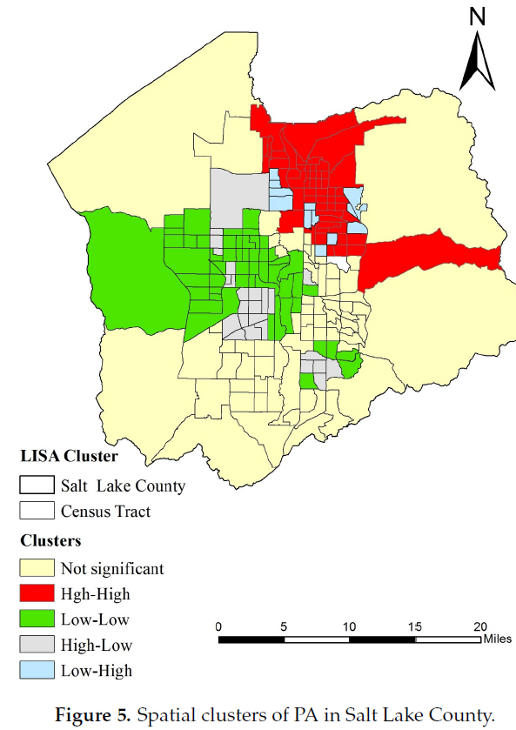
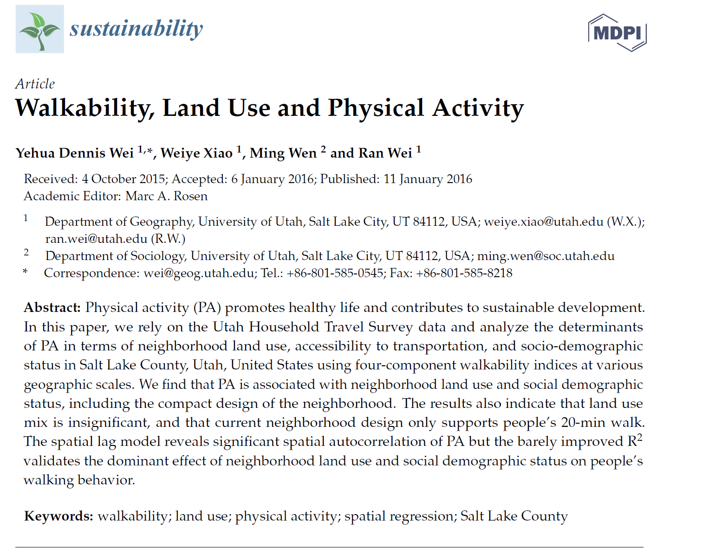
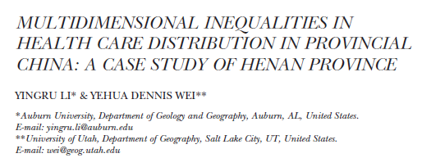
Research Interests: Urban/Health Geography
Spatiality of Health: Space, Scale, Place, Mobility & Environment
Urban Form/Neighborhood Effects on Health
Health Inequality & Public Policy
Methodology: GIS, Social Media, Big Data

Slide 29
Grants:
2015-2016. Amenity, Neighborhood and Spatial Inequality: A Study of SLCo. CSBS. PI
2015-2018. Economic Transition, Urbanization and Spatial Inequality in China. Ford Foundation. PI.
Proposal Under Review:
Comparative Regional Inequality Dynamics. NSF. Co-PI.
Plan: Physical Activity & Health Inequality
Effects of urban form and neighborhoods on health/PA
Urban form, safety and PA(60,000 accidents involving walkers, bikers)
Sources of Funding: UDOT/NITC, NIH, NSF

Slide 30
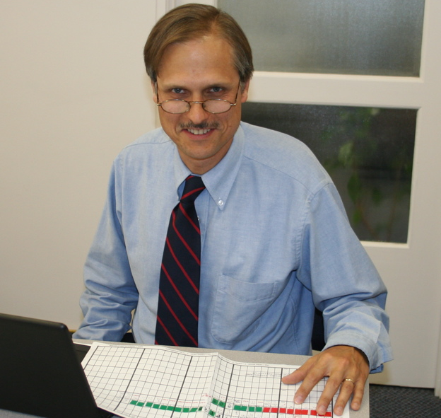
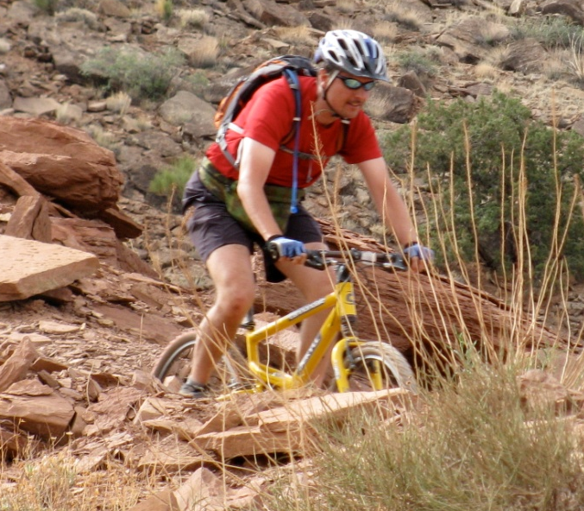
JOSEPH B. STANFORD, MD, MSPH
Professor, Family and Preventive Medicine; Obstetrics and Gynecology; Pediatrics
Currently Funded Research = Utah Children’s Project
Environmental influences on Child Health Outcomes
(ECHO; NIH)
Household-based community cohort pandemic influenza
surveillance (CDC)
Teaching (Public Health)
Research Methods
Advanced Research Design
Reproductive and Perinatal
Epidemiology
Service
Office of Cooperative Reproductive Health
University SJ Health Center: natural infertility, women’s health
CFAHR Executive Committee
Intntl. Institute for Restorative Reproductive Medicine
30

Slide 31
JOSEPH B. STANFORD, MD, MSPH
Contributions to Science
Population-based assessment of reproductive outcomes associated with fertility treatment
Preconception cohort studies
Day-specific probabilities of conception and the fertile window
Environmental exposure impacts on reproductive health, child health, and child development
Fertility intentions and behaviors
31

Slide 32
JOSEPH B. STANFORD, MD, MSPH
Recent mentees
Christy Porucznik, PhD, MSPH, Associate Prof, UU DFPM
  Periconceptional exposure assessment
Jessica Sanders, PhD, MSPH, Asst Prof, UU OBGYN
  Fertility treatment utilization, reproductive health
Karen Schliep, PhD, MSPH, Asst Prof, UU DFPM
  Life course epidemiology: reproduction and aging
Ulrike Ott, PhD, MSPH, Visiting Instructor, UU DFPM
  Health behaviors in workers
Current PhD students
  Sakineh Najmabadi, MSPH
    menstrual cycle characteristics and fertility status
  Matthew Reeder, MPH
    fertility treatments and fertility, pregnancy, and childhood outcomes
32

Slide 33
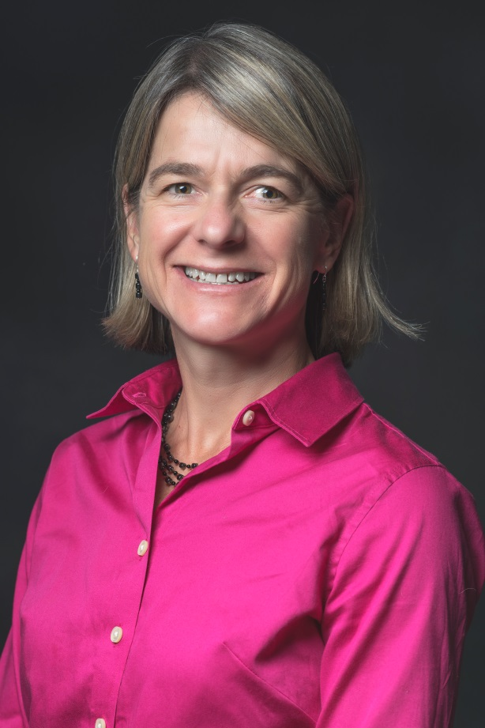
Karen Schliep, PhD, MSPH
Assistant Professor
Department of Family & Preventive Medicine
Division of Public Health
375 Chipeta Way, Suite A
Salt Lake City, UT 84108 | 801.587.7271
karen.schliep@utah.edu
@schliepy
@uupublichealth
#uupublichealth

Slide 34
Past Research: Lifestyle and Psychosocial Factors and Women’s reproductive health
Serum caffeine and its primary metabolite, paraxanthine, are associated with reduced testosterone and improved ovulatory function (Schliep et al, Am J Clin Nutr. 2016 Jul;104(1):155-63)
Moderate alcohol intake associated with higher E2 and improved ovulatory function (Schliep et al, Am J Clin Nutr. 2015 Oct;102(4):933-42)
Daily (but not baseline) perceived stress is associated with lower concentrations of total and free E2, LH, and luteal progesterone, higher concentrations of FSH, and increased odds for sporadic anovulation. (Schliep et al, Epidemiology. 2015 Mar;26(2):177-84)
Direct link between physical abuse and a women’s adhesion risk, for which mediation analyses showed could not be explained by a history of chronic pelvic pain, depression, or STIs (Schliep et al, Hum Reprod. 2016 Aug;31(8):1904-12)
Couples who try to achieve pregnancy immediately after a loss versus waiting >3 to 6 months later are more likely to achieve a live birth with a shorter TTP (Schliep et al, Obstet Gynecol. 2016 Feb;127(2):204-12)

Slide 35
My research passion
Interplay between reproductive/pregnancy disorders, modifiable exogenous factors (exposome), non-modifiable endogenous factors (genome) and chronic disease pathogenesis for mother and offspring.
Directions for future research
K01 Application: Hypertensive disorders of pregnancy and subsequent Alzheimer’s disease and related dementia
Collaborative R01 Application: Endometriosis and Women’s Overall Health
Continued work within the EAGeR Trial on maternal stress and reproductive and child health outcomes
Notes:
Alzheimer’s disease and related dementia disproportionately afflict women, with 1 in 5 women who reach age 45 developing Alzheimer’s disease compared to 1 in 10 men. There is an urgent need to investigate differences in dementia disease pathogenesis between men and women, so that tailored interventions can reduce dementia-related morbidity and mortality. Given emerging experimental evidence indicating that hypertensive disorders of pregnancy—such as preeclampsia, eclampsia, or gestational hypertension—and Alzheimer’s disease share common susceptibility genes and aggregation of misfolded proteins, we will use large linked registry datasets and rigorous population-based research to determine if hypertensive disorders of pregnancy are linked with dementia and whether high-risk pedigree overlap of the two diseases may indicate shared genetic or environmental factors at play.

Slide 36

Prenatal programming of risk for impaired neurodevelopment
Elisabeth Conradt, PhD
Department of Psychology
Elisabeth.Conradt@psych.utah.edu

Slide 37
Intergenerational Transmission of Emotion
Dysregulation
Exposure to maternal emotion dysregulation in utero
Programming through epigenetic effects
Impaired newborn neurobehavior and infant self-regulation
Epigenome-wide interrogation + development of a “stress array”
targeting genes and CpG sites specific to HPA axis pathway
Funding: NIMH R21 MH109777 (Crowell, PI; Conradt, Co-I); University of Utah department of psychology; Consortium for Families and Health Research; Interdisciplinary Research Pilot Program

Slide 38


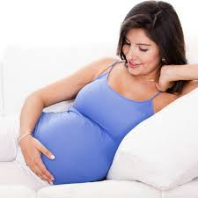

Future Directions
Exposure to maternal emotion dysregulation in utero
Programming through epigenetic effects
Impaired newborn neurobehavior and infant self-regulation
Infant dysregulation at 7 months and maternal-infant coregulation
Toddler dysregulation at 18 months; toddler cognition and executive functioning with L. Raby
Social epigenomics and health disparities with
D. Adkins and S. Crowell
Prenatal opioid exposure with S. Crowell,
M. Smid, K. Buchi, and J. Shakib

Slide 39
Megan M. Reynolds department of sociology
Robert wood Johnson foundation new connections scholar kl2 mentored career development scholar university of Utah vice-president’s clinical and translational scholar
consortium for families and health research
research mixer
Thursday, September 28 2017

Slide 40
past & current research
Domestic: immigrant health
  novel comparisons: gender, non-Latino groups
  novel mechanisms: healthcare utilization, family caregiving
Cross-national: political economy of health
  resource distribution
  non-health public policy
  labor market institutions
Notes:
current research for which you are most excited

Slide 41
future directions
Merging domestic and cross-national work
  To what extent do policies (TANF, UI), power (labor unions) and politics (political representation) affect health and health inequalities in the US?
  Are there contextual effects of these variables?
  What are the mechanisms that explain observed associations?
  How do these processes operate not only within, but across generations?
Social protection and child health
  Panel Study of Income Dynamics, CDS (0-12, 2003) and TAS (< 28 y.o.) supplements
    Welfare Generosity Index (Fox & Scruggs)
    Health, demographics, psychosocial factors, economic circumstances, program participation
    Family and household members
  Utah Population Database, virtual census
    Data pre-welfare reform
    Long pedigrees
    Conditions of birth
Notes:
, as well as future research directions you want to develop.

Slide 42
Families as Focus of Intervention

Slide 43


Alex Terrill, PhD
Department of Occupational & Recreational Therapies email: alex.terrill@hsc.Utah.edu
Phone: 801-581-5951

Slide 44
Current Research: Promoting resilience in individuals with chronic conditions/disability and their families
RESToreD: Couples coping with Stroke (NIH/NCMRR R03)
SCIPPR-D: Couples coping with SCI (Craig H. Neilsen)
Spokes4Strokes: Adaptive Rec (Skaggs)
Social
Physical
Psycho-logical
Notes:
Importantly, in the biopsychosocial model, health is not viewed simply as the absence of disease but as the presence of wellness– and this is one reason that makes it fit so well will concepts like resilience, where we are really talking about health-protective things
3 domains of health: Physical, Psychological, and Social. All factors can contribute (or take away from) resilience
Resilience does not result from one single dominant factor - instead multiple risk and protective factors may contribute to or subtract from the overall likelihood of resilient outcome

Slide 45
Exciting (Preliminary) Findings/What’s Next
RESToreD: 15 couples enrolled
  → go bigger
  → go telehealth
SCIPPR-D: Web-based app in development
  Prototype → other conditions
Spokes4Strokes: First cohort
  Include families?
14.9 + 6.2
*p=.02
Depressive Symptoms (PROMIS-D)
12.2 + 5.6
9.8 + 4.8
Pre-PPI
Post-PPI
3-month follow up
Notes:
Post-PPI, depressive symptoms significantly decreased (p<.02), with 70% of participants reporting less depression. Depressive symptoms continued to improve at follow-up (p<.02); 70% of survivors and 85% of caregivers either continued to improve or maintained mood at 3-month follow-up.

Slide 46


Cindy Berg
Department of Psychology
Cynthia.berg@psych.Utah.edu

Slide 47
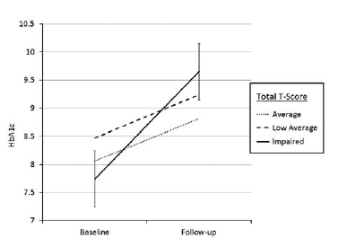
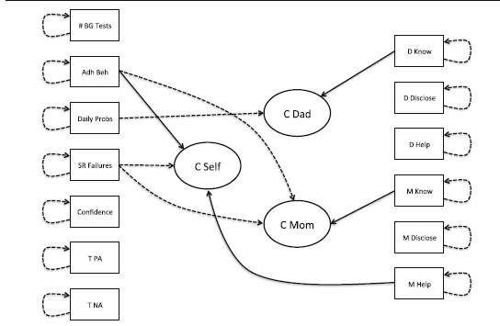
Current Research
Diabetes management requires good self-regulation, especially important during transitions such as emerging adulthood (Suchy et al., 2016, 2017).
Self-regulation benefits from involvement of families, although changes across transitions.

Slide 48
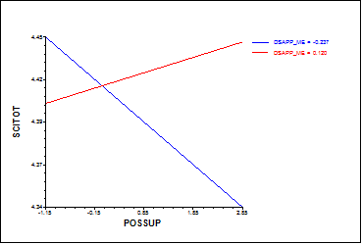
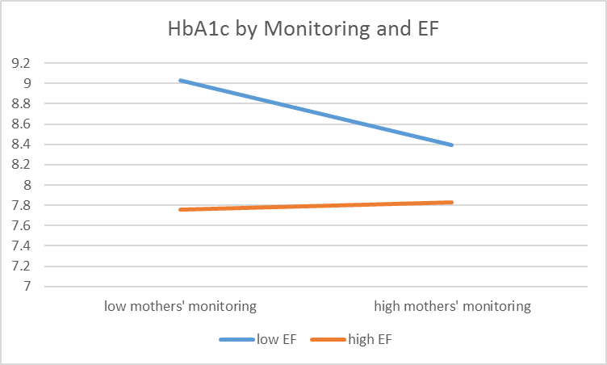
Next Steps
Family involvement may depend on whether you view the illness as shared.
Family involvement may benefit those with poorer self-regulation skills.

Slide 49
Family Caregivers
Debra Scammon
  Marketing Department
  MHA Program
  David Eccles School of Business
Debra.Scammon@eccles.Utah.edu
801-581-4754

Slide 50
Family Caregivers: Current Research
Taking Care of Our Parents
  Three tiers of Pipeline-to-Proposal funded by Patient Centered Outcomes Research Institute
Integrating Family Caregivers into Primary Care Teams: Best Practices – funded by C-FAHR
Conduct a deep dive with 10 clinics
        Observe processes in clinics
        Conduct in-depth interviews with providers

Slide 51
Family Caregivers: Future Research
  Creating Caregiver Provider Partnerships (CCPP)
  submitted to PCORI Engagement Award
  proposed four workshops over two years to bring a variety of stakeholders together to redesign primary care delivery models to effectively include family caregivers in partnership with primary care providers to enhance care for the elderly

Slide 52
Katarina Friberg Felsted
Assistant Professor (Clinical) katarina.felsted@nurs.utah.edu
801.585.7438
Gerontology Interdisciplinary Program
College of Nursing

Slide 53

Current Research
    Complementary &/or integrative therapies
    to treat chronic conditions in older adults
    Mindfulness-Based Stress Reduction compared to
    Health Enhancement Program
    to treat urinary urge incontinence in older adult women

Slide 54

Findings & Future
  Feasibility
  Preliminary efficacy
  Incontinence work
  Collaboration on refractory chronic conditions
  in an older adult population

Slide 55
CONTACTS
Marissa Diener, Family & Consumer Studies
  marissa.diener@fcs.utah.edu (ABI Community Reintegration Study)
Anne Kirby, Occupational Therapy
  anne.kirby@hsc.utah.edu (MAPSS)
Cheryl Wright, Family & Consumer Studies
  cheryl.wright@fcs.utah.edu (UHEAP, NWP)
  Carly Taylor, Research Assistant:
  carly.taylor@utah.edu (UHEAP)
Valerie D’Astous, Post Doc Family & Consumer Studies,
valerie.dastous@fcs.utah.edu (NWP)

Slide 56
ADOLESCENT/YOUNG ADULT ASD RESEARCH
Utah Higher Education Autism Program(UHEAP)
    Examining challenges and obstacles to higher education access and success for students with autism
    Contact: Cheryl Wright or Carly Taylor
Utah Neurodiversity Workforce Program (UNWP)
    developing resources to prepare youth w/ ASD for STEM fields (incl. families & industry partners)
    Contact: Cheryl Wright or Valeria D’Astous
    Collaborators: CSBS, NURS, MED, COH, BUS, FA, UVU, SLCC, BYU, Spectrum Academy, Columbus Community Center, Women Tech Council, Davis Technical College
Maximizing Adolescent Post-Secondary Success (MAPSS)
*C-FAHR-funded (Thanks!)
    group-based parent intervention to prepare families of teens w/ ASD for transition to adulthood
    Contact: Anne Kirby

Slide 57
Community Reintegration Following Child’s Acquired Brain Injury
New Direction - Parallels with Autism
Aim: To understand facilitators and barriers to community reintegration for children and families following ABI
Collaborators: Dr. Michael Green, Heather Canary, Ellie Hirshberg
Next Steps: Pilot Intervention
Telehealth? Online Support Groups

Slide 58
Mike Newman
3rd Year PhD student, Division of Public Health
Department of Family and Preventive Practice
mike.newman@hsc.utah.edu

Slide 59
Research
Hotspotting pilot group 2016-2017
  UU Interprofessional Education (IPE) office partnering with Camden Coalition
  Presentation at UPHA, poster at APHA this November, FeliAnne Hipol co-presenter
Dissertation proposal
  Project topic is healthy aging
    How to define what healthy aging is (lack of chronic disease)
    Identify individuals that display healthy aging
    Look for geographic hotspots of healthy aging

Slide 60

Future Direction – Aging Research
Phenotypic data
Genotypic data
Familial, Environmental, and Social data

Slide 61

Rebecca Utz
Associate Professor
Director of Graduate Studies, Department of Sociology
Director, Health Society & Policy program
Rebecca.utz@Utah.edu
903 BEHS (for now)
801.699.5685

Slide 62


Past & Current
Gerontologist *
Life Course Scholar * Sociologist * DemoGrapher
Development and testing of interventions for bereaved caregivers w/ Mike Caserta & Dale Lund

Slide 63
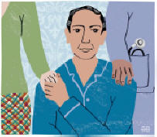
How do families cope with end of Life health Issues?
Can caregivers make better use of respite time to improve their overall well-being (not to mention, their ability to provide caregiving)? w/ Mike Caserta
Do preferences for end-of-life care differ by disease type? w/ Kara Dassel, Kathie Supiano
How do families, patients, and providers cope with a “live” discharge from hospice? w/ Mike Caserta, Kathie Supiano, Mardie Clayton, Jackie Eaton, Kara Dassel, Lyndsey Miller

Slide 64
Social Relationships & Health

Slide 65

Bert N. Uchino
Department of Psychology and Health Psychology Program bert.uchino@psych.utah.edu
(801-581-5682)

Slide 66
Health Consequences of Positive and Negative Aspects of Relationships
- Large body of epidemiological literature showing that supportive
relationships linked to lower mortality (Holt-Lunstad et al., 2010).
- However, not all relationships uniformly positive and a growing literature
links negativity in relationships to poorer health.
- Our work has focused on building a more comprehensive framework
linking both positivity and negativity in relationships to health.

Slide 67
Main Prior Research Findings and Future Directions
Competing hypotheses: Can individuals benefit from the positivity in ambivalent ties, or are such ties harmful due to their unpredictability which increases interpersonal stress?
  Ambivalent ties related to:
    greater lab-based cardiovascular reactivity (Uchino et al., 2001; Holt-Lunstad et al., 2007; Reblin, Uchino, & Smith, 2010; Uchino et al., 2016).
    higher ambulatory blood pressure during daily life (Holt-Lunstad et al., 2003; Uchino et al., 2013; Birmingham et al., 2015; Cundiff et al., 2016).
    higher levels of inflammation (Uchino et al., 2013; Uchino et al., 2015).
    greater cellular aging (Uchino et al., 2012).
Current/future work focusing on building a theoretical model testing antecedent processes (e.g., early family environment), maintenance factors (e.g., commitment), and potential interventions (e.g., Loving-kindness meditation).

Slide 68
Daniel L. Carlson, PhD
Department of Family and Consumer Studies
daniel.carlson@fcs.utah.edu

Slide 69
Previous Research
My research program revolves around two integrated questions:
How have families changed over the past 50 years and what consequences has this had for children and couples’ well-being?
  Shifts in the division of paid and unpaid labor in couples and its consequences for relationship quality/sexual intimacy
  Association of deviations from expected marital and parental timing with depressive symptoms
How are racial/ethnic and socioeconomic differences in family formation related to health disparities and inequalities across groups?
  Effect of teen childbearing on educational expectations/aspirations
  Moderating effect of SES on association of marriage and mental health
  The role of neighborhood disadvantage in shaping race/ethnic disparities in sexual risk behavior

Slide 70
Directions for Future Research
Our research on adolescent sexual risk behavior demonstrated that of all the indicators of neighborhood disadvantage – one – the concentration of single mother families (CSMH) best predicts adolescents’ sexual debut and number of partners, and best explains race/ethnic differences in these outcomes.
Our new research broadens the investigation of CSMH to examine a wider range of adolescent health risk behaviors and outcomes
  smoking, drinking, substance use, emotional problems, and depression
Considers how CSMH interacts with children’s own family structures to affect health behaviors and outcomes.
Examines how the timing of transitions into or out of disadvantaged neighborhoods and duration of residence in these neighborhoods affects health behaviors and outcomes over the early life course (birth to age 34).
DATA: National Longitudinal Survey of Youth 1997; Fragile Families and Child Well-being Study

Slide 71
Lauren Clark, RN, PhD
Professor
College of Nursing
801-581-5876
Lauren.clark@nurs.Utah.edu

Slide 72
Research
Disability and health disparities, including
  Reproductive health and pregnancy among women with intellectual disability
  Parents expecting a child with a disability and anticipatory guidance
  Health-related quality of life for adults
  Obesity and healthy lifestyle interventions
  Social network analysis, friendships and loneliness, social capital
Mexican immigrant and Mexican American maternal-child health
  Post-partum pelvic floor support changes
  Social support
  Cultural aspects of health and family health practices

Slide 73
What’s exciting?
Using social network analysis to identify resources for support among those experiencing health disparities
Prenatal genetic testing and disability
Cultural models in women’s reproductive health

Slide 74
Contact Information
Lee Raby
Department of Psychology (Developmental Area)
Email: lee.raby@psych.utah.edu
Website: psych.utah.edu/people/faculty/raby-lee.php

Slide 75
Research Questions
Do early experiences with caregivers have a long-term significance for later development?
What are the processes that help account for these long-term effects?
  I have focused on alterations to psychobiological systems involved in emotion regulation as well as cognitive processes related to attachment.
What is the nature of the interplay between early caregiving experiences and individuals’ genetic characteristics?

Slide 76
Directions for Future Research
Caregiving influences on children’s stress neurobiology at age 18 months
  Collaboration with Elisabeth Conradt and Sheila Crowell
Development of internationally and domestically adopted children
  Potential to illuminate both genetic and environmental influences on developmental adaptation

Slide 77
Zobayer Ahmmad (Zubi)
Department of Sociology
PhD student (2nd Year)
zubiahmmad@gmail.com

Slide 78
Previous Researches
Perception on smoking among four year college students in Bangladesh
Collected data from two universities in Bangladesh
One manuscript on peer smoking and smoking intent is being ready
46% of male students smoke
Very few girls smoke
Having a network of friends that has tobacco consumption is associated with intent of smoking

Slide 79
Project going on
Risky Sexual Behavior Predicted by Childhood Vulnerability and Depression: A longitudinal study
National Longitudinal Study of Adolescent and Adult Health (Add Health)
Looking into adolescent sexual risk taking behavior across the life course.
What does predict sexual risk taking? Childhood vulnerability (fragile family structure) or depression.
Why sexual risk taking behavior persists until adulthood?

Slide 80
Future Research
Gendered context, Gene, and Migraine
Why do women suffer migraine more than men?
Heritability or environment ?
Gene-environment interaction?
        Thank you

