Slide 1

C-FAHR Colloquium Series
September 8, 2014

Slide 2
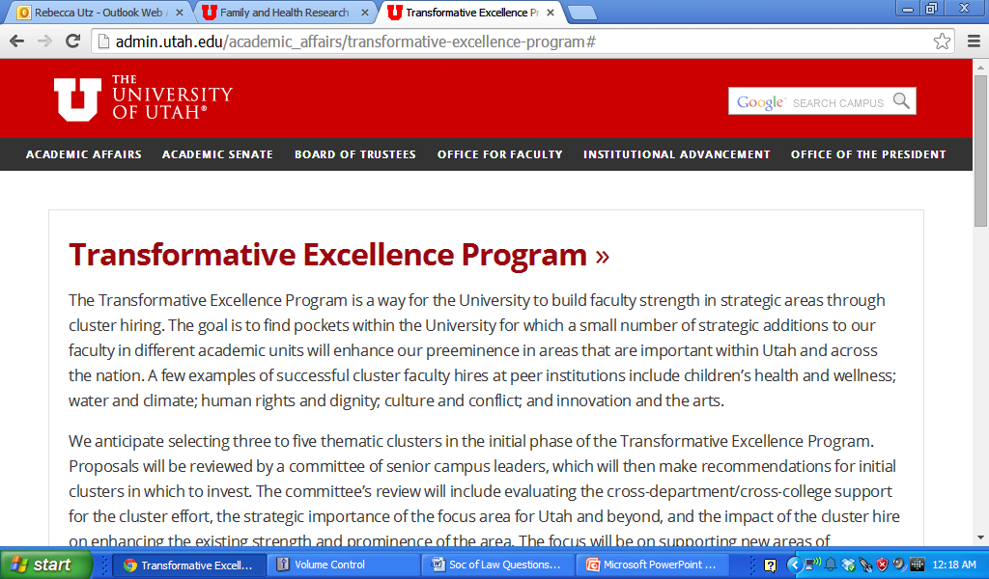
In Winter 2014 –
SVP Ruth Watkins issued a call for proposals to a new program.
Led by Cindy Berg, a team of approximately 30 faculty members quickly assembled and quickly created a proposal related to families and health across the lifespan.

Slide 3

Our proposal was selected as one of the 4 TEP - Cluster Hiring Initiatives .
• Lifespan Health and Wellness
• Digital Humanities
• Large-Scale Data Analysis/Utah Statistical Center
• Society, Water and Climate

Slide 4

Cluster Hiring
  Already Filled
    Communicating Complex Health Info
Kim Kapinghst arrives in October 2014
Currently Searching – to begin in July 2015
  Quantitative Methods
  Intervention
Please see website for a flyer to circulate . Search Committee Co-Chairs: Ken Smith & Jon Butner for Methods position. Robin Marcus & Becky Utz for Intervention position.
Future Possible Positions
  Social Networks
  Dissemination & Implementation
  Family Diversity and Culture

Slide 5
Who are we?
What can we become?
Notes:
Introduce the exec committee briefly
Cindy Berg, Becky Utz, Ken Smith, Jon Butner, Joe Stanford, Heather Canary, Julie Fritz
charged with defining the direction and mission of C-FAHR, including the creation of a “center”
But first we need to build interdisciplinary collaborations and evidence of success among faculty on campus in the area of families and health. To this end, we are doing campus outreach to identify interested and relevant faculty (membership drive), and funding small-grants that foster interdisciplinary collaboration related to families and health (pilot grant program). We are also having intellectual conversations like this one to help us define the unique themes and concepts that tie this group together (monthly colloquium series).

Slide 6
Purpose of C-FAHR
A research consortium to encourage/facilitate interdisciplinary research related to families and health across the life course.
How can the family be used as a vehicle for promoting health and adjusting to chronic illnesses and how such strategies may vary across developmental life stages (infancy, childhood, adolescence, across adulthood)?
Multi-level approach (genetic and environmental factors, methodologies, family interactions and interventions, and healthcare communication) to understanding health across the lifespan.
http://csbs.utah.edu/health_family.php

Slide 7





Membership
Initial team for the TEP proposal had approximately 30 faculty from 11 different departments, representing 5 different colleges/institutes
We are now beginning a campus-wide effort to expand the list of Affiliated Members.
  Submit your biosketch to C-Fahr_info@utah.edu.
  Further details on http://csbs.utah.edu/health_family.php

Slide 8
Colloquium Series
Monthly events. To be announced.
Pilot Grant Program
To be announced this fall.
  To support interdisciplinary collaborations among Affiliated Members
  To facilitate pilot work that will aid in the preparation and submission of external research proposals related to families and health across the life course.

Slide 9

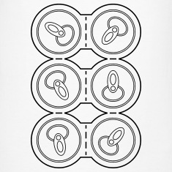
The Pac-12 Six-Pack
Developing a Comprehensive, Family-Based Model to Health
Notes:
So the name of our discussion today is – the Pac-12 Six-Pack. We have asked 6 different speakers to offer a very brief introduction, to help us think about and develop a “comprehensive, family-based model of health”

Slide 10
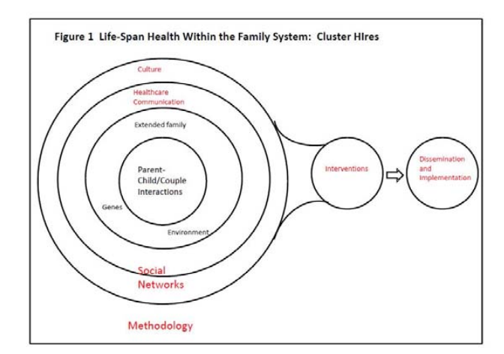
Family
Notes:
This is the model that appeared in the original TEP proposal – it got us the funding because it made it look like the cluster unified a bunch of different areas – however, what does it mean? Let’s take some time today to think about each component of the model and how it potentially contributes to the larger understanding of families and health across the life course.
We will first focus on the center most element of the figure – the family. How does approaching the study of lifelong health differ when viewing it from the perspective of the family, rather than an individual?

Slide 11
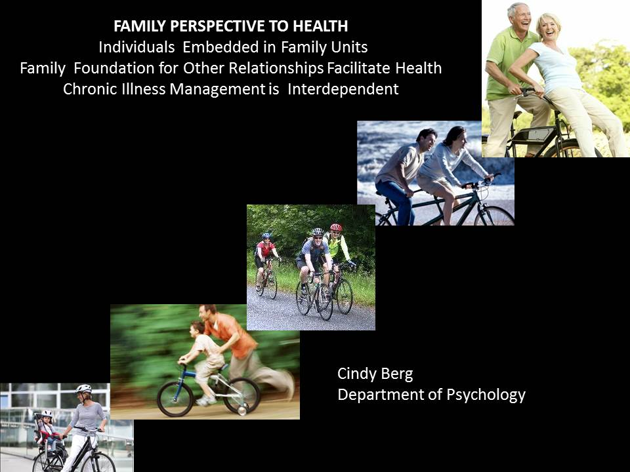
Notes:
1. A family perspective to health and chronic illness views individuals as embedded within family units throughout their developmental life span.
2. Family serves as a foundation for the development of other relationships, that when positive can facilitate health and reduce the likelihood of chronic illnesses. Positive parent-child relationships laid down in infancy through secure attachment processes provide a foundation for an individual’s use of friends, romantic partners, and healthcare providers as sources of social support all of which are associated with health.
3) When chronic illnesses do arise they are managed within the family system in an interdependent manner with parents initially providing a great deal of support, support that is later provided primarily by romantic partners. This interdependence, however, means that chronic illnesses can affect family members as well as the individual with the illness.

Slide 12
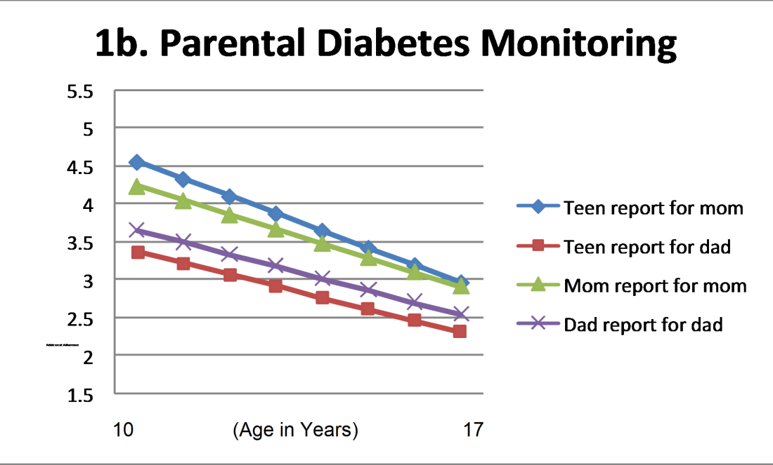
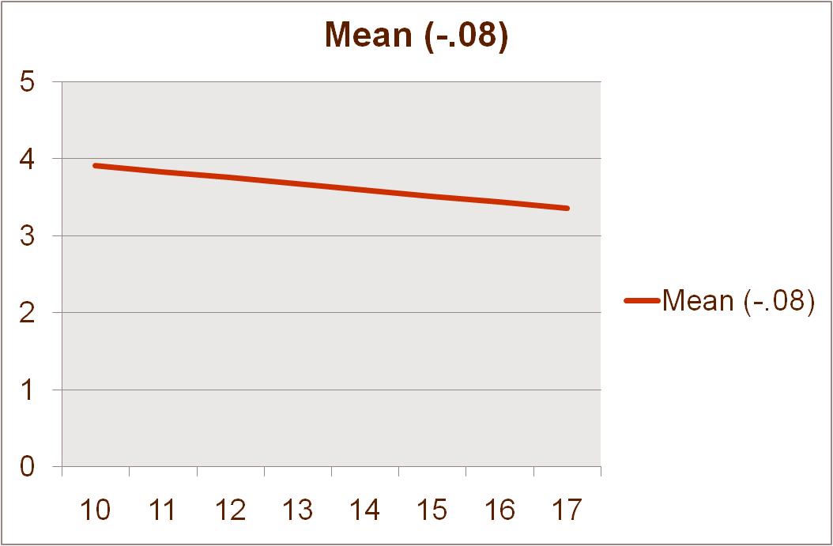
Chronic Illnesses are a Family Affair
Berg et al. (2007); Beveridge, Berg, Wiebe & Palmer (2006); King, Berg et al. (2013).
Family members view type 1 diabetes as a “family” issue (70.9% mothers, 52.8% children).
When parents collaborate, are warm and accepting, and monitor adolescents’ diabetes management, adherence and HbA1c are improved.
Notes:
In our own work with adolescents with type 1 diabetes, we see that diabetes is a family affair. When interviewed about their perceptions of diabetes, the majority of family members conceptualize the illness as a shared family issue rather than an issue that is the adolescent’s or the parent’s issue to deal with.
Further, when parents collaborate, are warm and accepting, and monitor adolescents’ diabetes management adherence and HbA1c are improved. Parental involvement is especially important it declines across adolescence at the same time that adherence declines. In our work we have found that these two are linked such that greater parental involvement longitudinally sustains adherence across time.

Slide 13
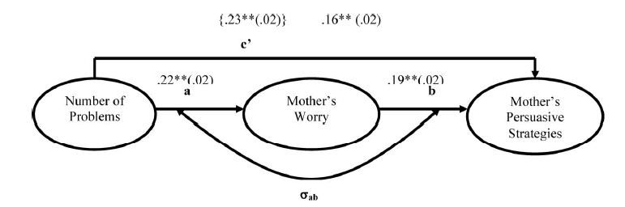
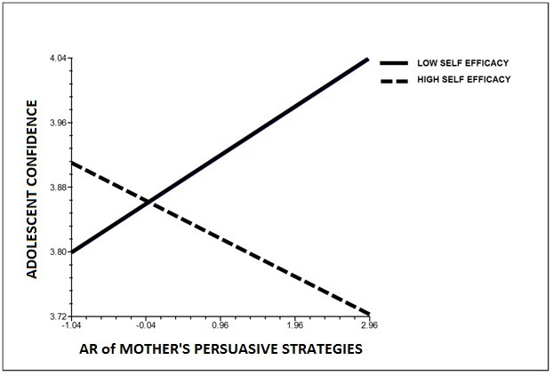


Daily Interdependence of Parent and Child in Managing Diabetes
b=-5.00*
M Persuasion_{t}
BG_{t+1}
BG_{t}
Berg et al. (2013)
Health Psychology
Notes:
To examine in more detail the daily interdependence between parents and adolescents in managing type 1 diabetes, we had mothers’, fathers’, and adolescents keep a daily diary of the problems that occurred in diabetes management. In addition, parents rated their worry about the adolescent’s diabetes and rated a number of persuasive strategies they used each day (reminded the child, persuaded the child to do more).
We found that adolescents problems with diabetes heightened mothers’ and fathers’ worry about diabetes and was associated with both mothers’ and fathers’ greater number of persuasive strategies. Further mothers’ persuasive strategies (not fathers) led to next day lower blood glucose values, suggesting that her strategies were facilitative of blood glucose management.
However, those persuasive strategies were associated with better adolescent confidence only to the extent that they were tailored to the child’s own views of confidence. These results suggest that parental involvement needs to be tailored to adolescents’ views of their competence.

Slide 14
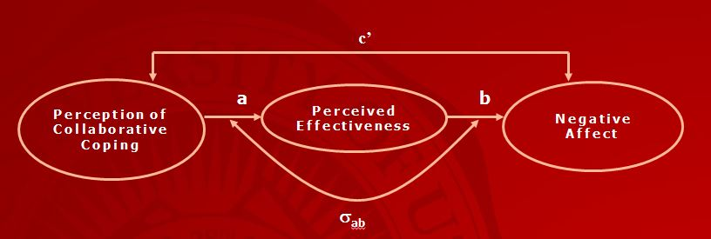
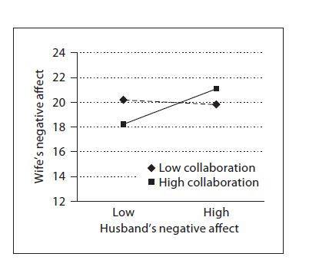
Collaborative Family Involvement Has Benefits and Liabilities: Couples Coping with Prostate Cancer
Daily collaborative coping associated with lower negative affect and higher perceived coping effectiveness for husbands and wives
Berg et al. (2008)
Psychology and Aging
A potential cost to collaboration may be negative affect transmission
Berg, Wiebe, & Butner (2011), Gerontology
Notes:
Family involvement has similar benefits at different parts of the life span involving different kinds of relationships such as the marital partner. In a study of husbands and wives and how they dealt with problems surrounding prostate cancer and its treatment, daily collaborative coping with stressful events surrounding prostate cancer was associated with lower negative affect and higher perceived coping effectiveness for both husbands and wives.
However, there may be a cost to this collaborative coping. On days when husbands were reporting greater negative affect, wives also experienced greater negative affect, when they reported collaborating frequently across the 14 days of the diary.
In summary, these studies illustrate the value of examining chronic illness from a family perspective, in that particular kinds of family involvement can facilitate adjustment for both the person with the illness and the family member. Further these studies indicate that even when family members are involved in positive ways, they may be affected by the chronic illness experience.

Slide 15
Family
Notes:
Health is determined by a series of complex influences – as represented by the concentric circles around the family.
We have speakers who will discuss specifically the role of genetics (Ken Smith), the role of environment (Ming Wen), and the role of health care (Joe Stanford)

Slide 16
Genetics and Familiality
Ken Smith, FCS & Population Sciences HCI
No one disputes that genetics matter for psychosocial and socioeconomic phenomena
Gene-Environment Interaction is key
Familiality-Environment Interaction is even keyer
Yet, several social science disciplines have resisted introducing genetics, biology, heritability and familiality into models
PSID, NHANES, ADHEALTH now include genetic data and family-based designs
2014 NAS & NIA Sponsored “Expert Meeting on Assessing and Encouraging Interaction between Genetic and Social-Behavioral Models”

Slide 17
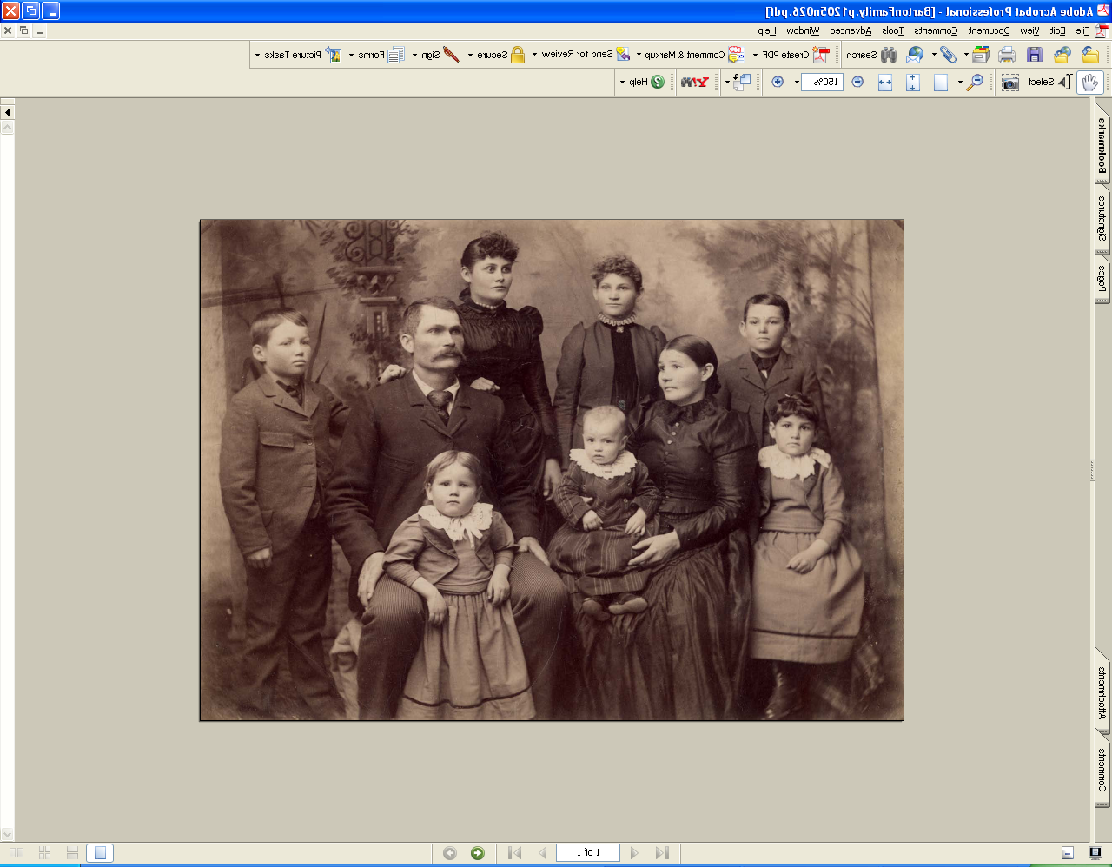
Utah Population Database
Studying Families and Health
Contributes to numerous groundbreaking genetic and public health discoveries spanning the past 35 years
Holds multigenerational pedigrees, 12 generations deep
Links family trees to cancer records spanning the past 50 years using the comprehensive Utah Cancer Registry
Includes critical birth and death records from the past century provided by the Utah Department of Health
Connects to medical records from Intermountain Healthcare & University of Utah Health Sciences Ctr.
Allows for recruitment

Slide 18
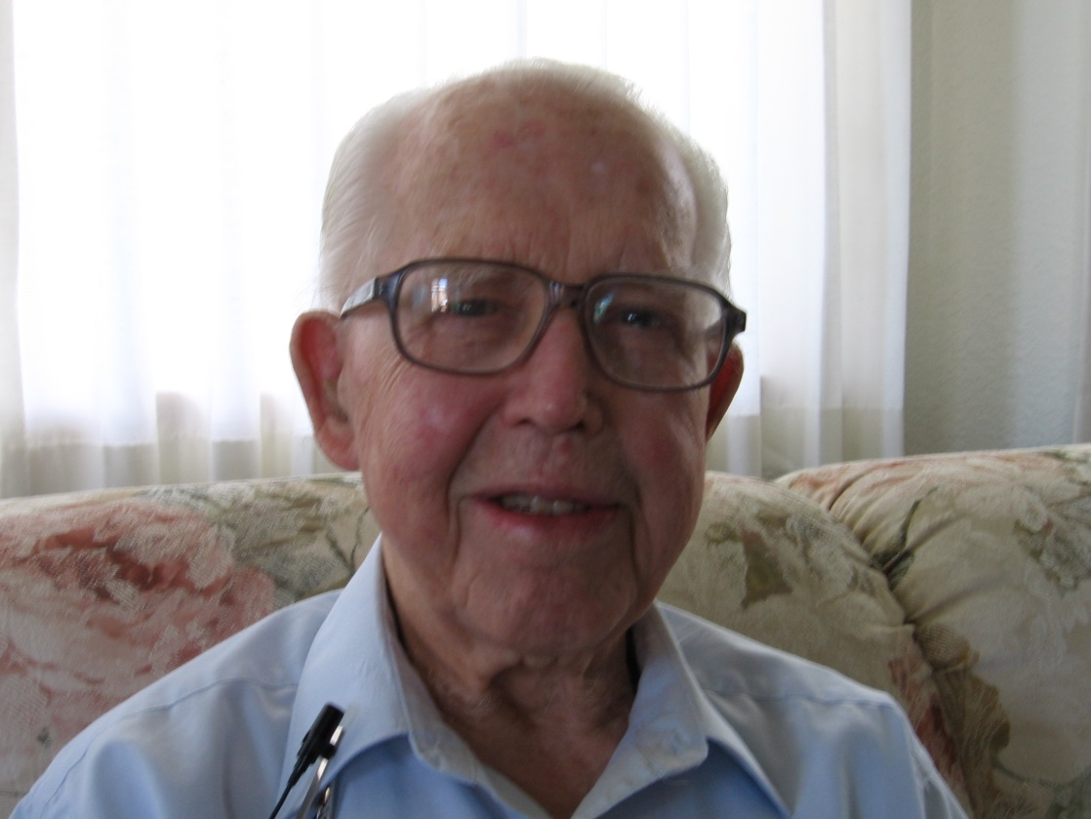
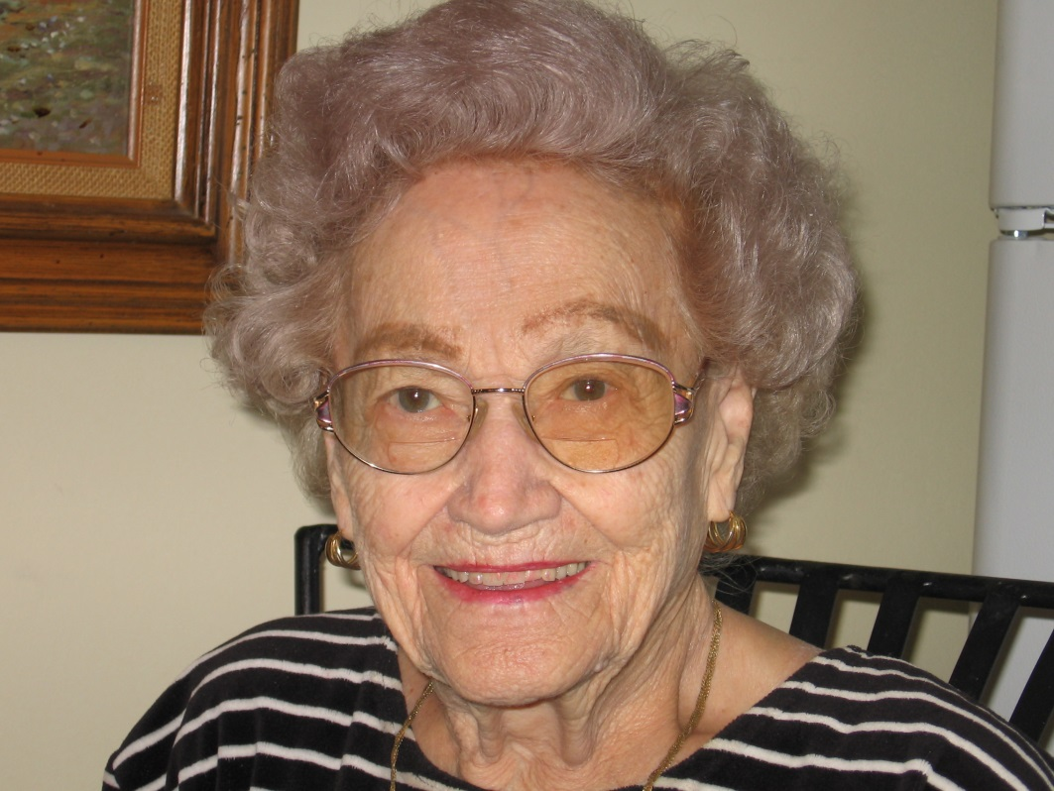
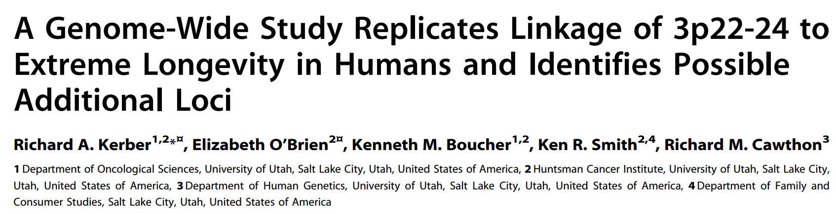
Brother 105 Sister 98

Slide 19
All Cause Mortality and APOE
(e33 is reference)
P<.05
Cox regression, includes controls for baseline age, age², gender, education, LDS affiliation, FEL

Slide 20
All Cause Mortality Hazard Rate Ratios for APOE Genotypes (ε33 is reference)
Interaction with Education
P<.05
Interaction between e44 and interval Education p<.05

Slide 21
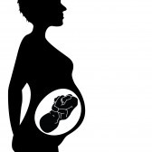


Adversity (Very Young/Old Age)
Among Maternal Grandmothers
Grandmother
Mother
Ego
Female
Fetus
Fetus
(Ego)
Germ
Line
(Ego)

Slide 22
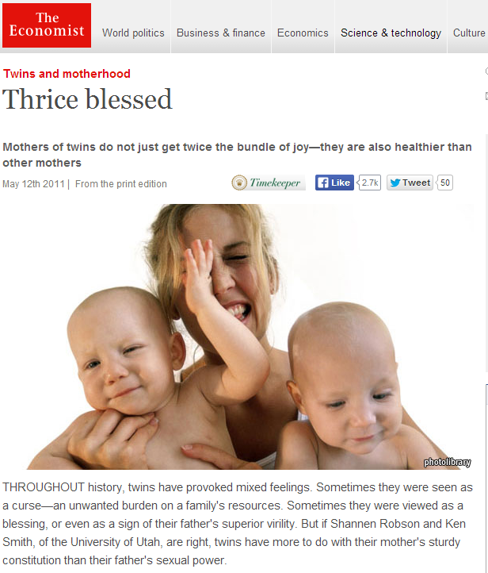
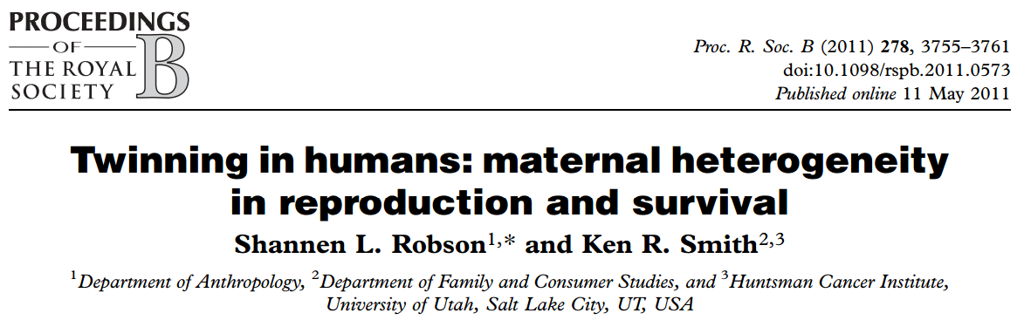


Slide 23
Family
Notes:
Next – we will consider the role of the environment – as discussed by Ming Wen (Sociology)

Slide 24
Social Contexts of Health
Ming Wen, Sociology
There have been calls to incorporate the social context into the study of health. Social context may refer to:
    cultural norms
    networks of social relationships
    family resources and socialization
    neighborhood/community environments
    policies and programs
Social contexts, or environments, place constraints on individual choice. They shape health behaviors by:
    shaping norms
    enforcing patterns of social control
    providing or not providing opportunities to engage in certain behaviors
    reducing or producing stress for which certain behaviors may be an effective coping strategy, at least in the short term.
Social environments vary across the life course.

Slide 25
Example 1: Adolescent Smoking
(Wen, Duker & Olson 2008)
Purpose: to examine multilevel factors of adolescent smoking after controlling for the baseline smoking behavior and individual characteristics.
Data: National Longitudinal Study of Adolescent Health (first two waves)
Key findings
  Peer, family and school were all important life domains contextually influencing smoking behavior among adolescents.
  Time spent with peers, best friend smoking and household member smoking were associated with higher risk.
  Parent-child closeness, parental control, attending a private school and having a higher percentage of Hispanic students were protective factors.
  None of the neighborhood and state-level factors significant in the final full model (but significant in reduced models).

Slide 26
Example 2: Adult Obesity
(Wen & Kowaleski-Jones 2012)
Purpose: to examine racial/ethnic disparities in risk of obesity based on objectively measured body mass and to explore the role of neighborhood built environment in contributing to these observed disparities.
Data: National Health and Nutrition Examination Survey (2003-2008) merged with a range of neighborhood data
Key findings
  Neighborhood socioeconomic status and ethnic heterogeneity negatively linked to risk of obesity controlling for other covariates.
  The built environment is a significant correlate of obesity risk. Neighborhood walkability (street connectivity and % walking to work), density, and distance to parks are significant covariates of obesity risks over and beyond individual risks
  Neighborhood factors were not mediators of racial-ethnic disparities in obesity.

Slide 27
Family
Notes:
Next will be the role of health care – Joe Stanford (DFPM)

Slide 28
The Role of Health Care
Joseph Stanford, Family & Preventive Medicine
Do clinicians treat individuals or families?
  Family Medicine, Pediatrics, + other primary care
How can a family perspective inform and enhance the current transformations in U.S. health care delivery?
  Accountable care organizations
  Patient-centered medical home

Slide 29
Example: Fertility Decisions
Office of Cooperative Reproductive Health, DFPM, UU
Fertility decisions and outcomes (family planning, fertility treatment) are usually studied from the woman’s perspective.
Several cohort studies enrolling women and men with separate longitudinal assessments of each over time.

Slide 30
Example: Fertility motivations
(Stanford PI, Office of Population Affairs, HHS)
Purpose: To investigate couple motivations, intentions, behaviors, and outcomes in family planning
Data: Cohort, multicenter (CEIBA study)
Key finding: Dis/concordance of couple feelings about hypothetical pregnancy in each cycle
 |  | Men
 |  | Unhappy | Neutral | Happy | TOTAL
Women | Unhappy | 5.4% | 2.7% | 5.4% | 13.4%
 | Neutral | 3.1% | 4.0% | 11.1% | 18.2
 | Happy | 4.8% | 6.5% | 57.1% | 68.3%
 | TOTAL | 13.3% | 13.1% | 73.6% | 100%

Slide 31
Example: Marital fertility
(Stanford and Smith, J Biosoc Sci 2013)
Purpose: Investigate the association between socioeconomic status, religion and marital fertility in Utah.
Data: Utah 1996 Health Status Survey
Key finding: Income positively associated with fertility among LDS; negatively associated among non-LDS.

Slide 32
Family
Methods & Data
Notes:
Considering the multiple layers of influence and dynamics – it becomes clear that a unique set of methods and models are needed to account for these complexities. Jon Butner, Psychology

Slide 33
Family relationships are complex webs of influence
Methods & Data
Jonathan Butner, Psychology
We need different metaphors for understanding families and health and methods/statistics that enable those different metaphors
  I use Dynamical Systems Theory
  Multiple outcomes measured repeatedly through time
Two Example Metaphors:
  Family Health as a Coordinated System
  Family Health as a Map

Slide 34
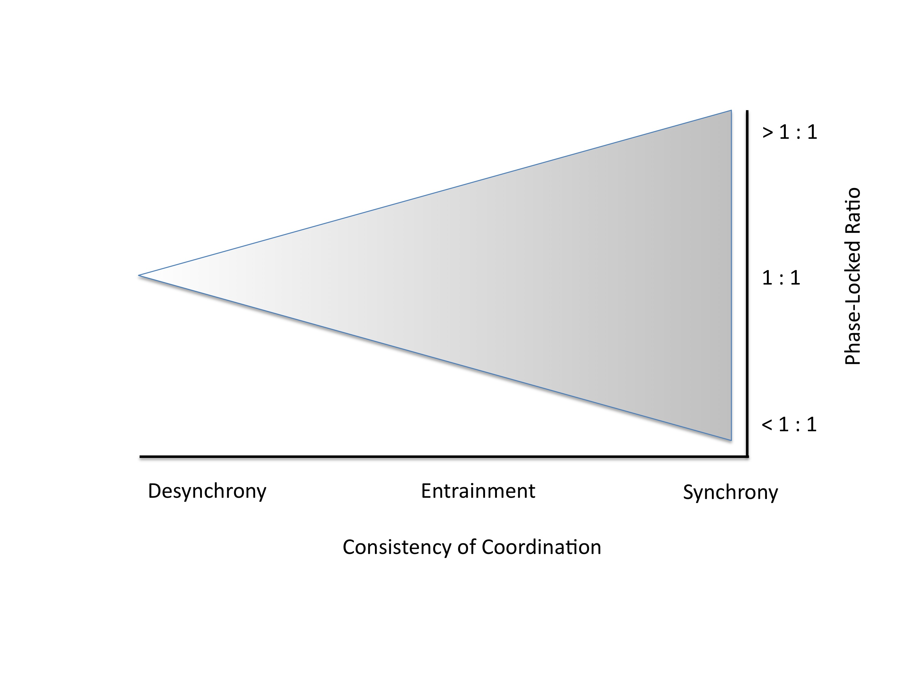
Health as Coordination
Coordination is a taxonomy of how ‘things’ move together through time
  We can build models in Structural Equation Modeling specifically designed to extract the coordination taxonomy

Slide 35
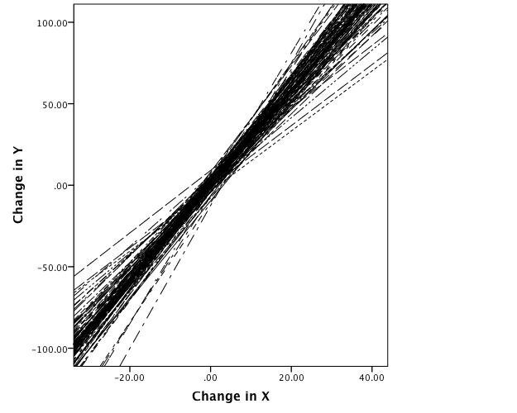
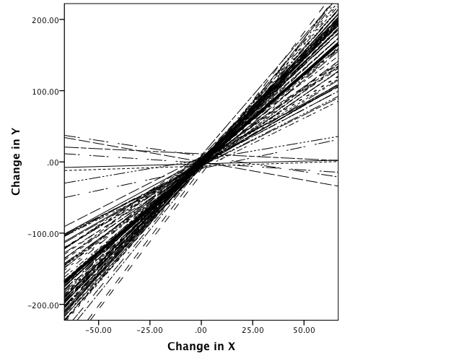
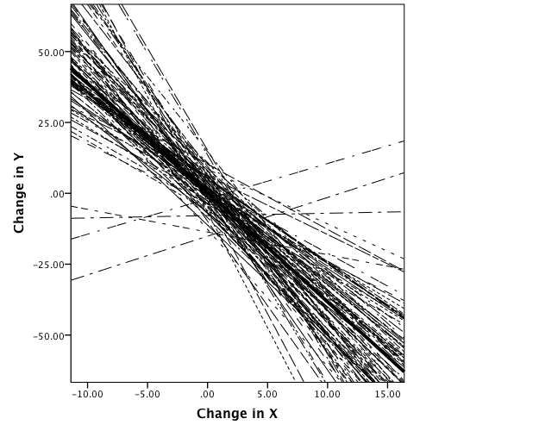
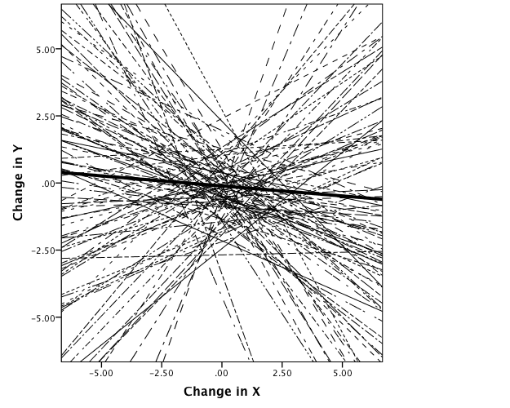
In Sync at 3:1 Ratio
Added Different Natural Tendencies for X and Y
A
B
Anti-Phase 5:1 Ratio, weaker Synchrony
No Synchrony
C
D

Slide 36
From ADAPT Study Where Mom/Dad Monitoring are Entrained and Adolescent Efficacy/Self Control are Synchronized
Predicted Average Values
Time
(Butner, Berg, Baucom, Weibe, In Press
Multivariate Behavioral Research)

Slide 37
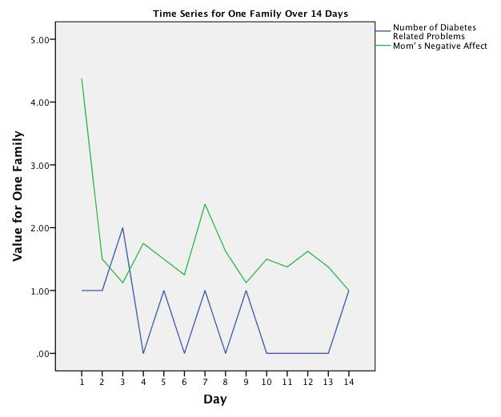
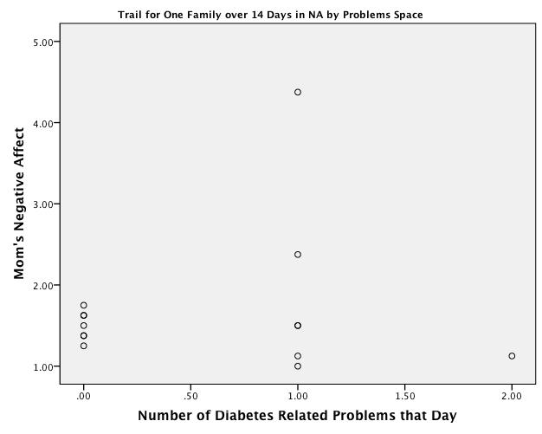
Health as a Map
Maps allow us to visualize very complex patterns of behavior. For example, a pair of Time Series translates into a trail
We can Use Math/Statistics That Directly Parallel Topographical Features in Maps
Exploratory or Confirmatory

Slide 38
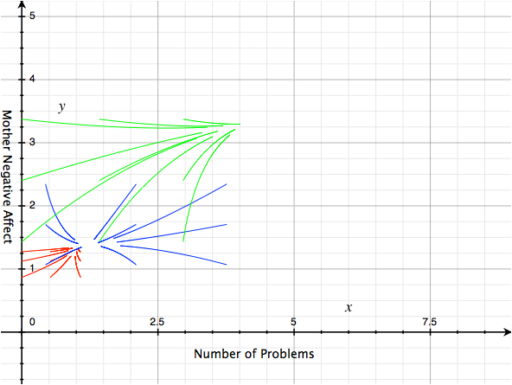
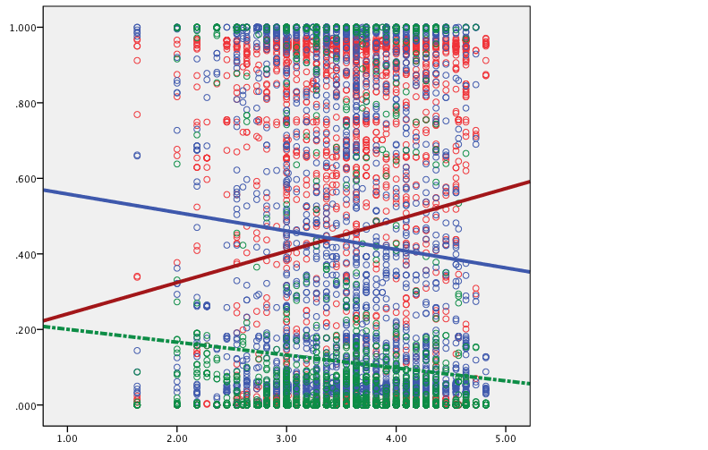
Exploratory Map Based On All Families
Estimated via Mixture Modeling
Probability of Being in Valley (Color Coded)
We can then examine what changes the Map giving a very complex understanding of the family
Adolescent Self Control

Slide 39
Intervention
Dissemination
Family
Methods & Data
Notes:
And finally, we need to consider how this theoretical model can be extended into real-world application.
Becky Utz (Sociology) will speak about intervention and dissemination efforts associated with families and health.

Slide 40
Intervention & Dissemination
Rebeccca Utz, Sociology
Does translation or dissemination of health promotion or health management programs/concepts differ when using this comprehensive family-based perspective?
Does a comprehensive family-based perspective improve the success of intervention efforts?
Yes
Yes

Slide 41

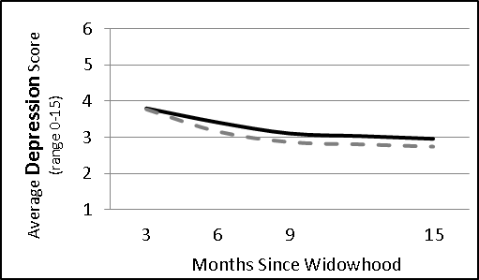
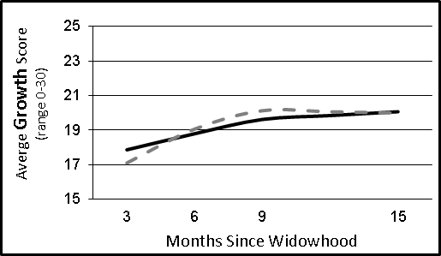
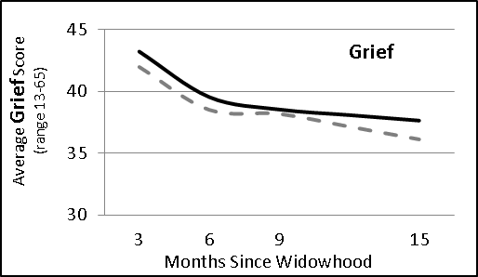
Example 1: Bereavement
(Utz, Caserta, Lund, 2013 -- R01AG023090-02 from NIA)
Purpose: To design , implement, and test a
theoretically-based, group-delivered model of
support for recently bereaved spouses.
Data: Randomized intervention design, with longitudinal survey follow-up
Key findings: Bereavement-related outcomes showed a general trend of adaptation or recovery following the loss. However, there were no differences between treatment and control groups
Need for individually delivered and/or individually tailored interventions
Family-based perspective

Slide 42
Example 2: Adolescent Obesity
(Coffield, Metos, Utz, Waitzman, 2011)
Purpose: To evaluate the effects of school wellness policies mandated by the 2004 Child Nutrition and WIC Reauthorization Act on the prevalence of overweight and obesity among adolescents.
Data: Utah Population Database, birth certificates and driver license linked to school policy data for a cohort of children born 1990 to 1992
Key findings:
  Each additional component included in a district's wellness policy was associated with as much as: 3.2% lower odds in the prevalence of adolescent overweight (OR = .968; 95% CI = .941-.997). Effect was primarily driven by nutrition related policies, not physical activity.
  When multivariate regression models controlled for individual, maternal, and familial characteristics, as well as characteristics of school district (environenet). The policy effects were dampened, but remained significant.

Slide 43
Comprehensive, Family-Based Model of Health
Intervention
Dissemination
Family
Discussion of this model’s potential and promise
Methods & Data
Notes:
DISCUSSION

Slide 44
Upcoming Events
C-FAHR Symposium
    October 6, 4pm to 8pm at the Officer’s Club
    Keynote Address by Dr. Rena Repetti, UCLA Department of Psychology. Followed by a “Research Mixer” and Cocktail Hour where we can begin to learn about other research and researchers on campus.
    October 7, morning to 130pm
    small group discussions related to the data/analytic considerations required for a comprehensive family-based perspective, and brainstorming related to forming new interdisciplinary collaborations
Submit your biosketch to become an Affiliated Member
C-FAHR-info@utah.edu

